Slide 1

Noell Niayesh, Deputy District Attorney
Kalina Laleva, Deputy District Attorney
Friday, September 30, 2016
Jury Selection
and
Voir Dire Techniques

Slide 2

Objective of this Presentation
To enhance your skills in jury selection.
To provide you with new tools for making informed decisions about who you select to be on your jury.
To enlighten you and your jurors about internal / unknown biases.
To demonstrate valuable techniques in questioning and educating your jurors.
To teach you what you should be aware of regarding Batson Wheeler motions, by giving you the case law and the Court’s recent treatment of Batson Wheeler motions brought by the defense.

Slide 3
A Science or an Art?
Jury selection is an art form.
Jury selection is an intuitive process.
Jury selection is a study in human behavior.
Jury selection varies with your evidence/witnesses.
Jury selection is not a task that can be delegated to another person.
ONE mistake in jury selection can deprive you, your victim and the community of a just verdict.

Slide 4
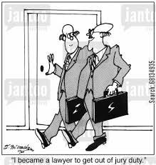
Jury Selection Does NOT begin in the Courtroom
The parking lot and the crosswalks.
Elevators and cell-phone conversations.
Outside the Courtroom (when the panel is first called).
BE A TRAINED OBSERVER
Remember, you are ALWAYS making a first impression.

Slide 5
Swear the Potential Jurors
BE OBSERVANT DURING THE OATH:
“Do you, and each of you, understand and agree that you will accurately and truthfully answer, under penalty of perjury, all questions propounded to you concerning your qualifications and competency to serve as a trial juror in the matter pending before this court; and that failure to do so may subject you to criminal prosecution?”
Potential Juror: “I do.”

Slide 6
Watch to See if the Potential Jurors Know Each Other
You want to see who is friends with whom.
What if you want to kick one of them, will the other one you want to keep be (secretly) upset?

Slide 7
Attorney Voir Dire
“Upon completion of the Court’s initial examination, counsel for each party SHALL have the right to examine, by oral and direct questioning, any or all of the prospective jurors.” (California Code of Civil Procedure Section 223)
The Court may limit the questioning by counsel.
The Court may limit the time with each juror.

Slide 8
The GOAL of Jury Selection Is …
To have the case be judged by a
JURY OF ONE’S PEERS

Slide 9
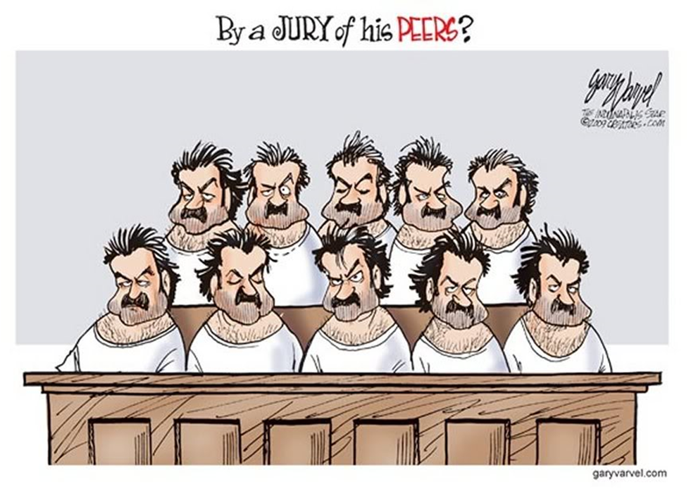
Voir Dire is ONLY to aid the exercise of challenges for CAUSE

Slide 10
Removal for Cause
CCP § 225 Challenge for Cause: one of the following:
(A) General disqualification--that the juror is disqualified from serving in the action on trial.
(B) Implied bias--as, when the existence of the facts as ascertained, in judgment of law disqualifies the juror.
(C) Actual bias--the existence of a state of mind on the part of the juror in reference to the case, or to any of the parties, which will prevent the juror from acting with entire impartiality, and without prejudice to the substantial rights of any party.

Slide 11
A juror who is Too Close to the Case = Implied Bias =
CAUSE CHALLENGE
Be sure to ask each juror whether they know ANYONE in the courtroom, including staff and other potential jurors.
Be sure to ask EACH juror whether they know any of the potential witnesses, including the Victim or Victim’s family, Defendant or Defendant’s family.
These questions go to challenge for CAUSE and must be asked regardless of whether you use a questionnaire or have attorney voir dire.

Slide 12
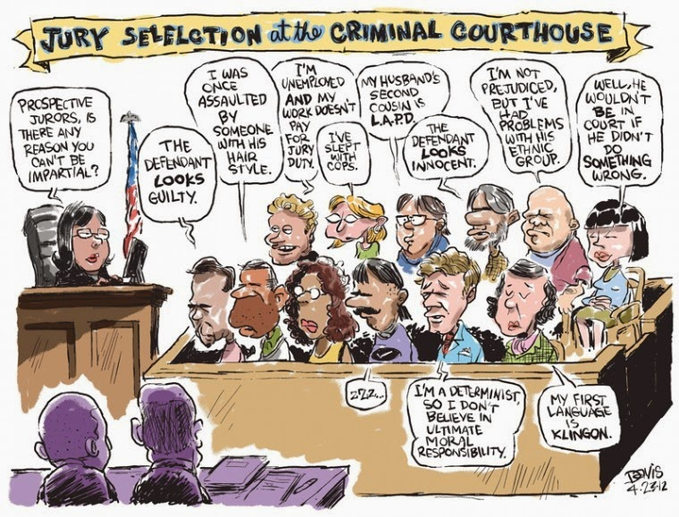

Slide 13
When Do You Exercise Your Preemptory Challenges?
Challenges for CAUSE are first, with preemptory challenges to follow.
Code Civ. Proc., § 226(d) All challenges to an individual juror, except a peremptory challenge, shall be taken, first by the defendants, and then by the people or plaintiffs. Defense goes first in cause challenges.
Code Civ. Proc., § 231(d) Peremptory challenges are exercised or passed by the sides alternately, People go first.

Slide 14
Preemptory Challenges – What reason do you need to give?
You do NOT NEED to give a reason for excusing a juror when you use a preemptory challenge:
  “The People would like to thank and excuse Juror number 6.”
    Side Note: If you make a mistake, tell the Court immediately! (It is better to be a little embarrassed then to lose one of your preemptory challenges excusing someone you really meant to keep; when you will need to use your next one to excuse the person you really meant to excuse in the first place.)

Slide 15
Preemptory Challenges – What reason do you need to give?
Although you do not need to give a reason for exercising a preemptory challenge, make SURE that you have race-gender neutral reasons for excusing the prospective juror, and that you can articulate those reasons if necessary (No Batson-Wheeler violations).
(Cannot kick based on race, ethnicity, religion, gender, race-gender, sexual orientation or disability.)

Slide 16
Proper Excuse of Jurors
Preemptory challenges are a historic right, provided “to insure that criminal trials are conducted before jurors who not only proclaim their impartiality, but whose ability to be even handed is not seriously questioned by the parties.”
Preemptory challenges excusing jurors MUST be for genuine, reasonably specific, race- or group-neutral explanation related to the particular case being tried. Hernandez v. New York (1991) 500 U.S. 352.
Reasons need not amount to challenge for cause.

Slide 17
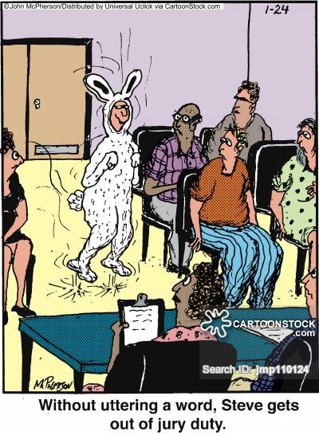

Slide 18
How Many Preemptory Challenges Do We Get?
Number of Challenges depends on Max Punishment and Number of Defendants (CCP §231)
(i.e. it depends on whether there is a single defendant or co-defendants.)

Slide 19
How Many Preemptory Challenges Do We Get?
SINGLE DEFENDANT CASES
Life/Death Cases = 20 challenges
Crime w/Max of 90 days = 6 challenges
All Others = 10 challenges (CCP §231(a))

Slide 20
How Many Preemptory Challenges Do We Get?
MULTIPLE DEFENDANT CASES
Life/Death Cases = 20 joint challenges (CCP §231(a))
  5 additional individual challenges per D
  DA gets the same as ENTIRE defense team.
Crime w/Max of 90 days = 6 joint challenges
  4 additional individual for each D
  DA gets the same as ENTIRE defense team.
All Others = 10 joint challenges (CCP §231(a))
  5 additional individual challenges
  DA gets the same as ENTIRE defense team.

Slide 21
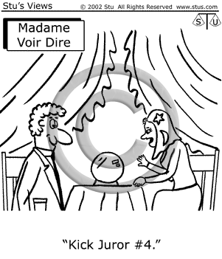

Slide 22
Safety Net – Bias Question 1
Magic question to ask EVERY JUROR:
“Have you ever been in a courtroom for any reason?”
This question uncovers the juror who:
  Attended her boyfriend’s murder trial.
  Attended his father’s molestation trial.
  Testified as a character witness for the defense.
  Was prosecuted for welfare fraud years ago. (Oh, is fraud a crime?)
  Was wrongfully arrested & arraigned for murder. (Do you think this person might have bias against the DA?)
  Was in juvenile court with their “innocent” son.

Slide 23
Safety Net – Bias Question 2
Magic question to ask EVERY JUROR:
“Please describe any contact you have had with law enforcement for any reason.”
This question uncovers the juror who:
  Was misidentified for a crime and later released.
  Was stopped and questioned at an anti-war protest.
  Had a juvenile child brought home by the police.
  Was harassed by the police.
  Who fought a traffic ticket.
  Went with her boyfriend to register as a sex offender.

Slide 24
Safety Net – Bias Question 3
Magic question to ask EVERY JUROR:
“Have you or anyone you know ever been in custody?”
This question uncovers the juror who:
  Is furious with the police because she was arrested and never charged.
  Is a woman who becomes pen pals with death row inmates.
  Arrested for participating in an anti-war protest, but not charged.
  Brother doing time because he took a plea bargain, but the brother did not do the crime.

Slide 25
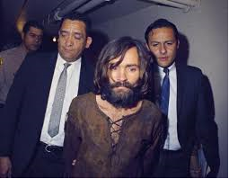
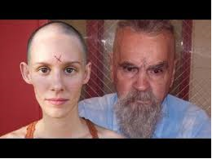

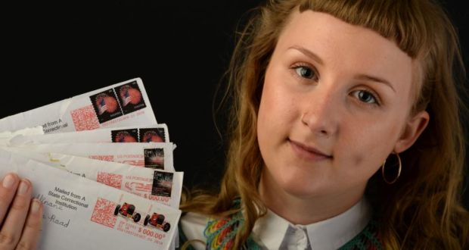
Charles Manson
The 79-year-old is due to wed 25-year-old 'Star' after the pair met in California’s Corcoran State Prison

Slide 26
Proper to Excuse Jurors for Attitudes About Law Enforcement
A preemptory challenge made on the basis of a prospective juror’s negative experience with law enforcement (or DA) is proper. (People v. Scott (2015) 61 Cal.4th 363, People v. Riccardi (2012) 54 Cal.4th 758.)
  However, if you have a potential juror who has a bad experience with police and you have a police witness, I would develop their bias against law enforcement during questioning and try to have them removed for implied bias or actual bias on a challenge for cause.

Slide 27
Topic for Voir Dire:
The Criminal Justice System
Have you, a family member or anyone you know ever been accused of, arrested for, charged with or convicted of a crime, including driving under the influence of drugs or alcohol?
Have you or anyone you know ever been investigated for a crime as a suspect?
What are your feelings about the effectiveness of our criminal justice system? (Leave space to explain.)

Slide 28
Topic for Voir Dire:
Judging the Credibility of a Witness or Evidence
Is it possible for you to return a verdict of guilty in a …
  Case with only one witness?
  Case with no fingerprints?
  Case with no medical findings?
  Case with delayed reporting?
  Case with a recanting witness?
    THESE QUESTIONS ALL GO TO ACTUAL OR IMPLIED BIAS – CAUSE! (Your Honor, s/he said he won’t follow the law. I ask that you kick him for cause.)

Slide 29
Judging the Credibility of a Witness or Evidence
(This is the beginning of educating the jury about the perceived weaknesses in your case – these go to cause.)
Is it possible for you to believe the testimony of an individual, if you think he/she is somehow involved in the crime about which he/she is testifying?
Is it possible for you return a verdict of assault with a deadly weapon, if the weapon was never recovered?
Is it possible for you to return a verdict of murder, if there is no DNA evidence presented?

Slide 30
The Jury Questionnaire
PRO’S
CON’S
Obtain more info
Obtain honest answers
Spares jurors of embarrassment in the group setting
Chance to educate the jurors about the law and the case
Jurors don’t learn “right” answers from other jurors
Jurors aren’t poisoned by other juror’s comments
Time
Money
Deprives you of “face time” with the juror
Can’t read body language or hesitation when juror is writing answers on the questionnaire

Slide 31
The “Discount” Question
You may find out that the Victim …
  Is married to the defendant …
  Delayed in reporting …
  Has a criminal record …
  Is a prostitute …
  Was drinking a lot that night …
  Has previously lied about this incident …
  Pretended that nothing happened afterward …
If I prove the charges to you beyond a reasonable doubt, will you nonetheless “discount” the crime because the Victim has issues?
  (Try to weed out potential jury nullification.)

Slide 32
The “Discount” Question
Cause questions:
  Will you automatically disregard the testimony of a witness who was intoxicated at the time of the crime?
  Will you automatically disregard the testimony of a witness who had previously lied about what happened that night?
  Will you automatically disregard the testimony of a witness who is a prostitute?
  Will you automatically disregard the testimony of a witness who did not disclose the assault right away?

Slide 33
Safety Net – Bias Question 4
Question to ask jurors in DV or sexual assault cases: (Can also be asked in any case …)
“Have you or anyone you know ever been the victim of domestic violence or sexual assault?”
    Was it ever reported to anyone?
    (May follow up in private.)
Have you or anyone you know ever been accused of DV or Sexual Assault?
    (May follow up in private.)

Slide 34
Safety Net – Bias Question 5
Question to ask jurors in DV or sexual assault cases. (Can also be asked in any case …)
“Have you ever followed any domestic violence or sexual assault cases in the news?”
    Which cases?
    What was the outcome?
    Did you agree with the outcome?

Slide 35
Safety Net – Bias Question 6
Question to ask jurors in DV or sexual assault cases. (Can also be asked in any case …)
“When you heard the charges,
did you look over at the defendant and say to yourself, hmmm, he doesn’t look like a rapist?” (or criminal?”)
    What does a rapist look like?
    Do you have some preconceived notion of what a rapist would look like?
    What if I prove my case to you beyond a reasonable doubt, would you hesitate to convict because he doesn’t look like your idea of a rapist?

Slide 36
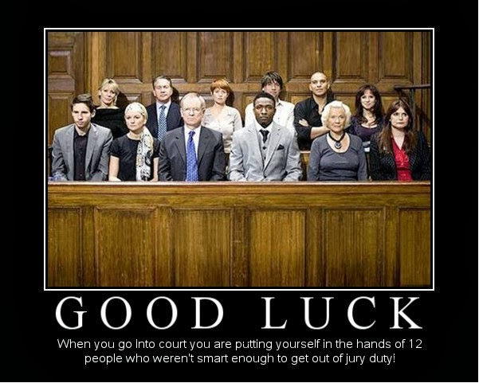
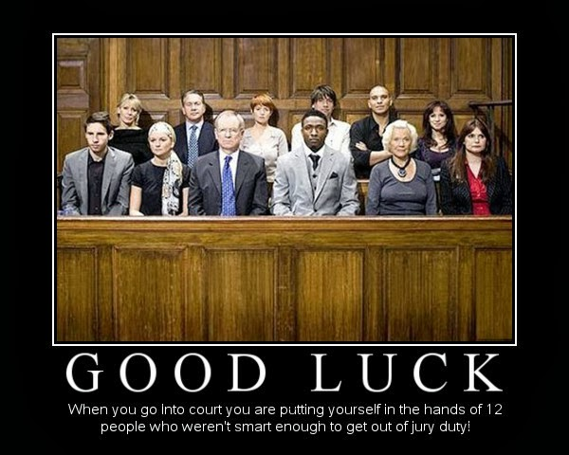

Slide 37
In General – Be Careful of Keeping the Following Kinds of People On A Jury:
(1) Criminal law justice background
(2) Legal training (law students, law clerks, etc.)
(3) Prison guards
(4) Social workers (unless on a rape or child molest case)
(5) Teachers – it depends (unless on a child molest case), Deans or Assistant Deans may be ok
(6) Nurses – not in cases where the Defendant is a nurse

Slide 38
You Investigating Officer
Consult your investigating officer, because they may catch something that you do not:
  Prospective juror with red shoe laces.
  Someone sleeping.
  Someone making faces.
  Someone nodding their head too much when the defense attorney is speaking.
  Someone that they know from their duties as a police officer. (This could be good or bad, as in keep them or kick them.)

Slide 39
We are the Voice
Victims need social acknowledgment and support
Victims need to establish power and control
Victims need an opportunity to tell their stories in their own way, in a setting of their choice
We are called to create this setting an be the vessel for their voice.
  Creating this setting starts with jury selection.

Slide 40
Go Forth And Seek Justice
(and don’t violate Batson Wheeler in the process)

Slide 41

Batson Wheeler Motions

Slide 42
The Framework
People v. Wheeler (1978) 22 Cal. 3d 258
People v. Kentucky (1986) 476 U.S. 79
Johnson v. California (2005) 545 U.S. 162

Slide 43
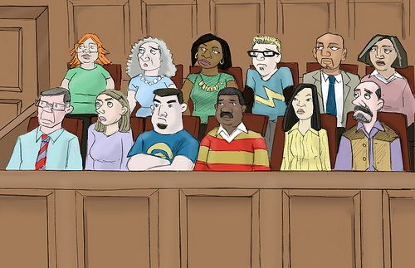
Public Policy
Allow juries to reflect diverse beliefs to avoid pressure of the majority.
Combat government oppression.
Promote perception of courts as legitimate.
Encourage citizen participation in government.
Prevent minority stigmatization.

Slide 44
People v. Wheeler
Article 1, Section 16 of the California Constitution contains a “right to trial by jury drawn from a representative cross-section of the community . . . .” (Id. at 276-77).
Using peremptory challenges to remove jurors solely on “group bias” violates that right. (Id.).

Slide 45
What is “Group Bias?”
“Group Bias”
The presumption “that certain jurors are biased merely because they are members of an identifiable group distinguished on racial, religious, ethnic, or similar ground.” (Id. at 276).

Slide 46
Batson v. Kentucky
14th Amendment’s Equal Protection Clause requires that jurors not be peremptorily challenged solely because of race (or protected classification).
Promulgated Three-Part Inquiry for the trial court to use in monitoring a Batson-type challenge.

Slide 47
Three-Part Inquiry
PRONG 1: Opponent must make prima facie case that totality of circumstances raises inference of discriminatory kick.
PRONG 2: Burden shifts to proponent to give permissible reasons.
PRONG 3: Trial court decides whether opponent has proven discriminatory purpose.

Slide 48
Prong 1: Johnson v. California (2005) 545 U.S. 162
Prong 1 of the original Wheeler test required opponent to show “strong likelihood” that jurors being excluded due to group bias.
Johnson held that standard too high.
California should be using mere “inference” language of Batson (totality of circumstances).

Slide 49
Prong 1: Tips and Strategies for Making the Prima Facie Case
Make the trial court put on the record whether they are finding prima facie case.
If the court does not expressly find prima facie case, and the prosecutor states their reasons, Prong 1 is deemed moot for appeal!

Slide 50
Prong 1: Tips and Strategies for Making the Prima Facie Case
If trial court finds no prima facie case, need to ask to put the classification-neutral reasons on the record for purposes of appeal
  If the court denies hearing the reasons, could file them in a written statement.
  People v. Scott (2015) 61 Cal 4th 363: if trial court expressly finds no prima facie case but allows the People to give reasons just in case.
    NOT MOOT 🡪 Appellate Court to consider whether the prima facie case is made.

Slide 51

Prong 2: Enunciation of Neutral Reasons
Remember and state your reasons.
  Stay calm!
Put your evidence on the record.
If you absolutely cannot remember your reasons 🡪 see Gonzalez v. Brown (9th Cir. 2009) 585 F. 3d 1202.
  Finding that while not forgetting is preferable, a trial court can still credit as neutral a reason not stated because the attorney cannot remember the reason for the kick when other factors show the attorney to be non-discriminatory:
    Remembering neutral reasons for kicking others in the class;
    Not kicking many in the class; and
    Having others in the class remain on the panel.

Slide 52
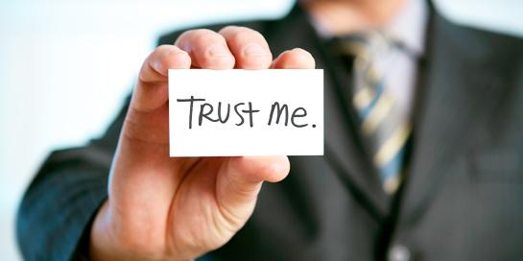
Prong 3: Weighing the scales
Prong 3 is a credibility determination.
It “demands of the trial judge a sincere and reasoned attempt to evaluate” the truthfulness of the proffered race-neutral reason. (People v. Hall (1983) 35 Cal. 3d 161, 167).

Slide 53
Who can make the motion?
Either the prosecution of the defense can bring a Batson motion. (Georgia v. McCollum (1992) 505 U.S. 42.)
It does not matter if the defendant and the challenged juror share the same classification or not. (Powers v. Ohio (1991) 499 U.S. 400.)

Slide 54
Mechanics and Timing
Best: Make motion at bench.
Hearing: Out of the jury’s presence.
Reasons: Not ex parte.
  See United States v. Thompson (9th Cir. 1987) 827 F.2d 1254.
Too late to Wheeler if jury AND alternates sworn.
But can still Wheeler as to entire panel if alternates not yet sworn.

Slide 55
What is a “Cognizable Group”?
NEW LAW CHANGE
Code of Civil Procedure Section 231.5 has for years defined in California the classification for which peremptory challenges may not be used due to a “group bias” stereotype.
A 2015 amendment changed it in three instances in 2016.

Slide 56

CCP §231.5: Pre-2016 Version
Race, Color, National Origin.
Religion (note that this is different from excluding someone who, due to religious views, cannot sit in judgment).
Sex (and per case law, sex in combination with race/ethnicity/etc.).
Sexual orientation.
Similar grounds.
Pre-2016 Non-cognizable Group Examples:
  The Young (see, e.g., People v. Estrada (1979) 93 Cal. App.3d 76, 93).
  The Old (see, e.g., People v. McCoy (1995) 40 Cal.App.4th 778, 783).

Slide 57
CCP §231.5: 2016 Version (2015 Amendment)
Took away the previous simple laundry list.
“[A] characteristic listed or defined in Section 11135 of the Government Code or similar grounds.
  GC §11135 outlaws government discrimination; promotes equal access in terms of benefits.
    No person in the State of California shall, on the basis of race, national origin, ethnic group identification, religion, age, sex, sexual orientation, color, genetic information, or disability, be unlawfully denied full and equal access to the benefits of, or be unlawfully subjected to discrimination under, any program or activity that is conducted, operated, or administered by the state or by any state agency, is funded directly by the state, or receives any financial assistance from the state.

Slide 58
Government Code §11135
Race
Color
National Origin
Ethnic Group Identification
Religion
Sexual Orientation
Age
Mental Disability
Physical Disability
Genetic Information
  Per Civil Code Section 51(e)(2): Genetic test information of the person or their family, a disease or disorder manifesting within the person/family or genetic services information.

Slide 59
Mental or Physical Disability
CCP §231.5 prohibits using peremptory challenge on the basis of an assumption that the juror is biased merely because of these characteristics.
If excluding because disability will prevent effective services:
  Blind and cannot see important details in crime photos 🡪 might be OK.
  See e.g., U.S. v. Harris (7th Cir. 1999) 197 F.3d 870 – rational basis test applied, kick of MS patient OK because medications cause drowsiness.

Slide 60
Still-valid Case Law Examples of Non-Cognizable Groups
People newly residing in the community.
  Adams v. Superior Court (1974) 12 Cal. 3d 55, 60.
People of color as a combined group.
  People v. Davis (2009) 46 Cal. 4th 539; People v. Newman (2009) 176 Cal. App. 4th 571.
Less-educated people (only 12th grade or less) and blue collar workers.
  People v. Estrada (1979) 93 Cal.App.3d 76.

Slide 61

What are similar grounds?
Hard to find a case law definition that is cited regularly.
  People v. Garcia (2000) 77 Cal. App. 4th 1269, 1275-76: drawing upon a California Supreme Court’s plurality opinion’s definition in the absence of something with more authority.

Slide 62
Similar Ground: Federal
Pre-Batson definition in grand jury context:
  Whether the group is one that is a recognizable, distinct class, singled out for different treatment under the laws, as written or applied.
    Castaneda v. Partida (1977) 430 U.S. 482, 494.
    People v. Garcia (2000) 77 Cal. App. 4th 1269, 1273: noting that this is likely the U.S. Supreme Court’s standard because they cited this case in Batson

Slide 63
Similar Grounds: State
CCP §231.5 was meant to codify the Garcia decision.
Garcia recites plurality language in Rubio v. Superior Court (1979) 24 Cal. 3d 93, suggesting the following as first prong of a two-prong definition:
  Groups whose members share a common perspective arising from their life experience in the group, i.e., a perspective gained precisely cause they are members of that group.
Garcia also used the second prong in its analysis:
  2. That no other members of the community are capable of adequately representing the perspective of the group in questions
    (Id. at 1278 (quoting Rubio).
  Garcia notes the Rubio court gave a two-prong test but only the first part seemed to have the majority support.

Slide 64
Religion: People v. Jones (2011) 51 Cal. 4th 346
Where the People excused a black juror partly because she attended the First A.M.E. Church which the Prosecutor called controversial organization and said he did not want anyone controversial.
California Supreme Court said the Prosecutor did not excuse her because of her religious views but because he believed she belonged to a controversial organization. Id. at 368.

Slide 65
Bilinguals #1: Hernandez v. New York (1991) 500 U.S. 300
PLURALITY OPINION
Four-justice opinion stated that the trial court did not commit clear error in believing the prosecutor’s claim that he excused a Spanish-speaking juror because they gave him reason to think they would reject the interpreter’s version in favor of their own and not because he wanted Latinos off his jury.
But: “[A] policy of striking all who speak a given language, without regard to the particular circumstances of the trial or the individual responses to the jurors, may be found by a trial judge to be a pretext for racial discrimination. But that case is not before us.” Id. at 371-72.

Slide 66
Bilinguals #2: People v. Cardenas (2007) 155 Cal. App. 4th 1468
Recognizing the U.S. Supreme Court’s plurality in Hernandez.
Upheld the trial court’s decision that the prosecutor has put forth a valid, race neutral reason for excluding Spanish-speaking jurors on ground the prosecutor though they would reject the official translation, and not as a pretext for racial kick.

Slide 67
Bilinguals #3: People v. Gonzalez (2008) 165 Cal. App. 4th 620
BUT SEE People v. Gonzales, where the prosecutor stated several reasons for excluding a juror, including the fear that the juror would reject the official interpreter’s version.
The record did not support the fear and also did not support the other stated reasons, so appellate court found the trial court erred in accepting the prosecutor’s reasons.

Slide 68
Miller-El v. Dretke (2005) 545 U.S. 231
The majority used the following methods to find the stated race-neutral reasons to be pre-textual:
Statistics:
  Prosecutor excluded 91% of the black potential jurors but only 12% of non-black of potential jurors.
Disparate Questioning:
  The prosecutor pressed black jurors harder in questioning.
  Also asked trick questions of them more often.
Evidence of past prosecutor’s office policy:
  Testimony of former prosecutors of office climate of race-based voir dire.
  Prosecutor’s office written manual discussing types of people not to serve.
Comparative analysis:
  Court compared prosecutor’s stated reasons for excluding potential jurors.
  If same quality applied to non-black potential jurors whom the prosecutor did not exclude 🡪 evidence of discrimination
Cumulative weight of all the above:
  Court put all the puzzle pieces together and did not like the result.

Slide 69
Williams v. Runnels (9th Cir. 2006) 432 F.3d 1102: Make the record!
Make your record.
Trial Court found no prima facie case.
Prosecutor tried to put reasons on record just in case for appeal.
Trial court denies the request.
9th Circuit said it was the prosecutor’s responsibility to make the record because prima facie case was shown.
During the appeal, the prosecutor no longer remembered his reasons.

Slide 70
Snyder v. Louisiana (2008) 552 U.S. 472: Ask Follow-up Questions
Court suggests that the prosecutor should have followed up with more questions when black potential juror’s hardship request was denied after school service said it was OK.
The prosecutor said he excluded the juror because he thought the juror would still worry but did not follow up with questions so the court did not believe the prosecutor.
Further, others whose hardships were denied were not excluded by the prosecutor 🡪 they were all white!

Slide 71
People v. Lenix (2008) 44 Cal. 4th 602: Make your record!
California Supreme Court recognized the comparative analysis required for first time on appeal.
  As long as the record contained enough information
The court preferred that we make our own record and do our own comparative analysis at trial.
So that the “defendant can make an inclusive record, [and] the prosecutor can respond to the alleged similarities.” Id. at 624.

Slide 72
People v. Lenix (2008) 44 Cal. 4th 602: Do NOT Cut Off Voir Dire Time
Lenix recognized the trial court’s CCP §223 power to limit voir dire time but said:
  “If the trial court truncates the time available or otherwise overly limits voir dire, unfair conclusions might be drawn based on the advocate’s perceived failure to follow up or ask questions.” Id. at 625.

Slide 73
Notations on Juror Cards
Lenix: Dicta re: Miller-El’s disapproval of race notions on juror cards:
  We empathize, however, that post-Batson, recording the race of each juror is an important tool to be used by the court and counsel in the mounting, refuting or analyzing a Batson challenge. Id. at 617 n.12.
BUT SEE: Green v. Lamarque (9th Cir. 2008) 532 F.3d 1028, 1033:
  Finding a Batson violation because the prosecutor had noted the race of each venire member he struck from the jury pool; when the trial judge asked him who he struck and why, the prosecutor was able to read off a list,” then cite Miller-El’s note of that.

Slide 74
Foster v. Chatman (5/23/2016) 136 S.Ct. 1737
NEW CASE ALERT
1986 facts and 1987 trial.
Defendant is a black male in Georgia – confessed to beating, raping, strangling and killing a 79-year old widow 🡪 convicted and death penalty imposed.
29 years later, U.S. Supreme Court remanded to Georgia Supreme Court their decision not let defendant to continue to appeal his Batson claim.
Trial occurred just months after Batson was decided – Batson objection denied after four black jurors were removed by the prosecutor.

Slide 75
Foster v. Chatman: New Evidence on Jury Cards
During appeals process, the defendant filed Georgia Open Records Act Request for the prosecutor’s file.
Notations were found suggesting the jurors were excluded because they were black and not because of the race-neutral reasons given.
EXTENSION OF MILLER-EL:
  Comparative analysis of similarly situated jurors kept
  Some of prosecutor’s stated reasons not believable
  New evidence of notes indicating race consciousness (B by black jurors names, No Black Church, etc.)

Slide 76
Currie v. McDowell (06/08/2016) 13-16187
NEW CASE ALERT
Defendant is Black, the victim was Hispanic.
Defendant shot, killed and robbed a drug dealer.
Convicted of second degree murder and other crimes. Convictions upheld on appeal but 9th Circuit granted habeas relief on Batson grounds 🡪 the prosecutor improperly excused prospective Black jurors from the venire and remanded for a retrial.
Same prosecutor handled the retrial and defendant was again convicted.
Convictions were again upheld on appeal. 9th Circuit granted habeas relief for excusing the juror in question – that she had close family members prosecuted for drug offenses, she provided inconsistent answers on her juror questionnaire and she state she was unaware what the defendant was accused of even though the court had read the charges.

Slide 77

Currie v. McDowell (06/08/2016) 13-16187
NEW CASE ALERT
Court found these to be not valid race-neutral reasons.
Cited Foster v. Chatman: [t]he “Constitution forbids striking even a single prospective juror for a discriminatory purpose.”
  Trial court found no prima facie case.
  Prosecutor stated reasons for the record.
Prosecutor identified by name: “This is the latest case arising out of a jury selected by David Brown, a prosecutor with a history of unconstitutional race-based peremptory strikes.”
Brown’s history of Batson violations and pretextual reasons in this case lead us to conclude that “race was a substantial motivating factor” for his strike of Jones.
ONCE A RACIST, ALWAYS A RACIST?

Slide 78
Comparative Analysis Shield: Rice v. Collins (2006) 546 U.S. 333
U.S. Supreme Court unanimously overturned the 9th Circuit for going too far in second-guessing the trial court’s Prong 3 credibility determination.
  The Supreme Court used Comparative Analysis as a shield rather than a sword.
  Notated that the prosecutor excluded similarly situated white potential jurors (challenge on appeal was the exclusion of black potential jurors).

Slide 79

Comparative Analysis: TIPS AND STRATEGIES
Keep a list of the attributes leading you to exclude.
If you saved a juror with that attribute 🡪 have a list of why you kept them.
Do not wait for the defense 🡪 make your own comparative analysis argument or the Appellate Court could draw judgment on an artificially short record.
SHIELD RATHER THAN A SWORD: point out when you kicked others with the same attribute.
Ask follow-up questions or point out that the trial court kept strict timetable and you did not have time.
Bring a calculator to do statistics.

Slide 80
Demeanor Strikes and Appellate Record
What happens when you exclude a juror because of demeanor but this is not reflected in the record?
  People v. Silva (2001) 25 Cal. 4th 345: reversed death penalty because the prosecutor’s non-demeanor reasons were rejected by the record and the demeanor reasons not supported by it.
  Snyder v. Louisiana: reversed when the prosecutor stated two reasons – one was rejected by the comparative analysis and the other one was demeanor not supported by the record. It was not clear which on the trial court relied on.
  People v. Allen (2004) 115 Cal.App. 4th 903: reversed because the prosecutor gave as a reason “her very response to your answers, her demeanor and how she took her seat” as an indication of an independent thinker 🡪 Appellate Court had no idea what the Prosecutor was talking about.

Slide 81
A RAY OF HOPE!
People v. Reynoso (2003) 31 Cal. 4th 903: Accepted the trial court’s non-detailed credibility ruling when the prosecutor’s demeanor reason not in the record but the prosecutor’s other reasons not rejected by it.
  NOTE: Could be a helpful decision but the better record is to make a demeanor and have the trial court give a detailed ruling.
Thaler v. Haynes (2010) 559 U.S. 43: The Supreme Court upheld the trial court’s credibility ruling of the prosecutor’s race-neutral demeanor reasons even when the trial court was not the judge who was present for voir dire, and could not have seen the demeanor.
  “[T]he best evidence of the intent of the attorney exercising a strike is often that attorney’s demeanor.” Id. at 49. While the trial judge’s first hand observations are of great importance, Batson does not hold that a demeanor-based explanation mist be rejected if the judge did not observe or cannot recall the juror’s demeanor. Id. at 48-49.
  BUT NOTE: No evidence in the record that would have undermined the prosecutor’s reasons.

Slide 82
Demeanor-Based TIPS AND STRATEGIES
Weave your observations into your voir dire record:
  I realized you were smiling at the defendant. I am curious as to why?
  You seem a little upset with me. Have we met before.
  So I noticed you were looking around during questioning. Is there something else on your mind besides this trial.
During Prong 2, ask the trial court whether the judge saw the same thing:
  Did the Court also that the juror kept coming in late after the brake?
  Does the Court agree with my observation that the juror rolled his eyes when the bailiff asked him to take his hat off?
The Appellate Court will not consider a reason if not on the record (and the trial court will not either).
  State your reasons. Make the trial court specify its rulings – which reasons accepting, which reasons rejecting.
Consider turning around and watching the panel from the minute they walk in until the first 12 are seated in the box.
Keep all your jury notes – for retained and kicked jurors. Paulino v. Harrison (9th Cir. 2008) 542 F.3d 692.

Slide 83
REMEDIES
Wheeler: DISMISS entire panel and start over.
  Because opponent is entitled to a random draw from an entire venire – not one partially or totally stripped of members of a cognizable group. Id. at 282.
Batson: U.S. Supreme Court remanded to allow the trial court to engage in the Three-Prong inquiry.
EXPLICITLY LEFT OPEN POSSIBLE REMEDIES OF:
  Discharge the entire panel and start over.
  Re-seating the offended juror.
What if the opponent does not want the panel dismissed? Holds the cards.
People v. Willis (2002) 27 Cal. 4th 811: Defense attorney purposefully violated Wheeler because did not like mostly white panel.
  Rather than reward the attorney with a new panel, the judge fined the attorney $1500 as alternate remedy. Later vacated the order.
  California Supreme Court affirmed the sanction. Approved the seating of the offended juror and giving extra peremptories instead of re-seating if juror gone. THE CATCH: Opponent had to agree.

Slide 84
STATE BAR REPORTING
AT TRIAL
  BP §6086.7(a)(3): Trial Court must report if monetary sanction for $1000 or more.
  BP §6068(o)(3): You must report self within 30 days if trial court monetarily sanctioned you $1000 or more.
ON APPEAL
  BP §6086.7(a)(2): Trial Court must report If judgment reversed in whole or in part because of attorney’s misconduct.
  BP §6068(o)(7): You must report self within 30 days if judgment reversed in whole or in part because of attorney’s misconduct.

Slide 85


