Slide 1
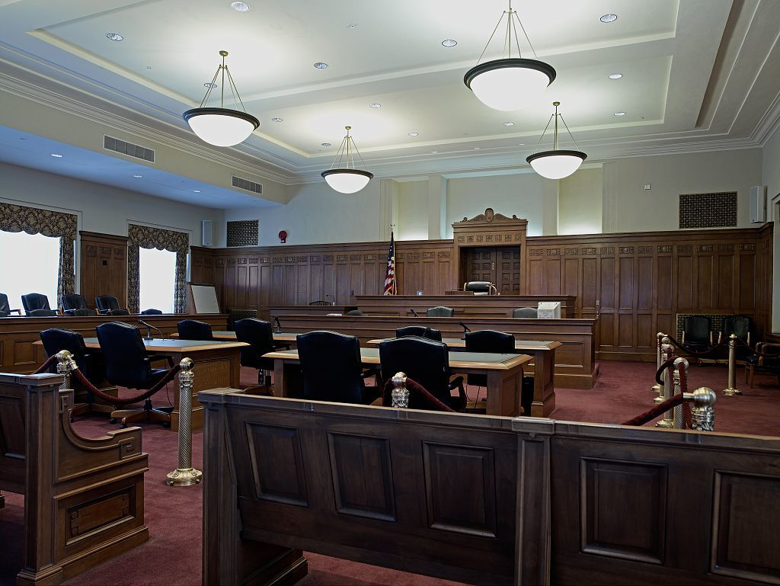
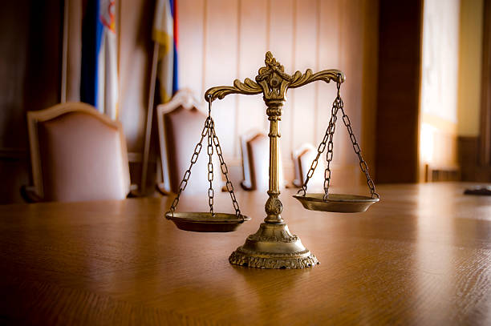
Basics of Criminal Procedure
For Prosecutors
Chuck Hughes
October 8, 2019

Slide 2
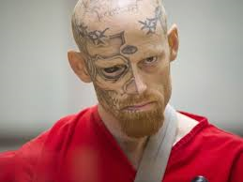
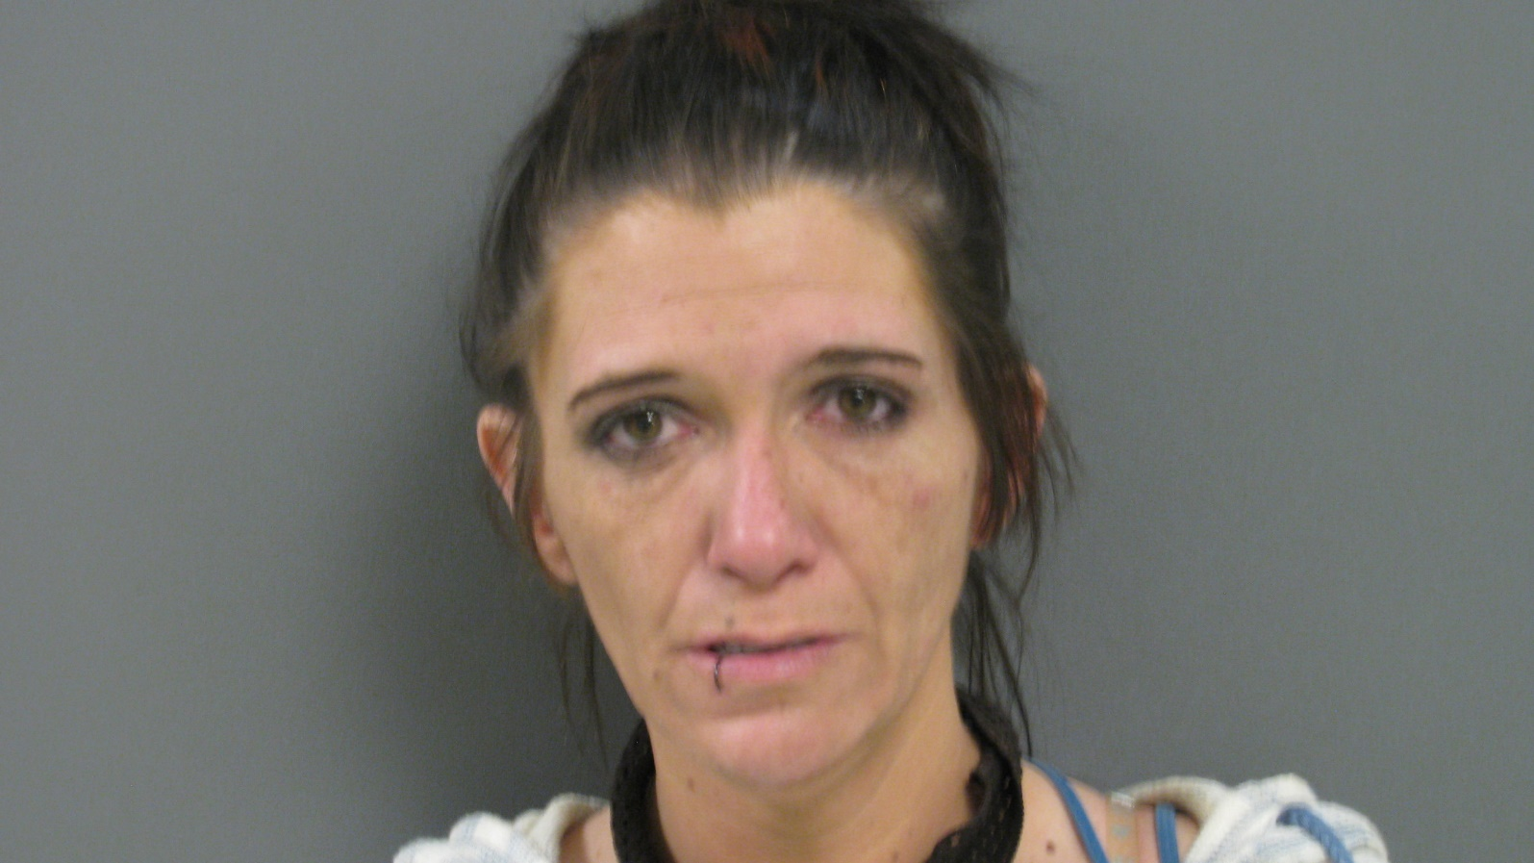
John Badtemper
Lorie Methuser

Slide 3
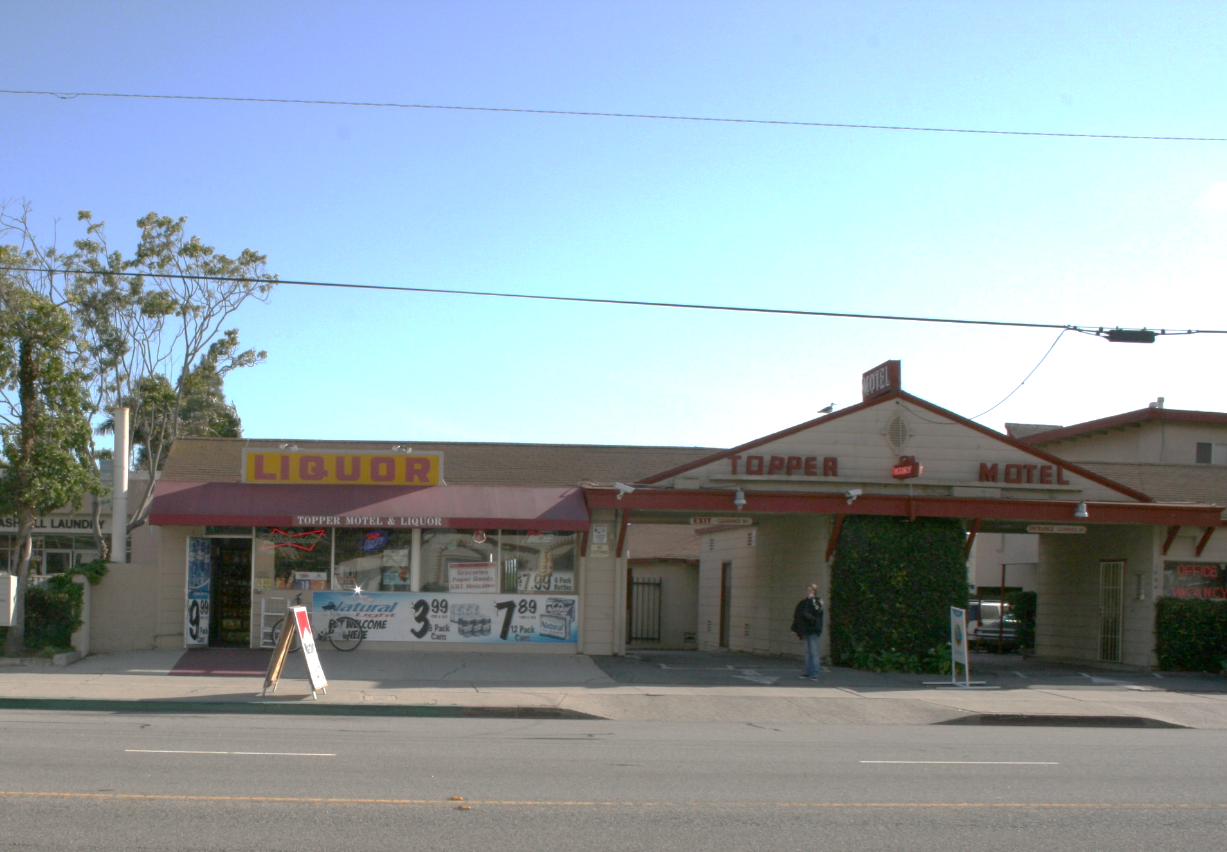

Slide 4
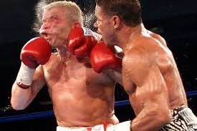

Slide 5
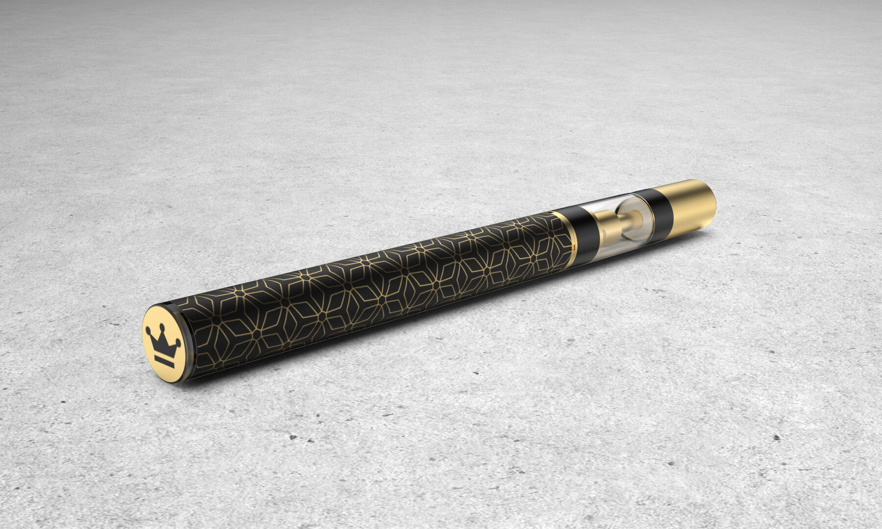

Slide 6
Felony Complaint
Robbery – PC 211
Badtemper & Methuser

Slide 7
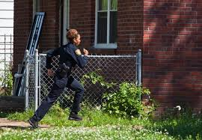
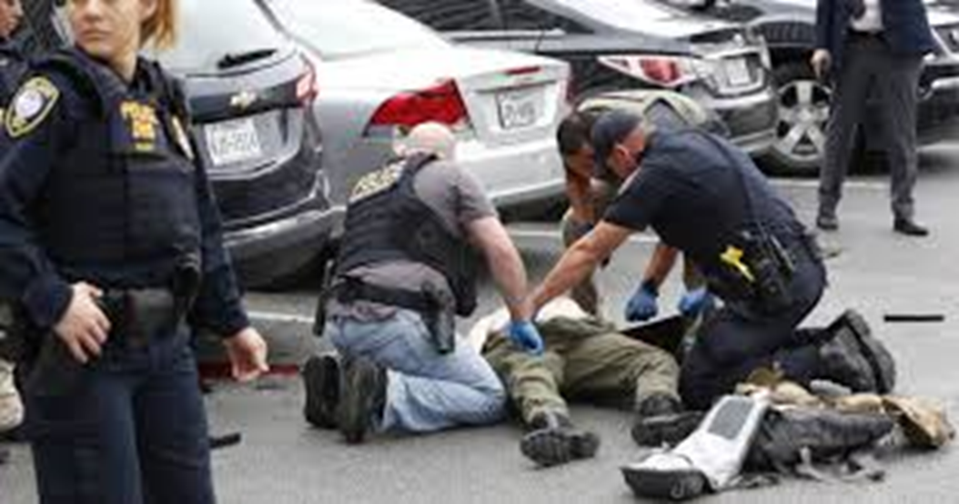

Slide 8
Misdemeanor Complaint
Resisting Arrest – PC 148
Badtemper Only

Slide 9
Misdemeanor 148

Slide 10
Misdemeanor Case Flow
Complaint
Jury Trial
Arraignment
Pre-trial Conference

Slide 11
Robbery

Slide 12

Felony Case Flow
Complaint
Preliminary Hearing
Arraignment
Early Dispo Conference
Prelim Memo
Info Review
Arraignment
Pre-trial Conference
Jury Trial

Slide 13


Felony or Misdemeanor
Up to one year = misdemeanor
More than one year = felony

Slide 14
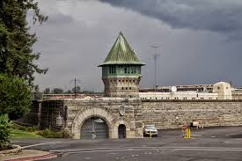
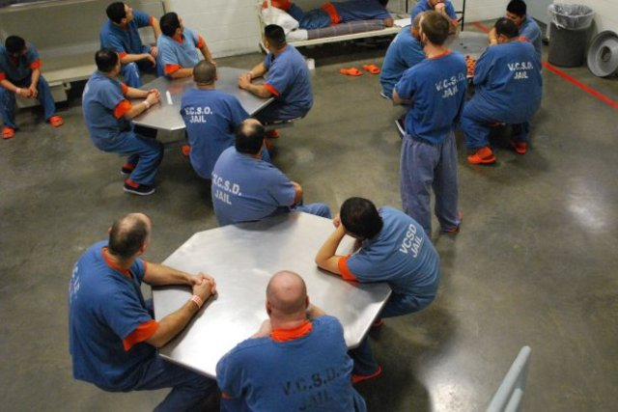
Felony Punishment
Straight Felony
Prison eligible
County jail (Local prison)
1170(h)(2)
Split sentence

Slide 15
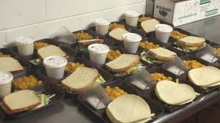
Felony Punishment
Wobbler – Misd or Felony
DA filing discretion
Judicial discretion - PC 17(b)
Wobblerette – Misd or Infraction

Slide 16
Probation
Alternative to custody-only sentencing
Deft must agree to supervision & terms
Custody
Violate no law
Search / test
Restitution
Others

Slide 17
Misdemeanor Case Flow
Complaint
Jury Trial
Arraignment
Pre-trial Conference
Timeliness – 48 hr rule (PC 825)
Bail
Right to Counsel
Deft presence in court (PC 977)

Slide 18

Discovery
PC 1054 et seq
Names/addresses – intended wits
Stmts of all Defts
All relevant real evidence
Fel convictions of any material wits
Exculpatory evidence
Written/recorded stmts, rpts, experts

Slide 19
Brady Evidence

Slide 20
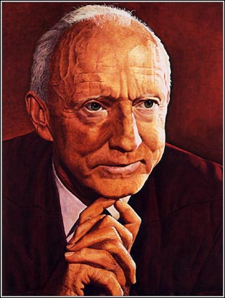
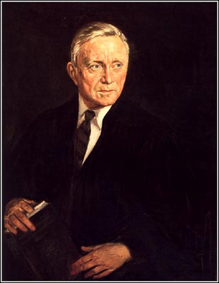
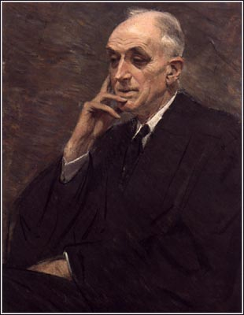
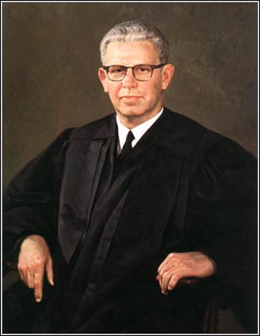
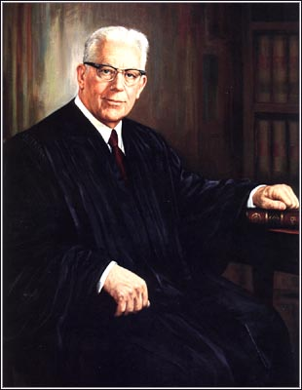
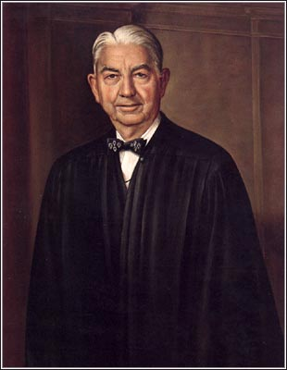
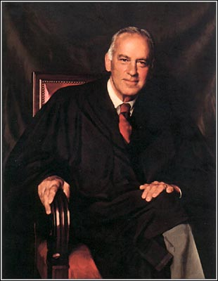
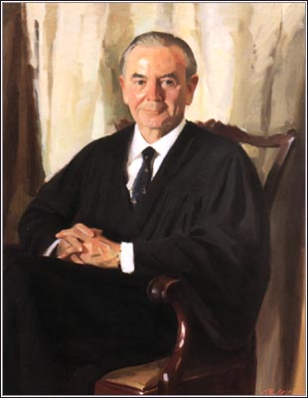
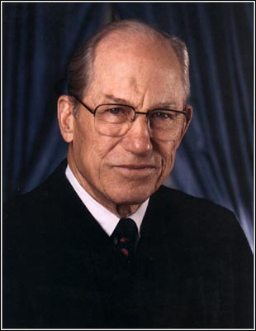
Brady v. Maryland
(1963) 373 U.S. 83

Slide 21
BRADY v. MARYLAND
Prosecutor must disclose material evidence that is favorable to the accused as to either guilt or punishment

Slide 22
Discovery is …
Constitutionally required
State law mandated
Office policy
The right thing to do!
Failure consequences:
Sanctions, Reversal, State Bar, Reputation, Felony

Slide 23
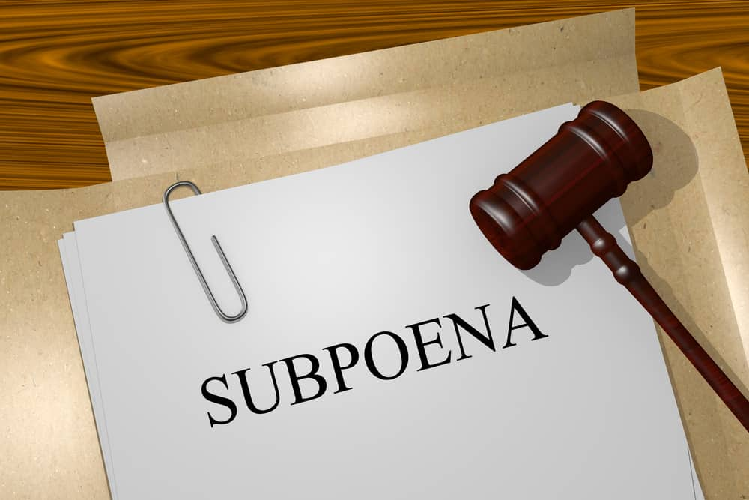
Getting Wits to Court
Appearance Subs (PC 1326, 1328, 1330, 1334)
Mail, personal service, email
Cops – 5 working days
150+ miles
Out of state
FTAs

Slide 24

Getting 3rd Party Evid to Court
SDTs - (PC 1326, EC 1560)
Mail
Records go to court
Court review / practice
Foundation / Busin. Records
Defense SDTs

Slide 25
Felony Case Flow
Complaint
Preliminary Hearing
Arraignment
Early Dispo Conference
Prelim Memo
Info Review
Arraignment
Pre-trial Conference
Jury Trial

Slide 26
Speedy Trial / Prelim Rights
Statute of Limitations (PC 799-805.5)
Misds typically 1 year
Most fels & wobblers 3 years
Prelim - 10 court, 60 calendar days (PC 859b)
Trial - Misd 30 or 45 days (PC 1382)
- Fel 60 days after Info arraignment (PC 1382)

Slide 27
Preliminary Hearings
Probable cause std
Hearsay admissible through qualified officer
Not for defense discovery (PC 866(b))
Continuous prelim rule

Slide 28
Competence to Stand Trial – PC 1368
Defense atty declares a doubt
Court appoints psych to evaluate
Jury trial on competence

Slide 29
Pleas, Diversion, Etc.
Guilty, no contest, not guilty, NGI, jeopardy – PC 1016
Waiver of Rights
Diversion statutory schemes – PC 1000+
Court vs. Jury trial – waiver must be by Deft personally
Pre-plea probation reports

Slide 30
Random Stuff
Miranda violations – can be used for impeachment, unless…
Griffin error – don’t comment on Deft failure to testify
Doyle error – don’t comment on Deft failure to talk to cops
Corpus delicti rule – Stmts of Deft alone not enough for guilt
- ID is not included
- DUI example
Polygraph is inadmissible

Slide 31



Getting to Trial
Ready, your honor!

Slide 32
Dismissal, discharge, mistrial
Dismissal – PC 1385, 1387, 1387.1
One dismissal for misds
Two for felonies
Three for violent fels, if excusable neglect
Discharge – if no charges have filed
Don’t request a mistrial – let the defense or ct

Slide 33
Jury Instructions - CalCrim
We prepare our requested instructions
Be exceptionally diligent
Pay attention when court is reading them

Slide 34
Pre-judgment Motions
1118.1 Motion (Close of People’s case)
New Trial Motion (Post-verdict)
Jury Misconduct (Any time)

Slide 35
Writs & Appeals
Misdemeanors – our office handles
Felonies – AG typically handles
People’s appeals – PC 1238, 1477
Preserve the record
Object on the record
Raise relevant grounds on the record, including facts

Slide 36

Have fun!!!!

