Slide 1
Cross Examination
May 2020

Slide 2
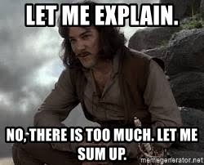

Slide 3
Topic
Cross Examination…
…of a defendant..
…without a prior statement.

Slide 4
Why?
The Stakes
Think: Audience

Slide 5
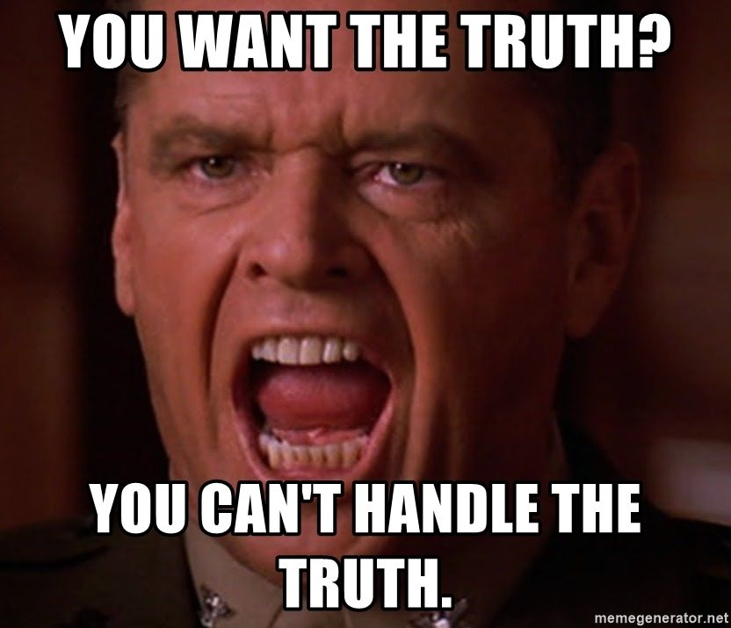

Slide 6
Why?
The Stakes
Think: Audience
Expectation Deficit
You win or you lose

Slide 7
Why?
The Stakes
Think: Audience
Expectation Deficit
You win or you lose
One juror is enough

Slide 8
Goals
Give you a strategy
Give you techniques

Slide 9
Cross Examination of Defendant
Planning
Preparation
Execution
…or “PPE”

Slide 10
Planning: Step 1
CASE ASSESSMENT
Always Be Closing
Outline
…What matters?

Slide 11
Planning: Step 2
Jury (De-)Selection*
Is this a cross examination case?
ID: Juror expectations?
ID: Harmful juror attitudes?
ID: Contradictory stories?

Slide 12
Planning: Step 3
Drafting MILs
Impeachment
Time

Slide 13
Planning: MILs Impeachment
Impeachment
[Prior Statement]
Prior felony MT convictions?
Prior MT conduct?
Think: Audience
…Why does this matter?

Slide 14
Planning: Step 3
Drafting MILs
Impeachment
Rebuttal?
Time

Slide 15
Planning: MILs Time
Time
Penal Code § 1051:
Continuance after testimony of defense witness
“Upon a trial for any offense, if a defense witness testifies, there shall be good cause for a reasonable continuance unless the court finds that the prosecutor was or should, with due diligence, have been aware of such evidence. If the continuance is granted because of the defendant’s testimony, it shall not exceed one day.”

Slide 16
Planning: Summary
Closing
Jury Selection
MILs

Slide 17
Preparation
Set Objectives
Think: Concessions
Arguedas Method
Outline v. Questions
Beware Doyle Error

Slide 18
Preparation: Set Objectives
What do I need from this cross examination?
How might Defendant’s testimony impact the central issue(s) in the case?
Don’t re-tell Defendant’s story

Slide 19
Preparation: Concessions
We benefit from narrowing the issues in a case
What can we get Defendant to agree is true?

Slide 20
Preparation: Concessions
Example: Self-Defense case
Background
Presence at scene
Actual conduct
Consequences of conduct
Other elements (CalCrim language)

Slide 21
Preparation: Arguedas Method
Avoid “one question too many”
Cristina C. Arguedas
OJ Simpson: the cross that never was
Method
Argument
Individual, undeniable facts

Slide 22
“Argument”
Fact 1
Fact 2
Fact 3
Fact 4
Fact 5
Fact 5a
Fact 5b
Fact 5c

Slide 23
Preparation: Outline v. Questions
Organize Arguedas method argument pages into an outline
Primacy, Recency, Repetition
Write out questions, as necessary

Slide 24
Preparation: Cross Questions
Important if…
MIL ruling impacts topic
Tricky or complicated concept
You’ll be more confident
…but, think FACTS not questions

Slide 25
Preparation: Cross Questions
Leading
One fact per question
7 words or fewer
One word answer
“Yes” better than “No”
Don’t ask for impressions/judgments

Slide 26
Beware Doyle Error
Doyle v. Ohio (1976) 426 U.S. 610
Can’t use post-Miranda silence against D
“You never told the police that…”
“We’re hearing this for the first time today…”

Slide 27
Preparation: Summary
Set Objectives
Think: Concessions
Arguedas Method
Outline v. Questions
Beware Doyle Error

Slide 28
Execution
Take notes
Be the star of the show
Get your answers
Escalating Control
Impeachments
You can’t lose

Slide 29
Execution: Take Notes
During Defendant’s testimony…
Details
Quotes
Adapt your outline
“Quotation” response/issue

Slide 30
Execution: Be The Star
Courtroom positioning
Body language
Voice/Tone
Build a rhythm
Avoid verbal “tics”
Give yourself room to escalate

Slide 31
Execution: Get Your Answers
Use “Cross Question” principles
ONE fact per question
Listen
The Ideal
“Yes” or “No”
Stay in control
…But how?

Slide 32
Execution: Escalating Control
You have to earn it.
For anything but your answer…
Repeat question, more stern
“Is that a yes?” / “Is that a no?”
Strip qualifications, re-ask
[Beg the judge for help Object]

Slide 33
Execution: Impeachments
Types:
By Prior Inconsistent Statement
By Omission
By Common Sense

Slide 34
Execution: Impeachments
Basics: The Three C’s
Confirm
Credit
Confront

Slide 35
Execution: Impeachments
Types:
By Prior Inconsistent Statement
By Omission (Probably)
By Common Sense
“What would have to be true for Defendant’s story to make sense…?”
Same Arguedas Method

Slide 36
Execution: Impeachments
By Common Sense (Logos)…
Still “Three C’s”
Confront is tricky
Think: “What would have to be true?”

Slide 37
Execution: You Can’t Lose
You get the last word!
Use evasiveness/demeanor during cross in argument
Compare/contrast with direct
Simpler questions = more effective

Slide 38
Execution: Summary
Take notes
Be the star of the show
Get your answers
Escalating Control
Impeachments
You can’t lose

Slide 39
Summary
Planning
Preparation
Execution
…Questions?

