Slide 1

Sentencing
Sean Riordan

Slide 2

PART I

Slide 3
When Should You Start Thinking About Sentencing?
Post jury verdict?
Pre-Trial Conference?
Preliminary Hearing?
Filing Charges!

Slide 4
Penal Code section 654

Slide 5
Defendant has been found guilty, now what??
Preliminary Question - PC 654
“An act or omission that is punishable in different ways by different provisions of law shall be punished under the provision that provides for the longest potential term of imprisonment, but in no case shall the act or omission be punished under more than one provision. An acquittal or conviction and sentence under any one bars a prosecution for the same act or omission under any other.”

Slide 6
PC 654
PC 654 only concerns multiple punishment, not multiple convictions.
  P. v. McFarland (1962) 58 Cal.2d 748; P. v. Reed (2006) 38 Cal.4th 1224.
The application of PC 654 turns on the defendant's intent and objective when committing multiple crimes
  P. v. Britt (2004) 32 C4th 944.

Slide 7
PC 654
General Concept
If D is convicted of more than one crime,
during the course of one act,
and harbored a single intent,
D cannot be punished more than once.

Slide 8
PC 654 - Exceptions
Does not bar multiple punishment for violations of the same provision of law.
  P v. Correa (2012) 54 Cal.4th 331 (seven counts of PC 29800(a)(1))
Victims of Violent Crimes
  P v. Deloza (1998) 8 Cal.4th 585 (multiple victims of robbery)
Multiple Sex Crimes, Same Victim
  P v. Harrison (1989) 48 Cal.3d 321 (multiple acts of sexual penetration with the same victim)

Slide 9
PC 654 - Application
The court must impose sentence on the greatest penalty. (PC 654)
This includes the crime, plus any applicable enhancements. (P v. Kramer (2002) Cal.4th 720.)
The court must impose but stay a full term* from the 654 count. (P v. Cantrell (2009) 175 Cal.App.4th 1161.)
Any enhancement attached to the stayed count is also stayed. (P v. Bracamonte (2003) 106 Cal.App.4th 704.)

Slide 10
PC 654 – Common Issues
Held 654 Applied
Burglary to commit a robbery
Assault/threats during robbery
Residential Burglary and theft of vehicle therefrom
DUI & DUI w/ 14601
Multiple Assaults on same victim close in time
Multiple theft victims in 1 residence
Receiving Stolen Property from multiple victims
Child Porn
Loaded Gun
Multiple Drugs*

Slide 11
Defendant has been found guilty, now what??
Probation
Is D Eligible?
  Presumptive Denial
  Mandatory Denial
Is D Amenable?
Length
Terms
  Including Jail Time
Jail/Prison
Misdemeanors
Single Felony Determinate
Felony & Misdemeanor(s)
Multiple Felony Determinate
Indeterminate Felony
Indeterminate & Determinate Felony

Slide 12
Probation

Slide 13
Probation Eligibility
Every defendant is:
Eligible for Probation
Presumptively Ineligible for Probation
  OR
Ineligible for Probation

Slide 14
Presumptively Ineligible for Probation
“Except in unusual cases where the interests of justice would best be served, probation shall not be granted”
The court can still grant probation, it need only determine that the case is “unusual” and that the interests of justice would be served
So, what is “Unusual”?

Slide 15
Unusual Cases
California Rule of Court 4.413(c)
Factors overcoming the presumption of ineligibility
  Factors related to the case
  Factors related to the defendant’s culpability
  Results of risk/needs assessment
Notes:
Rule 4.413. Grant of probation when defendant is presumptively ineligible for probation
(a) Consideration of eligibility
The court must determine whether the defendant is eligible for probation. In most cases, the defendant is presumptively eligible for probation; in some cases, the defendant is presumptively ineligible; and in some cases, probation is not allowed.
(Subd (a) amended effective January 1, 2018; previously amended effective January 1, 2007.)
(b) Probation in cases when defendant is presumptively ineligible
If the defendant comes under a statutory provision prohibiting probation "except in unusual cases where the interests of justice would best be served," or a substantially equivalent provision, the court should apply the criteria in (c) to evaluate whether the statutory limitation on probation is overcome; and if it is, the court should then apply the criteria in rule 4.414 to decide whether to grant probation.
(Subd (b) amended effective January 1, 2018; previously amended effective July 1, 2003, and January 1, 2007.)
(c) Factors overcoming the presumption of ineligibility
The following factors may indicate the existence of an unusual case in which probation may be granted if otherwise appropriate:
Factors relating to basis for limitation on probation:
(1) A factor or circumstance indicating that the basis for the statutory limitation on probation, although technically present, is not fully applicable to the case, including:
(A) The factor or circumstance giving rise to the limitation on probation is, in this case, substantially less serious than the circumstances typically present in other cases involving the same probation limitation, and the defendant has no recent record of committing similar crimes or crimes of violence; and
(B) The current offense is less serious than a prior felony conviction that is the cause of the limitation on probation, and the defendant has been free from incarceration and serious violation of the law for a substantial time before the current offense.
(2) Factors limiting defendant's culpability
A factor or circumstance not amounting to a defense, but reducing the defendant's culpability for the offense, including:
(A) The defendant participated in the crime under circumstances of great provocation, coercion, or duress not amounting to a defense, and the defendant has no recent record of committing crimes of violence;
(B) The crime was committed because of a mental condition not amounting to a defense, and there is a high likelihood that the defendant would respond favorably to mental health care and treatment that would be required as a condition of probation; and
(C) The defendant is youthful or aged, and has no significant record of prior criminal offenses.
(3) Results of risk/needs assessment
Along with all other relevant information in the case, the court may consider the results of a risk/needs assessment of the defendant, if one was performed. The weight of a risk/needs assessment is for the court to consider in its sentencing discretion.

Slide 16
Examples of Presumptive Ineligibly
Related to Priors
  PC 1203(e)(4) – Felony w/ 2 or More Prior Felonies
  PC 1203(e)(5) – Felony w/ 1 Prior Specified Felony
  PC 1203(e)(6) – Felony w/ 1 Prior Deadly Weapon or GBI

Slide 17
Examples of Presumptive Ineligibly
Related to Current Offense
  PC 1203(e)(1) – Armed w/ DW and Specified Felony (Murder is on this list)
  PC 1203.073 – Specified Narcotics + Weight
  PC 1203.045 – Theft of $100k+
  PC 290.018 – Felony conviction
  PC 462 – Residential Burglary
  PC 454 – Arson Conviction
  PC 1203.09(f) – Victim 60+ yo

Slide 18
Presumptively Ineligible for Probation
Example:
D convicted of PC 212.5(c) with PC 12022(b)(1) enhancement
Estes Robbery
  PC 1203(e)(1)
  PC 1203.09(f)
D is Presumptively Ineligible for Probation
  Follow CRC 4.413

Slide 19
Presumptively Ineligible for Probation
Example:
D convicted of PC 187(a), 2nd Degree
  D and her accomplice demanded the victim's money and when the victim tried to run, defendant's accomplice shot the victim.
There is no mandatory or presumptive prohibition on granting probation
  People v. Manriquez (1991) 235 Cal.App.3d 1614

Slide 20
Mandatory Denial of Probation
The court MUST sentence the defendant to prison
The court cannot violate PC 654(b) to sentence to probation
Most statutes prohibit the court from striking them per 1385
  However, this has been weakened as of late and the Legislature is attempting to remove more of them (i.e. PC 12022.53)
  Be careful of language that is not clear (i.e. PC 1170.12)
Notes:
(b) Notwithstanding subdivision (a), a defendant sentenced pursuant to subdivision (a) shall not be granted probation if any of the provisions that would otherwise apply to the defendant prohibits the granting of probation

Slide 21
Examples of Mandatory Probation Denial
Related to Priors
  PC 667.71(e) – Habitual Sex Offender
  PC 1203(k) – Commit Strike on Felony Probation
  PC 1203.08 – Designated Felony w/ 2 Priors
  PC 1203.085(a)/(b) – Felony while on Parole
    Not PRCS or MS
  PC 1170.12(a)(2) – Three Strikes Law (except for Romero)
  PC 1203.07(a)(11) – Prior Drug Sales w/ Current Drug Sales

Slide 22
Examples of Mandatory Probation Denial
Arson
  PC 451.5 – Aggravated Arson
GBI
  PC 1203.075 – Specified Offence
Use of Firearm
  PC 12022.53
  PC 1203.06 – Specified Offense and Use of Firearm
Sex Assault
  PC 1203.065 & 1203.066
  PC 667.61 – Forceable Sex Crimes
Narcotics
  PC 1203.07 – Minors and Narcotics
Elder Abuse
  PC 1203.09 – Specified offense

Slide 23
Examples of Mandatory Probation Denial
Example:
D convicted of PC 212.5(c) with PC 12022.53(b) enhancement
Bank Robbery
D is prohibited from getting probation (PC 12022.53(g))
  2018 – PC 12022.53(h) (court can 1385 enhancement)
Make sure you charge: PC 1203.06(a)(1) & 12022.5(a)

Slide 24
Probation Eligibility
PLEAD AND PROVE
People v. Lo Cicero (1969) 71 Cal.2nd 1186

Slide 25
Probation Eligibility
If the defendant has no Presumptive Probation Ineligibility and no Mandatory Probation Denial allegations,
should they get probation?

Slide 26
Probation Eligibility
CRC 4.414
  Factors related to the crime
    Seriousness
    Weapons
    Vulnerable victim
    Injury
    $ Loss
    Unusual circumstances
  Factors related to the defendant
    Prior Record
    Prior performance on supervision
    Willingness to comply
    Remorse
    Danger to others
Notes:
Rule 4.414. Criteria affecting probation
Criteria affecting the decision to grant or deny probation include facts relating to the crime and facts relating to the defendant.
(a) Facts relating to the crime
Facts relating to the crime include:
(1) The nature, seriousness, and circumstances of the crime as compared to other instances of the same crime;
(2) Whether the defendant was armed with or used a weapon;
(3) The vulnerability of the victim;
(4) Whether the defendant inflicted physical or emotional injury;
(5) The degree of monetary loss to the victim;
(6) Whether the defendant was an active or a passive participant;
(7) Whether the crime was committed because of an unusual circumstance, such as great provocation, which is unlikely to recur;
(8) Whether the manner in which the crime was carried out demonstrated criminal sophistication or professionalism on the part of the defendant; and
(9) Whether the defendant took advantage of a position of trust or confidence to commit the crime.
(b) Facts relating to the defendant
Facts relating to the defendant include:
(1) Prior record of criminal conduct, whether as an adult or a juvenile, including the recency and frequency of prior crimes; and whether the prior record indicates a pattern of regular or increasingly serious criminal conduct;
(2) Prior performance and present status on probation, mandatory supervision, postrelease community supervision, or parole;
(3) Willingness to comply with the terms of probation;
(4) Ability to comply with reasonable terms of probation as indicated by the defendant's age, education, health, mental faculties, history of alcohol or other substance abuse, family background and ties, employment and military service history, and other relevant factors;
(5) The likely effect of imprisonment on the defendant and his or her dependents;
(6) The adverse collateral consequences on the defendant's life resulting from the felony conviction;
(7) Whether the defendant is remorseful; and
(8) The likelihood that if not imprisoned the defendant will be a danger to others.

Slide 27
Probation Eligibility
Diagnostic
Court can send the defendant to CDCR for a diagnostic evaluation
  PC 1203.03
90 day evaluation
CDCR recommends a CDCR or Probationary Sentence
CDCR recommendation is not binding on the sentencing court

Slide 28
Two Forms of Granting Probation
Imposition of Sentence Suspended - Common
Court deferring the determination of a potential prison sentence
If the defendant violates probation, court has full sentencing discretion
Court retains discretion to reduce the offense to a misdemeanor

Slide 29
Two Forms of Granting Probation
Execution of Sentence Suspended - Rare
Court will impose a prison sentence, but suspend that sentence pending the defendant’s performance on probation
If the defendant violates probation, the court sentencing on the violation lacks discretion on the sentence
  However, limited by PC 1170(d) which allows the court to recall the sentence for any reason within 120 days.

Slide 30
Probation Length & AB1950
Felony
  Maximum of 2 Years
Misdemeanor
  Maximum of 1 Year
Exceptions
  If there is a specific statute otherwise, you follow that
    DV, DUIs, Child Abuse, etc.
  Violent Felonies
    PC 667.5(c)

Slide 31
Probation Terms
The court can impose any term of probation that is “reasonably related to the offense of to future criminality.”
  P v. Lent (1975) 15 Cal.3d 481
Conditions must relate to a count that D is convicted of, and cannot related to dismissed counts, absent a Harvey Waiver.
  P v. Harvey (1979) 25 Cal.3d 754
D may waive their constitutional rights in order to accept the privilege of probation.
  P v. Olguin (2008) 45 Cal.4th 375

Slide 32
Probation Terms
Mandatory Terms
Domestic Violence - PC 1203.097
Sex Offender Terms
DUI
Child Abuse
PC 290 – Sex Offender Registration
PC 186.30 – Gang Member Registration
PC 457.1 – Arson Offender Registration
PC 296 – DNA Sample
PC 1202.1 – AIDS Testing

Slide 33
Probation Terms
Discretionary Terms
Search & Seizure
Stay Away Orders
  Including not associating with others (gang members, parolees, probationers)
Abstain & Testing Terms
  Including medical marijuana
Jail Terms
Employment Limitations

Slide 34
Collaborative Courts in SMC
Pathways
Veterans Treatment Court
Military Diversion
Drug Court
MDUI Court

Slide 35
If not probation,
then what?
Jail, County Imprisonment, State Prison

Slide 36
Misdemeanors
Misdemeanor Jail Time
364 Days
180 Days
90 Days
Misdemeanors can be run concurrently or fully consecutive, there is no “Costco Bulk Discount” like Felonies.
  P v. Brown (2016) 247 Cal.App.4th 1430

Slide 37
Felonies
Punishment
  “…in state prison or pursuant to PC 1170(h)…”
    16 Months – 2 Years – 3 Years
  Specific Determinate Triad
    “…imprisonment in the state prison for two, four, or six years” (PC 461)
  Indeterminate
    “… imprisonment in the state prison for life with the possibility or parole” (PC 209)
    “… imprisonment in the state prison for a term of 25 years to life” (PC 190)
  Life Without the Possibility of Parole
  Death

Slide 38
Felony Sentence NOT in “Prison”
Issue
Non-probationary sentence
No commitment to “prison” (CDCR or 1170(h))
Wobbler Offense
The offense becomes a misdemeanor.

Slide 39
PC 1170(h) v. CDCR
Where does the D serve time?

Slide 40
PC 1170(h) v. CDCR
Where a defendant serves time depends on:
Nature of conviction
Any applicable prior convictions
What, if any, sort of post incarceration depends on:
Where D served time
Nature of conviction
Any applicable prior convictions

Slide 41
PC 1170(h) v. CDCR
Persons Excluded from 1170(h)
  Prior or current “strike” conviction
    Even if Romero granted, P dismiss strike, or was never pled
      P v. Delgado (2013) 213 Cal.App.4th 1357
      P v. Griffis (2013) 212 Cal.App.4th 956
  PC 290 Registrant
  PC 186.11 enhancement imposed
  Punishment for current crime calls for “state prison”
    VC 2800.2, 23153
    PC 245(a)(4), 29800(a)(1), 30305(a), 273.5, 646.9

Slide 42
PC 1170(h) v. CDCR
Issues with crimes that prescribe PC 1170(h) imprisonment
  HS 11377(a)
    To be felony, you must be 1) 290 Registrant or 2) have a “Super Strike”
    Statute call for 1170(h) imprisonment
      Legally not applicable
  PC 243(d), 246.3, 192(b), 191.5(b), PC 192.5(b)
    All would involve personal use of firearm or personal infliction of GBI
    TECHNICALLY, could aid and abet and avoid “personal” making non-strike and it would be PC 1170(h) eligible

Slide 43
PC 1170(h) Sentences
Take “Prison Term”
  Portion I/C & Portion on Mandatory Supervision (“MS”)
  “Straight” sentence = All I/C
Example:
  PC 460(b) = 16-2-3
    8M I/C & 8M on MS

Slide 44
PC 1170(h) Sentences
Split Sentencing
  Presumption it to split the sentence between I/C and MS
    Unless the court finds that, in the interests of justice, it is not appropriate in a particular case, the court, when imposing a sentence pursuant to paragraph (1) or (2), shall suspend execution of a concluding portion of the term for a period selected at the court’s discretion. (PC 1170(h)(5)(a).)
    CRC 4.415
      Presumption
      Criteria for denying mandatory supervision in the interests of justice
      Criteria affecting conditions and length of mandatory supervision
      Statement of reasons for denial of mandatory supervision
Notes:
Rule 4.415. Criteria affecting the imposition of mandatory supervision
(a) Presumption
Except where the defendant is statutorily ineligible for suspension of any part of the sentence, when imposing a term of imprisonment in county jail under section 1170(h), the court must suspend execution of a concluding portion of the term to be served as a period of mandatory supervision unless the court finds, in the interests of justice, that mandatory supervision is not appropriate in a particular case. Because section 1170(h)(5)(A) establishes a statutory presumption in favor of the imposition of a period of mandatory supervision in all applicable cases, denials of a period of mandatory supervision should be limited.
(Subd (a) amended effective January 1, 2017.)
(b) Criteria for denying mandatory supervision in the interests of justice
In determining that mandatory supervision is not appropriate in the interests of justice under section 1170(h)(5)(A), the court's determination must be based on factors that are specific to a particular case or defendant. Factors the court may consider include:
(1) Consideration of the balance of custody exposure available after imposition of presentence custody credits;
(2) The defendant's present status on probation, mandatory supervision, postrelease community supervision, or parole;
(3) Specific factors related to the defendant that indicate a lack of need for treatment or supervision upon release from custody; and
(4) Whether the nature, seriousness, or circumstances of the case or the defendant's past performance on supervision substantially outweigh the benefits of supervision in promoting public safety and the defendant's successful reentry into the community upon release from custody.
(c) Criteria affecting conditions and length of mandatory supervision
In exercising discretion to select the appropriate period and conditions of mandatory supervision, factors the court may consider include:
(1) Availability of appropriate community corrections programs;
(2) Victim restitution, including any conditions or period of supervision necessary to promote the collection of any court-ordered restitution;
(3) Consideration of length and conditions of supervision to promote the successful reintegration of the defendant into the community upon release from custody;
(4) Public safety, including protection of any victims and witnesses;
(5) Past performance and present status on probation, mandatory supervision, postrelease community supervision, and parole;
(6) The balance of custody exposure after imposition of presentence custody credits;
(7) Consideration of the statutory accrual of post-sentence custody credits for mandatory supervision under section 1170(h)(5)(B) and sentences served in county jail under section 4019(a)(6);
(8) The defendant's specific needs and risk factors identified by a risk/needs assessment, if available; and
(9) The likely effect of extended imprisonment on the defendant and any dependents.
(Subd (c) amended effective January 1, 2018.)
(d) Statement of reasons for denial of mandatory supervision
Notwithstanding rule 4.412(a), when a court denies a period of mandatory supervision in the interests of justice, the court must state the reasons for the denial on the record.

Slide 45
PC 1170(h) Sentences
Exception to Presumption of Split Sentencing
  If either the crime itself, an enhancement, or a probation eligibility allegation prohibit D from being granted probation, court cannot use a Mandatory Supervision term in lieu of the inability to grant probation.
    People v. Borynack (2015) 238 Cal.App.4th 958, 965.

Slide 46
Mandatory Supervision
Reality is that D is “serving a state prison sentence” at home
Since D is “serving a sentence,” any new crime while on MS is subject to Determinate Sentencing Laws

Slide 47
Post Incarceration Supervision
PC 1170(h)
  Straight Sentence
  Split Sentence
CDCR
  Current Strike or 290 Reg.
  Prior Strike
PC 1170(h)
  No Supervision
  Mandatory Supervision
CDCR
  Parole
  Post Release Community Supervision

Slide 48
Enhancements

Slide 49
Enhancements
Conduct Based
GBI
Weapons
Amount of Loss
Amount of Narcotics
Gang
Status Based
Strike Prior
“Nickle” Prior
Prison Prior
On Bail
Specific Prior Convictions

Slide 50
Enhancements/Priors
Enhancements/Priors can elevate a sentence in 3 ways:
Elevate a Misdemeanor to Felony
  DUI
Add a specific number of years to the base term for a crime
  i.e. PC 12022(b)(1) adds 1 Year to any Felony
Modify the triad term
  i.e. PC 666.5 [16-2-3 → 2-3-4]
  i.e. PC 273.5(f) [2-3-4 → 2-4-5]

Slide 51
Conduct Enhancements

Slide 52
Conduct Enhancements
General Enhancements to “Any Felony”
PC 12022.7(a) – GBI
PC 12022.5(a) – Firearm Use
PC 12022(b)(1) – DW Use
Crime Specific Enhancements
PC 12022.53 – Gun Use
PC 12022.3 – DW use during SA

Slide 53
GBI Enhancements
PC 12022.7
  General GBI + 3 Years
  Coma or Paralysis + 5 Years
  Elder Victim (70+) + 5 Years
  Child Victim (Under 5) + 4-5-6 Years
  Domestic Violence + 3-4-5 Years
  PC 12022.8
    GBI during Sex Assault + 5 Years
  PC 12022.9
    Injury that Term. Pregnancy + 5 Years
PC 368(b)(2) & (b)(3)
  Dep. Adult + 3 Years
  Elder Victim (70+) + 5 Years
  Death
    Dep Adult + 5
    Elder + 7 Years
  PC 451.1 & 452.1
    GBI to Arson Responders + 3-4-5 or 1-2-3

Slide 54
Other (Non GBI) Injury Enhancements
DUI
  VC 23558 – Multiple Injured People + 1Y for each vic (3 Year max
  VC 23566 – DUI with Priors and GBI
    VC 23153 + 2 Priors in 10Y = 2-3-4
    VC 23153 + GBI + 2 Priors in 10Y = 2-3-4
    VC 23153 + GBI + 4 or More Priors in 10Y = 2-3-4 + 3
Injure Police Animal
  PC 600 + 1 for animal or + 2 for person

Slide 55
Deadly Weapons Enhancements
Use
Generally, “Intentionally displaying in a menacing manner”
  P v. Johnson (1995) 146 Cal.App.4th 1315
  Each statute may have slightly different definition
Armed
Generally, “knowingly carry or have available for use as a means of offense or defense.”
  Aimed at the potential for harm.
  P v. Wandick (1991) 227 Cal.App.3d 91

Slide 56
Armed with DW or Firearm
PC 12022(a)(1) – Principal Armed with Firearm [+1Y]
  Vicarious Liability
PC 12022(a)(2) – Principal Armed with Assault Weapon [+3Y]
PC 12022(c) & (d) – Armed during Narcotics Offenses
  Personally + 3-4-5 Years
  Vicarious + 1-2-3 Years
PC 12022.3(b) – Armed during SA [+1-2-5Y]

Slide 57
Use of a DW
PC 12022(b)(1) – Personal use during Felony [+1Y]
  (b)(2) relates specifically to PC 215, + 1-2-3
  Does not apply if use of a weapon is an element of the offense
PC 12022.3(b) – Personal use during SA [+1-2-3]

Slide 58
Use of Firearm
PC 12022.5(a) – Personal use during Felony [+3-4-10]
  Assault Weapon or Machine Gun?!? [+5-6-10]
  Does not apply if use of a firearm is an element of the offense, but does
  apply to ADW, and to murder in a drive-by shooting [PC 12022.5(d)
PC 12022.55 – Discharge from Vehicle w/ GBI [+5-6-10]
PC 12022.3(a) – Personal use during SA [+3-4-10]

Slide 59
Use of Firearm
PC 12022.53(b), (c), (d) – “10-20-Life”
  Enumerated Felony
  Use = +10 Years
  Discharge = +20 Years
  Discharge causing GBI or Death = + 25-Life
Normally requires “Personal Use” except in the gang context.
  PC 12022.53(e) provides for vicarious liability

Slide 60
Narcotics Weight Enhancements
HS 11370.4(a) – Heroin, Cocaine Base, Cocaine
HS 11370.4(b) – Meth, PCP
HS 11379.8(a) – Manufacture
  + 3, 5, 10, 15, 20, or 25 Years depending on weight

Slide 61
Minors & Narcotics
HS 11353.1 – Conviction of HS 11353 and one of the following:
  4+ years age gap [+1-2-3]
  Heroin, cocaine, etc. [+1]
  Near school or playground [+2]
HS 11380.1 – Conviction for HS 11380 and one of the following:
  4+ years age gap [+1-2-3]
  Meth PCP, LSD, etc. [+1]
  Near school or playground [+2]

Slide 62
Minors & Narcotics
HS 11353.6 – Trafficking Near School
  Specific Offenses +
  Near school or 4+ Year age gap [+3-4-5]
HS 11380.7 – Trafficking Near Drug Treatment Center
  Specific Offenses
  +1 Year

Slide 63
Financial Loss
Money Laundering - PC 186.10(a)
  Enhancements for value of transactions
  + 1-2-3-4 depending on value
Aggravated White Collar Crime – PC 186.11(a) [+2-3-5]
  2 or more related felonies
  Material element is fraud or embezzlement
  Loss is $500,000 or more
  CDCR

Slide 64
Gang Enhancements
PC 186.22(b)(1)
  General Felony + 2-3-4
  Serious Felony + 5
  Violent Felony + 10
  Enumerated Felony = 15-Life or 7-Life
PC 186.22(d)
  Elevate misdemeanor to felony w/ 1-2-3 triad
PC 186.33(b)
  Commit gang crime after failing to register as gang member [+16-2-3]

Slide 65
Gang Enhancements
PC 186.26(d)
  Recruit minor into CSG +3
PC 190.2(a)(22)
  Murder for CSG
  LWOP or DP
PC 12021.5
  Gun possession during gang crime + 1-2-3 or 2-3-4 depending on type of gun

Slide 66
Vulnerable Victims
PC 667.9
Specified Crime
65+ or under 14 years old, or disabled
1st violation +1
2nd violation +2

Slide 67
Limitation on Enhancements
Only one weapon enhancement (the greatest) is permitted for a single crime
Only one injury enhancement for the same victim (the greatest) is permitted for a single crime.
However, there is no limitation on imposing both a weapon and an injury enhancement on any crime
  PC 1170.1(f) and (g); CRC 4.447;
  P v. Ahmed (2011) 53 Cal.4th 156;
  P v. Jones (2000) 82 Cal.App.4th 485
  P v. Mercado (2013) 216 Cal.App.4th 67

Slide 68
Limitation on Enhancements
Multiple firearms enhancements on multiple crimes
  Proper to impose multiple enhancements on separate crimes, even if they all occurred on the same occasion
    P v. King (1993) 5 Cal.4th 59
  Proper to apply firearm enhancements to multiple counts even if only one shot or one injured person
    In re Tameka C (2000) Cal. 4th 190
    P v. Mason (2002) 96 Cal.App.4th 1

Slide 69
Staying and Striking Enhancements
For almost all enhancements, the court can strike either
the enhancement itself or the additional punishment for the enhancement in the furtherance of justice, with stated reasons, based on the general provision of PC 1385
Note: If the enhancement makes the offense a “strike” we always want the court to impose the enhancement and then strike only the additional
punishment for that enhancement, not the enhancement itself, under
PC 1385(b)

Slide 70
Enhancements & PC 17(b)
A wobbler offense, such as PC 245(a)(1), (a)(2) or (a)(4) or
VC 23153, with a weapon or injury enhancement, such as PC 12022.5 or PC 12022.7, can still be reduced to a misdemeanor
  P v. Kunkel (1985) 176 Cal.App.3d 46
  P v. Feyrer (2010) 48 Cal.4th 426

Slide 71
Dual Use of Facts Prohibited
The same fact cannot be used to impose the upper term
for an offense and also be the basis for an enhancement or a consecutive sentence
  PC 1170(b); CRC 4.420(c); CRC 4.425(b)(2); see
  P v. Jenkins (1995) 10 Cal.4th 234
  P v. McFearson (2008) 168 Cal.App.4th 388
However, the same fact or facts may properly aggravate the base term
and the term for the enhancement
  P v. Moberly (2009) 176 CA4th 1191

Slide 72
Conduct Based Enhancements
PLEAD AND PROVE
To each count
People v. Anderson (2020) 9 Cal.5th 946

Slide 73
Status
Enhancements

Slide 74
On Bail – PC 12022.1
PC 12022.1(b)(1)
Any person arrested for a secondary offense that was alleged to have been committed while that person was released from custody on a primary offense shall be subject to a penalty enhancement of an additional two years, which shall be served consecutive to any other term imposed by the court.

Slide 75
On Bail – PC 12022.1
Primary Offense
  “Primary offense” means a felony offense for which a person has been released from custody on bail or on his or her own recognizance prior to the judgment becoming final, including the disposition of any appeal, or for which release on bail or his or her own recognizance has been revoked.
Secondary Offense
  “Secondary offense” means a felony offense alleged to have been committed while the person is released from custody for a primary offense.

Slide 76
On Bail – PC 12022.1
Mandatory Consecutive
  If the person is convicted of a felony for the primary offense, is sentenced to state prison for the primary offense, and is convicted of a felony for the secondary offense, any sentence for the secondary offense shall be consecutive to the primary sentence
  Any person arrested for a secondary offense that was alleged to have been committed while that person was released from custody on a primary offense shall be subject to a penalty enhancement of an additional two years, which shall be served consecutive to any other term imposed by the court.

Slide 77
Combination of PC 1170.1(a) & 12022.1
Principal
&
Subordinate
Primary
&
Secondary

Slide 78
Combination of PC 1170.1(a) & 12022.1
The "principal term" is the crime with the longest sentence, regardless of whether it is the "primary" or "secondary" offense.
  P. v. Melchor (1989) 211 Cal.App.3d 1485, 1490

Slide 79
Prior Convictions

Slide 80
Prior Convictions
To qualify as a prior conviction, the date of conviction on the prior offense must occur before the date of commission of the current offense.
  P v. McGee (1934) 1 Cal.2d 611; P v. Rojas (1988) 206 Cal.App.3d 795
In this context, conviction means adjudication of guilt (by verdict or plea), and pre-judgment prior convictions can be used.
  PC 689; P v. Johnson (1989) 210 Cal.App.3d 316; P. v. Rhoads (1990) 221 Cal.App.3d 56

Slide 81
Prior Convictions
Priors under a previous statute with matching elements can qualify.
  PC 668.5
Prior felony convictions from another jurisdiction (another state or federal) with matching elements qualify as prior convictions in California
  PC 668; P v. Johnson (1995) 33 Cal.App.4th 623;
A juvenile adjudication is not a criminal conviction
  WI 203; P. v. West (1984) 154 Cal.App.3d 100

Slide 82
Prior Convictions
Generally speaking, reduction of a 'wobbler' to a misdemeanor precludes its use as a prior felony conviction in a subsequent prosecution.
  P v. Park (2013) 56 Cal.4th 782; P v. Banks (1959) 53 Cal.2d 370
  One exception is the Three Strikes law
Prior felonies that have been dismissed pursuant to PC 1203.4
or WI 1772 can still be used as prior convictions.
  PC 1203.4(a); P v. Park (2013) 56 Cal.4th 782; P v. Diaz (1996) 41 Cal.App.4th 1424

Slide 83
Prior Convictions
The same prior conviction can be used as both an element of the offense or to elevate a crime to a felony and also as an enhancement; there is no PC 654 or “dual use” violation
  P v. Baird (1995) 12 Cal.4th 126

Slide 84
PC 667(a) – “Nickle” Priors
If the current offense is a “serious felony” as defined in PC 1192.7(c), add five years for each separate “serious felony” prior conviction
  No Washout
  Court can strike per PC 1385
Prior convictions must be separately brought and tried.
  PC 667(a)(1); P v. Jones (2015) 236 Cal.App.4th 1411.
  If they are separate docket numbers, it does not matter if the convictions, sentencing, or prison terms happened concurrently

Slide 85
PC 667.5 – Prison Priors
PC 667.5(a)
  If the current offense is a “violent felony” as defined in PC 667.5(c), add three years for each prior separate prison term for a “violent felony”
  Subject to 10 year “Wash-out”
    Largely replaced by PC 667(a) Nickle Priors as you cannot impose both a prison prior and a Nickle Prior for the same conviction/commitment
    Consider charging since court can strike Nickle Priors now
PC 667.5(b)
  If the current offense is any felony, add one year for each prior separate state prison term, for a sexually violent offense listed in WI 6600(b)
  Subject to 10 year “Wash-out”

Slide 86
Status Based Enhancements
PLEAD AND PROVE

Slide 87
Questions?

Slide 88
PART II

Slide 89
Determinate Sentencing Law (DSL)

Slide 90
Determinate Sentencing Law (“DSL”)
Single Felony Count - Penal Code 1170
1170(b)
  “When a judgment of imprisonment is to be imposed and the statute specifies three possible terms, the choice of the appropriate term shall rest within the sound discretion of the court…”
  Consider:
    Probation Reports
    Statements in Aggravation and Mitigation from P & D
    Statements from victims
    PC 1203.03 Diagnostic Reports
    Any other evidence…

Slide 91
Determinate Sentencing Law (“DSL”)
What does the court consider in determining term of imprisonment?
CRC Rule 4.420 - Selection of term of imprisonment
  Select a Term
  Statement of Reasons
  No Dual Use of Enhancements
Notes:
Rule 4.420. Selection of term of imprisonment
(a) When a sentence of imprisonment is imposed, or the execution of a sentence of imprisonment is ordered suspended, the sentencing judge must select the upper, middle, or lower term on each count for which the defendant has been convicted, as provided in section 1170(b) and these rules.
(Subd (a) amended effective May 23, 2007; previously amended effective July 28, 1977, January 1, 1991, and January 1, 2007.)
(b) In exercising his or her discretion in selecting one of the three authorized terms of imprisonment referred to in section 1170(b), the sentencing judge may consider circumstances in aggravation or mitigation, and any other factor reasonably related to the sentencing decision. The relevant circumstances may be obtained from the case record, the probation officer's report, other reports and statements properly received, statements in aggravation or mitigation, and any evidence introduced at the sentencing hearing.
(Subd (b) amended effective January 1, 2017; previously amended effective July 28, 1977, January 1, 1991, January 1, 2007, May 23, 2007, and January 1, 2008.)
(c) To comply with section 1170(b), a fact charged and found as an enhancement may be used as a reason for imposing a particular term only if the court has discretion to strike the punishment for the enhancement and does so. The use of a fact of an enhancement to impose the upper term of imprisonment is an adequate reason for striking the additional term of imprisonment, regardless of the effect on the total term.
(Subd (c) amended effective January 1, 2018; adopted effective January 1, 1991.)
(d) A fact that is an element of the crime on which punishment is being imposed may not be used to impose a particular term.
(Subd (d) amended effective January 1, 2018; adopted effective January 1, 1991; previously amended effective January 1, 2007, May 23, 2007, and January 1, 2008.)
(e) The reasons for selecting one of the three authorized terms of imprisonment referred to in section 1170(b) must be stated orally on the record.

Slide 92
Determinate Sentencing Law (“DSL”)
Rule 4.421 - Circumstances in aggravation
  Factors Related to the Crime
    Seriousness
    Weapons, Injuries, vulnerable victim, dissuasion
  Factors Related to the Defendant
    Priors
    On probation or supervision
  “Catch All”
Notes:
Rule 4.421. Circumstances in aggravation
Circumstances in aggravation include factors relating to the crime and factors relating to the defendant.
(a) Factors relating to the crime
Factors relating to the crime, whether or not charged or chargeable as enhancements include that:
(1) The crime involved great violence, great bodily harm, threat of great bodily harm, or other acts disclosing a high degree of cruelty, viciousness, or callousness;
(2) The defendant was armed with or used a weapon at the time of the commission of the crime;
(3) The victim was particularly vulnerable;
(4) The defendant induced others to participate in the commission of the crime or occupied a position of leadership or dominance of other participants in its commission;
(5) The defendant induced a minor to commit or assist in the commission of the crime;
(6) The defendant threatened witnesses, unlawfully prevented or dissuaded witnesses from testifying, suborned perjury, or in any other way illegally interfered with the judicial process;
(7) The defendant was convicted of other crimes for which consecutive sentences could have been imposed but for which concurrent sentences are being imposed;
(8) The manner in which the crime was carried out indicates planning, sophistication, or professionalism;
(9) The crime involved an attempted or actual taking or damage of great monetary value;
(10) The crime involved a large quantity of contraband; and
(11) The defendant took advantage of a position of trust or confidence to commit the offense.
(12) The crime constitutes a hate crime under section 422.55 and:
(A) No hate crime enhancements under section 422.75 are imposed; and
(B) The crime is not subject to sentencing under section 1170.8.
(Subd (a) amended effective May 23, 2007; previously amended effective January 1, 1991, and January 1, 2007.)
(b) Factors relating to the defendant
Factors relating to the defendant include that:
(1) The defendant has engaged in violent conduct that indicates a serious danger to society;
(2) The defendant's prior convictions as an adult or sustained petitions in juvenile delinquency proceedings are numerous or of increasing seriousness;
(3) The defendant has served a prior term in prison or county jail under section 1170(h);
(4) The defendant was on probation, mandatory supervision, postrelease community supervision, or parole when the crime was committed; and
(5) The defendant's prior performance on probation, mandatory supervision, postrelease community supervision, or parole was unsatisfactory.
(Subd (b) amended effective January 1, 2017; previously amended effective January 1, 1991, January 1, 2007, and May 23, 2007.)
(c) Other factors
Any other factors statutorily declared to be circumstances in aggravation or that reasonably relate to the defendant or the circumstances under which the crime was committed.

Slide 93
Determinate Sentencing Law (“DSL”)
Rule 4.423 - Circumstances in mitigation
  Factors Related to the Crime
    Victim aggressor
    Providing for family
    Unusual circumstances
  Factors Related to the Defendant
    Prior supervision performance
  “Catch All”
Notes:
Rule 4.423. Circumstances in mitigation
Circumstances in mitigation include factors relating to the crime and factors relating to the defendant.
(a) Factors relating to the crime
Factors relating to the crime include that:
(1) The defendant was a passive participant or played a minor role in the crime;
(2) The victim was an initiator of, willing participant in, or aggressor or provoker of the incident;
(3) The crime was committed because of an unusual circumstance, such as great provocation, that is unlikely to recur;
(4) The defendant participated in the crime under circumstances of coercion or duress, or the criminal conduct was partially excusable for some other reason not amounting to a defense;
(5) The defendant, with no apparent predisposition to do so, was induced by others to participate in the crime;
(6) The defendant exercised caution to avoid harm to persons or damage to property, or the amounts of money or property taken were deliberately small, or no harm was done or threatened against the victim;
(7) The defendant believed that he or she had a claim or right to the property taken, or for other reasons mistakenly believed that the conduct was legal;
(8) The defendant was motivated by a desire to provide necessities for his or her family or self; and
(9) The defendant suffered from repeated or continuous physical, sexual, or psychological abuse inflicted by the victim of the crime, and the victim of the crime, who inflicted the abuse, was the defendant's spouse, intimate cohabitant, or parent of the defendant's child; and the abuse does not amount to a defense.
(Subd (a) amended effective May 23, 2007; previously amended effective January 1, 1991, July 1, 1993, and January 1, 2007.)
(b) Factors relating to the defendant
Factors relating to the defendant include that:
(1) The defendant has no prior record, or has an insignificant record of criminal conduct, considering the recency and frequency of prior crimes;
(2) The defendant was suffering from a mental or physical condition that significantly reduced culpability for the crime;
(3) The defendant voluntarily acknowledged wrongdoing before arrest or at an early stage of the criminal process;
(4) The defendant is ineligible for probation and but for that ineligibility would have been granted probation;
(5) The defendant made restitution to the victim; and
(6) The defendant's prior performance on probation, mandatory supervision, postrelease community supervision, or parole was satisfactory.
(Subd (b) amended effective January 1, 2017; previously amended effective January 1, 1991, January 1, 2007, and May 23, 2007.)
(c) Other factors
Any other factors statutorily declared to be circumstances in mitigation or that reasonably relate to the defendant or the circumstances under which the crime was committed.

Slide 94
DSL & Enhancements
When a prison sentence is imposed, the court must impose a consecutive sentence for any enhancement or strike the punishment.
  PC 1170(a)(3), 1170.1(d), & CRC 4.428
Enhancements with a sentencing range (i.e. PC 12022.5; 3-4-10) are subject to Factors in Aggravation and Mitigation
  CRC 4.428, 4.421, 4.423

Slide 95
DSL – Single Felony
Example:
D convicted of PC 212.5(c) with PC 12022(b)(1) enhancement
PC 212.5(c) = 2-3-4
PC 12022(b)(1) = +1
Court must select 2, 3, or 4
Then impose +1 for the knife

Slide 96
DSL – Multiple Felonies
Multiple Felony Counts - Penal Code 1170.1
1170.1(a)
  Except as otherwise provided by law, and subject to Section 654, when any person is convicted of two or more felonies, whether in the same proceeding or court or in different proceedings or courts, and whether by judgment rendered by the same or by a different court, and a consecutive term of imprisonment is imposed under Sections 669 and 1170, the aggregate term of imprisonment for all these convictions shall be the sum of the principal term, the subordinate term, and any additional term imposed for applicable enhancements for prior convictions, prior prison terms, and Section 12022.1.

Slide 97
DSL – Multiple Felonies
Multiple Felony Counts - Penal Code 1170.1
1170.1(a)
  Except as otherwise provided by law, and subject to Section 654, when any person is convicted of two or more felonies, whether in the same proceeding or court or in different proceedings or courts, and whether by judgment rendered by the same or by a different court, and a consecutive term of imprisonment is imposed under Sections 669 and 1170, the aggregate term of imprisonment for all these convictions shall be the sum of the principal term, the subordinate term, and any additional term imposed for applicable enhancements for prior convictions, prior prison terms, and Section 12022.1.

Slide 98
DSL – Multiple Felonies
Principal Term
The principal term shall consist of the greatest term of imprisonment imposed by the court for any of the crimes, including any term imposed for applicable specific enhancements.
  PC 1170.1(a)
  P v. Miller (2006) 145 Cal.App.4th 206

Slide 99
DSL – Multiple Felonies
Subordinate Term
The subordinate term for each consecutive offense shall consist of one-third of the middle term of imprisonment prescribed for each other felony conviction for which a consecutive term of imprisonment is imposed, and shall include one-third of the term imposed for any specific enhancements applicable to those subordinate offenses.
  PC 1170.1(a)

Slide 100
DSL – Multiple Felonies
Prior Convictions & PC 12022.1 (Out on Bail)
Added on after all Subordinate Terms are added to the Principal Term
Not subject to the 1/3 mid term rule because not part of the “Subordinate Term”

Slide 101
DSL – Multiple Felonies
Principal Term
Base term for crime
  i.e. 2-3-5 for PC 212.5
  PLUS
Additional Term for Conduct Based Enhancements
  i.e. +1 for PC 12022(b)(1)

Slide 102
DSL – Multiple Felonies
Subordinate Term
1/3 Middle Term
  i.e. 1 year [2-3-5 for PC 212.5]
  PLUS
Additional Term for Conduct Based Enhancements
  i.e. 4 months [+1 for PC 12022(b)(1)]

Slide 103
DSL – Multiple Felonies
Example:
Case A = HS 11378
Case B = PC 212.5(c) w/ 12022.7(a)
Which case must be the “Principal Term”?
Either.
  It is not longest exposure; it is longest imposed sentence.
  P v. Miller (2006) 145 Cal.App.4th 206

Slide 104
DSL – Multiple Felonies
So long as the court does not impose a 1/3 Mid Term sentence that is longer than the principal term, the sentence is legal.
Example: Same Case A & B as before
The court cannot use the Low Term from the HS 11378 as the Principal Term
With a Subordinate Term of 1/3 Mid Term on the PC 212.5 [1Y] plus 1/3 the Punishment on PC 12022.7 [1Y]
  16M is less than 2Y

Slide 105
DSL – Multiple Felonies
Example:
D convicted of 3 counts of PC 212.5(c) [2-3-5] w/ 12022.53(b) [+10]
Principal Term
  Count 1 = 2-3-5 + 10
Subordinate Term
  Count 2 = 1/3 Mid Term [1Y] + 1/3 of 10 year term [3Y4M]
  PLUS
  Count 3 = 1/3 Mid Term [1Y] + 1/3 of 10 year term [3Y4M]

Slide 106
DSL – Multiple Felonies
Example:
Case A = PC 212.5(c) [2-3-5] w/ 12022.53(b) [+10]
Case B = PC 245(a)(2) [2-3-4] w/ 12022.5(a) [3-4-10]
Principal Term
  Case A = 2-3-5 + 10
Subordinate Term
  Case B = 1/3 Mid Term [1Y] + 1/3 of any term of the 3-4-10 Triad!

Slide 107
DSL – Multiple Felonies
Example Continued:
Principal Term
  Case A = 2-3-5 + 10
Subordinate Term
  Case B = 1/3 Mid Term [1Y] + 1/3 of any term of the 3-4-10 Triad!
Aggregate Term
  Case A + Case B = 3 [MT] + 10 + 1Y + 1Y = 15Y
What if D was out on bail in Case A when he committed Case B
  Add “Status Enhancements” to Aggregate Term, so 15Y + 2Y

Slide 108
DSL – Multiple Felonies
Aggregate Term
Principal Term
Base Term for Crime
+
Conduct Based Enhancement Term
Subordinate Term(s)
1/3 Mid Term for Crime(s)
+
1/3 Term for Conduct Based Enhancement(s)
Status Enhancements
Out On Bail
Nickel Priors
Prison Priors

Slide 109
DSL – Multiple Felonies & MS
Example:
Case A = HS 11378 & Case B = PC 460(b) w/ 12022.1
Sentence = 16M + 8M + 2Y = 4Y 1170(a)
Court Splits 2Y I/C & 2Y on MS
While out on MS, D commits another PC 460(b)
  Max sentence is 8M consecutive
  UNLESS the court re-sentences on the entire sentence

Slide 110
DSL – Multiple Felonies & MS
Example:
Case A = HS 11378 & Case B = PC 460(b) w/ 12022.1
Sentence = 16M + 8M + 2Y = 4Y 1170(a)
Court Splits 2Y I/C & 2Y on MS
While out on MS, D commits PC 29800(a)(1)
  Max sentence is 8M consecutive unless resentencing
  HOWEVER, entire term converts to CDCR!

Slide 111
DSL – Multiple Felonies & MS
Example:
Case A = HS 11378 & Case B = PC 460(b) w/ 12022.1
Sentence = 16M + 8M + 2Y = 4Y 1170(a)
Court Splits 2Y I/C & 2Y on MS
While out on MS, D commits PC 212.5(c)
  If court does not re-sentence, max is 1Y consecutive, but whole term CDCR

Slide 112
DSL – Multiple Felonies & MS
Example Cont.:
PC 212.5(c) 2-3-5 5Y
PC 11378(a) 16-2-3 +8M
PC 460(b) 16-2-3 +8M
PC 12022.1 +2 +2Y
8Y 4M CDCR

Slide 113
DSL – Multiple Felonies & Different Jurisdictions
Example Cont.:
Santa Clara
  D convicted of PC 460(b), sentenced to 8M I/C & 8M on MS
San Mateo
  D convicted of HS 11378
  What Options does court have?
    Resentence & make SMC case principal
      Still have to keep 8M of MS
    Sentence SMC case as subordinate
      Can be I/C or on MS
    Concurrent

Slide 114
Exceptions to the 1/3 Rule
Kidnapping – PC 1170.1(b)
“In Prison” Offenses – PC 1170.1(c)
Witness Intimidation – PC 1170.13 & 1170.15
Voluntary Manslaughter – PC 1170.16
Forceable Escape – 4532(b)(1)
Forcible Sex Crimes – PC 667.7(c) & (d)

Slide 115
Exceptions to the 1/3 Rule
Misdemeanors
  Misdemeanors that are not subject to PC 654 can be sentence consecutively to any felony sentence
  They are imposed as full-term sentences, not subject to the 1/3 rule
    In re Eric J. (1979) 25 Cal.3d 522, 537-38
    P v. Erdelen (1996) 46 Cal.App.4th 86
  Useful for using up pre-sentence confinement credits so D has less credits towards prison term.

Slide 116
Exceptions to the 1/3 Rule
Other Jurisdiction Sentences - Federal or Out of State
  Sentences from another jurisdiction (out-of-state court or federal court) are computed separately from California DSL sentences; if consecutive, terms from other jurisdictions are not part of the principal/subordinate computation
    CRC 4.451(b)
    P v. Veasey (1979) 98 Cal.App.3d 779
    P v. Gulbrandsen (1989) 209 Cal.App.3d 1547, 1552-61

Slide 117
Concurrent Sentencing
Two or more sentences being served at the same time
Not subject to the principal/subordinate term rules of PC 1170.1
  Because each term is a separate “Aggregate Term”
Results in terms of different lengths with different start and end dates as well as different credits
Note: you may be able to achieve a longer sentence with concurrent terms rather than consecutive.
  P v. Lepe (1987) 195 Cal.App.3rd 1347

Slide 118
The Three Strikes Law

Slide 119
PC 667 v. PC 1170.12
Nearly identical statutory structures
that have the same effect on a current felony conviction.
PC 667(b)-(i) was enacted by legislation while
PC 1170.12 was enacted Prop. 184

Slide 120
The Three Strikes Law
The Basic Premise:
  If D has one or more qualifying prior convictions, the punishment for a new non-qualifying felony conviction is doubled.
  If D has two or more qualifying prior convictions, and a new conviction for a qualifying offense, the punishment becomes an indeterminate life term with a minimum of at least 25 years in prison

Slide 121
The Three Strikes Law
What is a “Strike”?
PC 1192.7(c) – “Serious Felony” List
  See PC 1192.8 Also!
PC 667.5(c) – “Violent Felony” List
  Specific Crimes (i.e. Robbery, Murder, Rape)
  Statutes (i.e. any violation of Section 12022.53)
  “Conduct” (i.e. any felony in which the defendant personally inflicts great bodily injury on any person, other than an accomplice, or any felony in which the defendant personally uses a firearm)
    PC 243(d), 417.8, 246.3

Slide 122
PC 1192.7(c) v. PC 667.5(c)
What is the difference?
PC 1192.7(c) includes “any attempt to commit a crime listed in this subdivision other than an assault”; PC 667.5(c) does no
PC 667.5(c) will invoke credit limitations per PC 2933.1 [15%]
All PC 667.5(c) offences are included in PC 1192.7(c), but the reverse is not true

Slide 123
Non-California Adult Priors
Out of State or Federal Priors
  Use the “Least adjudicated elements test”
  PC 667(d)(2); 1170.12(b)(2); P v. Hazelton (1996) 14 Cal.4th 101
Juvenile Adjudication
  D was at least 16 years old on the date of commission of the offense
  W&I 707(b) Offense
  Would qualify as a “Serious or Violent Felony” [PC 667.5(c) & 1192.7(c)]
  No Attempts (except for 664/187)
  Adjudged Ward of the Court per WI 602

Slide 124
“Strike” v. “Nickel”
What is the difference?
Strikes do not need to be “brought and tried separately” so multiple strikes from the same case can be the basis for a 25-Life sentence.
  Limited by PC 654, when two prior convictions arise out of a single act against the same victim, the court must dismiss one of them.
    P v. Vargas (2014) 59 Cal.4th 635
“Strikes” apply to any felony, while “Nickel” Priors only apply to new “Serious Felonies”

Slide 125
Post Conviction Relief and The Three Strikes Law
PC 17(b)
  So long as the court imposed a felony sentence, later reduction to a misdemeanor does not negate the use as a prior “strike”
    P v. Feyrer (2010) 48 Cal.4th 426
PC 1203.4
  Prior felonies that have been dismissed pursuant to PC 1203.4 can still be used as prior convictions
    P. v. Diaz (1996) 41 Cal.App.4th 1424

Slide 126
Proving Priors
RAP Sheet
PC 969b Packet from CDCR
Certified Prior from Court
  Charging Document
  Plea Form
  Court Docket
  Plea Transcript
Appellate Opinion (even if not published)

Slide 127
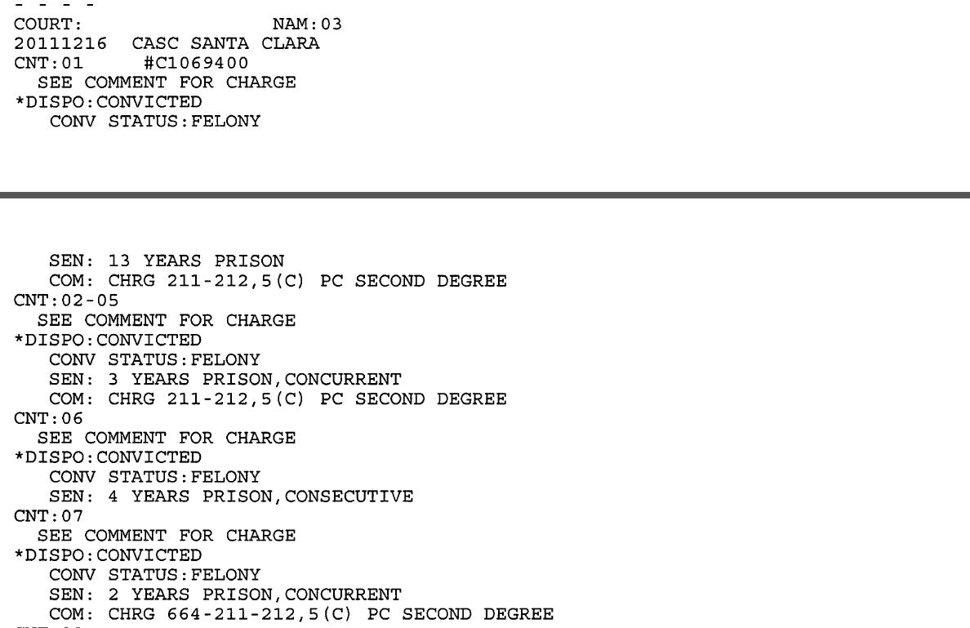

Slide 128
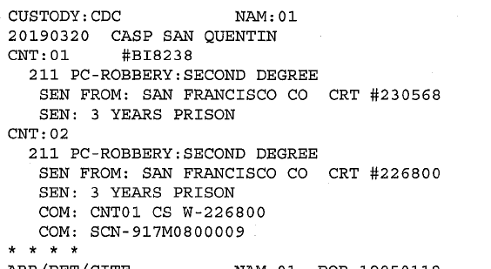

Slide 129
“Second Strike” Sentencing
If the current offense is any felony, and the defendant has one qualifying prior “strike” conviction:
The term for the crime is doubled
Probation denial with a prison sentence is mandatory
There is no aggregate term limitation on consecutive sentences
and
Prison conduct credit reduction is limited to one-fifth of the total term
(PC 667(c); 1170.12(a))

Slide 130
“Second Strike” Sentencing
For one prior & one current felony:
The “term” that is doubled is only the base term selected for the crime
Applicable specific enhancements are added after the base term has been doubled; the specific enhancements, and any other enhancements, are not doubled.
  P v. Dominguez (1995) 38 Cal.App.4th 410
  P v. Hardy (1999) 73 Cal.App.4th 1429

Slide 131
“Second Strike” Sentencing
For one prior & multiple current felonies:
The base term for each count is doubled, including both principal and subordinate terms.
However, subordinate terms are still computed using the “one-third middle term” formula for determinate consecutive sentences under PC 1170.1(a).
Thus, each of these subordinate consecutive sentences is computed as one-third of the middle term for the crime doubled, plus one-third of the term for applicable specific enhancements (not doubled) .
  P v. Nguyen (1999) 21 Cal.4th 197
  P v. Riggs (2001) 86 Cal.App.4th 1126

Slide 132
“Second Strike” Sentencing
Concurrent v. Consecutive for Multiple New Felony Convictions
Multiple new felony convictions sentenced pursuant to the Three Strikes Law are mandatory consecutive.
  PC 1170.12(a)(6)
Exceptions:
  Romero Granted
  Felony convictions are based on the same “operative facts”
  Felony convictions committed on the “same occasion”

Slide 133
Dismissal of a “Prior Strike”
P v. Superior Court (Romero) (1996) 13 Cal.4th 497
The court can selectively grant Romero as to some counts but not all counts.
  P v. Garcia (1999) 20 Cal.4th 490
The court may still have to sentence consecutively even with selectively granting Romero.
  P v. Casper (2004) 33 Cal.4th 38.

Slide 134
“Third Strike” Sentencing
If the current offense is “Serious/Violent” felony, and the defendant has two or more qualifying prior “strike” convictions:
Triple the Term
  Upper Term of triad is 9 or more years
  Indeterminate Term of at least 15-Life
25-Life – Default Option
General DSL Statutes including all Enhancements

Slide 135
“Third Strike” Sentencing
Example:
Defendant convicted of PC 211 + 12022.7(a) + 667(a)(1) x 2
  (i) 2, 3, 5 years x 3 = 15 years maximum minimum term.
  (ii) 25 years minimum term.
  (iii) 2, 3, 5 years + 3 + 5 + 5 = 18 years maximum minimum term.
  In this example, 25 years is the greatest minimum term, therefore the court would impose an indeterminate term of 25 years to life plus the enhancements for GBI and the prior serious felony convictions.

Slide 136
Exceptions to the “New” Three Strikes Law
Original Three Strikes Law allowed for an indeterminate sentence for any felony conviction with 2 prior strikes
Prop 36 in 2012 amended the Three Strikes Law
Now requires your “third strike” to be a “serious or violent felony”
Unless…

Slide 137
Exceptions to the “New” Three Strikes Law
Penal Code section 1170.12(c)(2)(C)
Qualifying Prior Convictions – “SUPER STRIKE”
  “Sexually Violent Offense” – WI 6600(b)
  Sex Crimes of victim under 14 – PC 288a(c)(1), 286(c)(1), 289(j), 288(a), 288(b)
  Any Homicide or Attempted Homicide – PC 187 to 191.5
  Solicitation to Commit Murder- PC 653f
  Assault on PO w/ Machine Gun – PC 245(d)(3)
  Possession of Weapon of Mass Destruction – PC 11418(a)(1)
  Any offense punishable by Life Imprisonment or Death

Slide 138
Exceptions to the “New” Three Strikes Law
Penal Code section 1170.12(c)(2)(C)
Current Offense
  Narcotics with Weight Enhancement – HS 11370.4 & 11379.8
  Stat or Spousal Rape – PC 261.5(d) & 262
  Felony Conviction with Mandatory PC 290 reg – Some Exceptions (314, 311.11, etc.)
  During offense, D:
    Used a Firearm
    Armed with Firearm or DW
    Intended to cause GBI to another

Slide 139
Exceptions to the “New” Three Strikes Law
Penal Code section 1170.12(c)(2)(C)
Current Offense
  Narcotics with Weight Enhancement – HS 11370.4 & 11379.8
  Stat or Spousal Rape – PC 261.5(d) & 262
  Felony Conviction with Mandatory PC 290 reg – Some Exceptions (314, 311.11, etc.)
  During offense, D:
    Used a Firearm
    Armed with Firearm or DW
    Intended to cause GBI to another

Slide 140
Exceptions to the “New” Three Strikes Law
Penal Code section 1170.12(c)(2)(C)(iii)
Armed with a Firearm or DW
  PC 29800(a)(1)
    A defendant convicted of being a felon in possession of a firearm may be considered “armed with a firearm”
      P v. While (2014) 223 Cal.App.4th 512
Intended to Cause GBI
  PC 273.5 & P v. Guilford (2014) 228 Cal.App.4th 651
    D punched wife in nose, court upheld that he “intended to cause GBI”

Slide 141
Three Strikes Law
PLEAD AND PROVE

Slide 142
Indeterminate Sentencing Law (ISL)

Slide 143
Indeterminate Sentencing Law (“ISL”)
Indeterminate (ISL) sentences are imposed under PC 1168(b) and are computed separately from determinate (DSL) sentences, which are imposed under PC 1168(a), 1170(a), & 1170.1(a).
ISL life sentences can have enhancements imposed, can be consecutive to each other, and can be consecutive to DSL sentences.
If consecutive ISL and DSL sentences are imposed, the DSL term is
served first and is not credited toward any ISL parole eligibility.

Slide 144
ISL & Enhancements
Consecutive ISL life sentences and enhancements on consecutive ISL sentences are imposed full term; the one-third formula of PC 1170.1(a) has no application to these terms or enhancements.
  P v. Felix (2000) 22 Cal.4th 651
So, on each ISL sentence, the court can impose full term conduct and status-based enhancements.
  P v. Williams (2004) 34 Cal.4th 397

Slide 145
ISL & Enhancements
PC 12022.53(d)
  Enhancement with punishment of 25-Life
  Indeterminate enhancement qualifies as a full-term enhancement, even if imposed on a subordinate consecutive DSL sentence
    P v. Mason (2002) 96 Cal.App.4th 1
  Example:
    D convicted of 2 counts of PC 212.5(c) w/ 12022.53(d) for robbing 2 people and shooting and injuring one of them:
      2-3-5 + 1/3 MT [1Y] = 6Y + 25-Life + 25-Life

Slide 146
Examples of ISL Terms
“Life imprisonment”
  7-Life per PC 3046(a)(1)
Life with a minimum term
  i.e. 15-Life, 25-Life
The number is the number of years D must serve before being eligible for Parole, aka “Minimum Eligible Parole Date” or MEPD.

Slide 147
Examples of ISL Crimes
Assaultive Crimes
  Murder, Premeditated Attempted Murder, Aggravated Mayhem, Torture, Child Abuse causing Death, Using Weapon of Mass Destruction/Destructive Device
Kidnapping
  For ransom, robbery, sex, carjacking, etc.
Aggravated Arson
Gang Crimes
  PC 213, 215, 246, 519 (extortion), 136.1
Other Crimes
  Treason (PC 37), Perjury causing execution of innocent person (PC 128), Train wrecking (PC 218), Sabotage (MV 1670)

Slide 148
Examples of ISL Based on Priors
Priors Based
  Three Strikes Law
  “Courtney’s Law”- PC 192.5(d)
    Gross Vehic Manslaughter while Intox w. Specified Manslaughter or DUI Prior
  Arson with Arson prior – PC 451.5
  Habitual GBI Offender – PC 667.7
    Crime with GBI or Force Likely [PC 245(a)(4)] w/ 2 Priors = 20-Life
    Crime with GBI or Force Likely [PC 245(a)(4)] w/ 3 Priors = LWOP
  Drug Dealing to Minors w/ Priors for the Same – PC 667.75

Slide 149
Sex Assault & ISL
Multiple SA Statutes can result in an Indeterminate sentence:
  PC 220 – Assault during PC 460(a)
  PC 269 – Aggravated SA of Child
  PC 288(i) – Lewd act on child with Bodily Harm
  PC 288.7 – SA of Young Child (10 or younger)
  PC 667.51(c) – Lew Act with Priors
  PC 667.61 – “One Strike” Sex Assault Law
    15-Life or 25-Life for specified SA Crime and wither a “minor factor” or “major factor”

Slide 150
Sentencing on Supervision Violations

Slide 151
Types of Supervision
Probation
Mandatory Supervision
Post Release Community Supervision
Parole

Slide 152
Parole & PRCS
Maximum on any violations is 180 days.
Any violation that is based on a new conviction must be sentenced concurrently to the new sentence.
  P v. Mathews (1980) 102 Cal.App.3d 704, 713
  P v. Adrian (1987) 191 Cal.App.3d 868
  P v. Garcia (2018) 22 Cal.App.5th 106 [PRCS revocation]

Slide 153
Mandatory Supervision
During term of incarceration, D gets half time credits per PC 4019
During time of Mandatory Supervision, D gets only day for day credits
  PC 1170(h)(5)(b)
For any violation, court only has any days left on MS term.
Violations will be served at half time per PC 4019
  All time spent in custody reduces total term of supervision because D will double the speed at which they accrue credits.

Slide 154
Probation
PV & Consecutive sentencing may be based on the same conduct.
  P v. Williams (1968) 260 Cal.App.2nd 868; P v. Todd (1994) Cal.App.4th 82
The principal/subordinate computation under PC 1170.1(a) applies
  P v. Riolo (1983) 33 Cal.3rd 223, 225-30
If the case that results in PV carries a longer term, court can make that the principal term.
Excess Credits on the subordinate term are not applied to principal term
  P v. Brown (1984) 156 Cal.App.3rd 1131

Slide 155
Credits

Slide 156
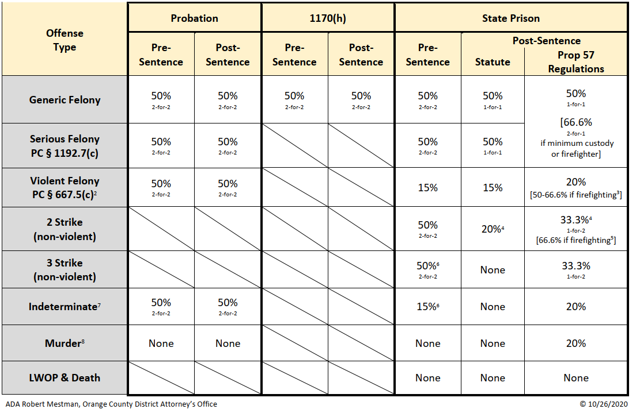

Slide 157
Credits for Pre-Sentence Confinement
County Jail
Residential Treatment Program
  Pre-sentence, D entitled to conduct credits.
    P v. Mobley (1983) 139 Cal.App.3rd 320
  Condition of Probation, Actual Credits only
    P v. Ambrose (1992) 7 Cal.App.4th 1917
Electronic Monitoring
  Actual days only. PC 1203.016, 1203.018

Slide 158
Abstract of Judgement

Slide 159
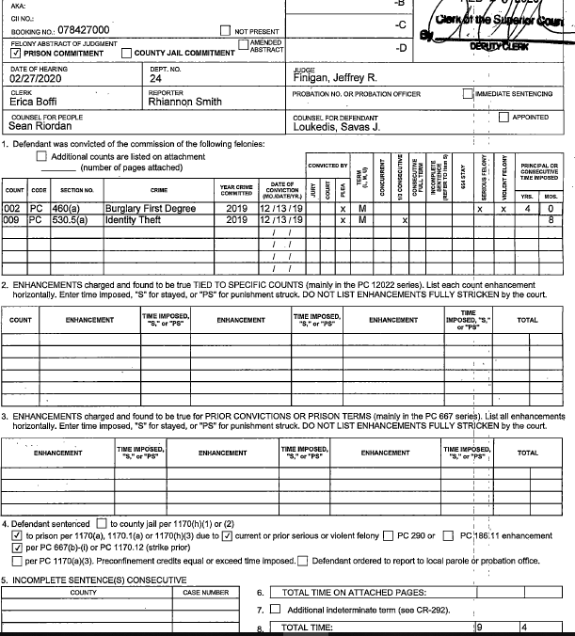

Slide 160
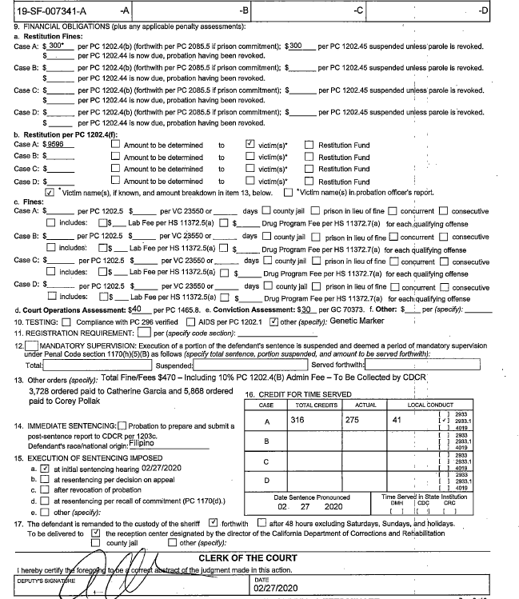

Slide 161
Questions?

