Slide 1
Post Traumatic Stress Disorder: The Basics Lisa A. Jeko, Ph.D. San Francisco District Attorney’s Office San Francisco, CA September 10, 2015

Slide 2
Today:
Post Traumatic Stress Disorder(PTSD)Defined
PTSD as a Limbic Disorder
Additional Brain Involvement
Malingering
Alternative Diagnoses
Recommendations
Q and A

Slide 3
Post Traumatic Stress Disorder (PTSD) Defined
Diagnostic Statistical Manual V (DSM-V)
8.7% projected lifetime risk for PTSD among US adults at age 75
Highest rates: Rape, military combat and captivity, ethnically or politically motivated internment, genocide.
Rates are higher among veterans and vocations with increased risk of TE exposure (Police, firefighters, EMT’s).
Included in Trauma and Stressor Related Disorders Section
Essential Feature of PTSD:
Development of characteristic symptoms following an exposure to a traumatic event (TE)

Slide 4
…Post Traumatic Stress Disorder (PTSD) Defined continued
*Teaser: Any underlined word can be source for challenging the diagnosis*
Criterion A- Exposure to actual or threatened death, serious injury or sexual violence.
Criterion B- Presence of one or more Intrusion symptoms.

Slide 5
…Post Traumatic Stress Disorder (PTSD) Defined continued
Criterion C- Persistent Avoidance of stimuli associated with TE (one or both symptoms).
Criterion D- Negative Alterations in Cognition and Mood (2 or more).
Criterion E- Marked alterations in Arousal and Reactivity (2 or more)

Slide 6
…Post Traumatic Stress Disorder (PTSD) Defined continued
Criterion F- Duration of Disturbance (Criterion A, B, C, D and E) greater than one month.
Criterion G- Disturbance causes (emphasis added) clinically significant distress or impairment in social, occupational or other important areas of functioning.
Criterion H- Disturbance is not attributable to physiological effects of a substance (emphasis added) (medication, alcohol) or other medical condition

Slide 7
Criterion A
Criterion A- Exposure to actual or threatened death, serious injury or sexual violence.
One required for this diagnosis
Directly experiencing
Exposure to war as a combat veteran
Threatened or actual physical assault (physical attack, mugging, childhood physical abuse)
Threatened or actual sexual violence (forced sexual penetration, alcohol/drug facilitated sexual penetration, abusive sexual contact, noncontact sexual abuse, sex trafficking)
Being kidnapped

Slide 8
…Criterion A continued
Being taken hostage
Terrorist attack
Torture
Incarceration as a prisoner of war
Natural or manmade disasters
Severe motor vehicle accident
Medical Incidents that DO apply: waking during surgery, anaphylactic shock
Life-threatening illness or debilitating medical condition NOT considered a traumatic event

Slide 9
…Criterion A continued
Witnessing event in person
Observed threatened or serious injury
Unnatural death
Physical or sexual abuse of another due to a violent assault
Domestic violence
Accident
War or disaster
Medical catastrophe in one’s child (i.e. life threatening hemorrhage)

Slide 10
…Criterion A continued
Indirect exposure through learning about the TE limited to experiences affecting close relatives or friends
Violent or accidental
NOT death due to natural causes
Suicide
Serious accident
Serious Injury
Could be severe or long-lasting when stressor is interpersonal and intentional (torture, sexual violence)

Slide 11
…Criterion A continued
Experiencing repeated or extreme exposure to aversive details of traumatic events
First responders collecting human remains
Police officers repeatedly exposed to details of child abuse
*DA’s and defense attorneys*

Slide 12
…Criterion B
Criterion B -Presence of intrusion symptoms associated with TE
One or more symptoms required
Recurrent, involuntary and intrusive memories
Usually sensory, emotional and behavioral components of the TE
Recurrent, Distressing dreams of the TE
Content/affect of dreams are related to TE
(Malingering: often report exact same dream repeatedly; rare in true PTSD)
Representative of thematically related to major threats involved in TE

Slide 13
…Criterion B continued
Dissociative reactions (flashbacks)
Occurs on a continuum
Most extreme- complete loss of awareness of present surroundings
Brief visual or other sensory intrusions w/out loss of reality orientation to complete loss of awareness
Typically brief episode
Associated with prolonged distress and heightened arousal

Slide 14
…Criterion B continued
Intense or prolonged physiological distress
At exposure to internal or external cues that symbolize or resemble an aspect of the TE
Windy days after a hurricane
Seeing someone resembling a perpetrator

Slide 15
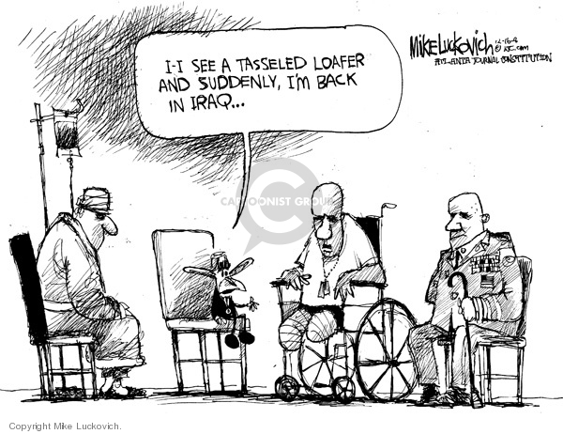

Slide 16
…Criterion B continued
Marked physiological reactions to internal or external cues that symbolize or resemble aspect of the TE
Dizziness for survivors of head trauma
Rapid heart rate for previously traumatized child
Prominent for individuals with highly somatic presentations

Slide 17
Criterion C
Criterion C- Persistent avoidance of stimuli associated with TE.
Requires one or both symptoms.
Avoidance of, or efforts to avoid distressing memories, thoughts, feelings (Internal).
Utilizes distraction
Extras- drugs/ETOH
Avoidance of, or efforts to avoid external reminders of TE
People, places, objects, conversations, activities, situations
Not walking in front of someone, closed, spaces, fireworks.

Slide 18
Criterion D
Criterion D -Negative alterations in cognitions and mood that began or worsened associated with TE.
Two or more symptoms required.
Inability to remember an important aspect of TE
Not due to head injury, ETOH, drugs.

Slide 19
…Criterion D continued
Persistent and exaggerated negative beliefs or expectations about oneself, others, the world, or future.
“I always have bad judgment.”
“People in authority can’t be trusted.”
“I can’t trust anyone again.”
“Something died in me.”
May manifest as a negative change in perceived identity

Slide 20
Criterion D continued
Persistent, distorted cognitions about the cause or consequences of TE that led individual to blame self or others.
“It’s all my fault my uncle abused me.”
Persistent negative emotional state.
Fear, horror, anger, guilt, shame
Began or worsened after the TE

Slide 21
Criterion D continued
Marked diminished interest or participation in significant activities
Decreased in previously enjoyed activities (anhedonia)
Feelings of detachment or estrangement from others
Intimacy difficulties
Estrangement from work, friends
Persistent inability to experience positive emotions
Inability to experience happiness, satisfaction, loving feelings

Slide 22
Criterion E
Criterion E- Marked alterations in arousal and reactivity associated with all TE beginning or worsening after the TE
Requires two or more symptoms
Irritable behavior and angry outbursts with little or no provocation
Typically expressed as verbal or physical aggression toward people or objects
Yelling at people
Getting into fights
Destroying objects

Slide 23
…Criterion E continued
Reckless or self-destructive behavior
Dangerously driving
Excessive ETOH/drug use
Self injurious or suicidal behavior
Hypervigilence
Heightened sensitivity to potential threats
Not only related to TE
Auto accident-potential threats on the road-global
Fear of suffering heart attack

Slide 24
…Criterion E continued
Exaggerated startle response.
Jumping with phone ringing
Loud noises (car backfiring, fireworks)
Unexpected movements

Slide 25
…Criterion E continued
Problems with concentration.
Difficulty remembering daily events
Forgetting one’s phone number
Following conversation for sustained period of time

Slide 26
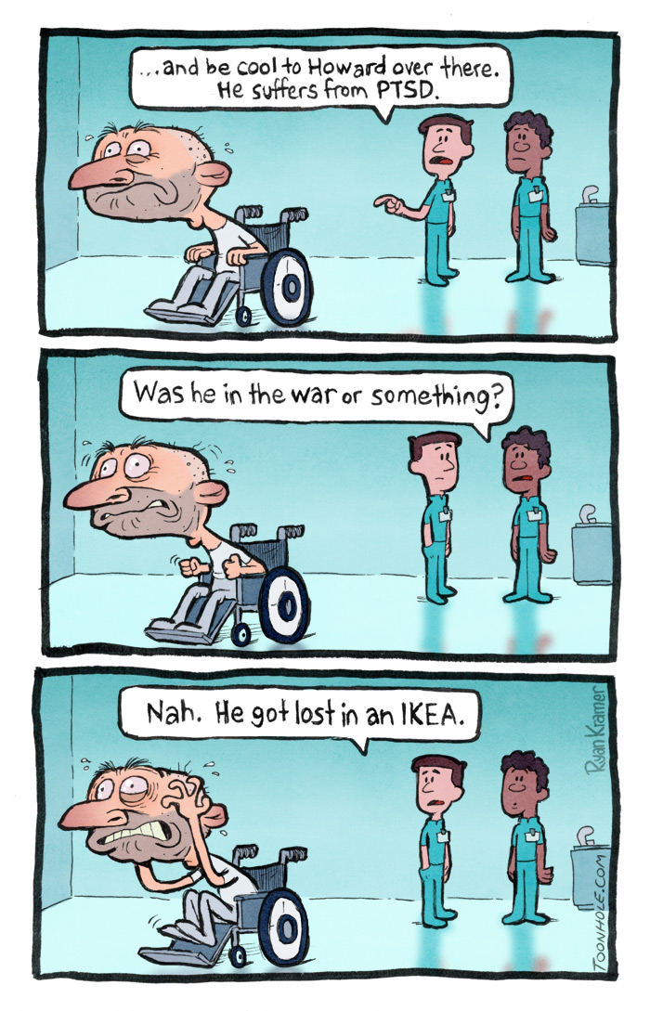
…Criterion E continued

Slide 27
…Criterion E continued
Sleep disturbance
Difficulty falling, staying, or restless sleep
May be associated with nightmares, safety concerns or generalized arousal

Slide 28
Criterion F, G, and H
Criterion F- Duration of disturbance (Criterion Be, C, D, and E,) greater than one month (versus Acute Stress Disorder-three days to one month).
Criterion G- Disturbance causes clinically significant distress or impairment in social, occupational or other important areas of functioning.
Criterion H- Disturbance is not attributable to physiological effects of a substance (medication, alcohol) or other medical condition.

Slide 29
…Criterion F, G, and H continued
F, G
Specify whether with dissociative symptoms: persistent or recurring
Depersonalization-
Feeling detached and as if one were and outside observer of one’s mental process or body
Feeling as though one were in a dream
Feeling a sense of unreality of self or body
Time moving slowly
Derealization- feeling of unreality of surroundings
The world around the individual is experienced as unreal, dreamlike, distant, distorted
Specify:
With a delayed expression
Full diagnostic criteria not met until six months after TE

Slide 30
PTSD as a Limbic Disorder
Trauma = Fear=Limbic System (The Emotional Brain)
An object in the path is no longer considered a stick
Emotional neural circuitry of the brain is changed
The “Emotional Brain” is on overdrive
The Wildcard: Helplessness

Slide 31
(…PTSD as a Limbic Disorder continued)
Helplessness triggers PTSD
Helplessness- subjectively overwhelming
Example:
Someone being attacked with a knife knows how to defend oneself and takes action vs. another in same predicament thinks, “I’m dead.”
Helpless person is more susceptible to PTSD
Feeling one’s life is in danger and can do nothing to escape it.
THAT’S THE MOMENT BRAIN CHANGE BEGINS

Slide 32
(…PTSD as a Limbic Disorder continued)
The Almighty Amygdala
Part of the “Emotional Brain” most commonly associated with fear- Fight/Flight/Freeze
Background:
Early studies of fear used avoidance conditioning tasks.
Measured fear in terms of how well an animal learned to avoid shock- Pavlovian
1980’s- researchers began to study the brain mechanisms of fear.
Focus on the fear reaction conditioned by the shock rather than on behaviors to avoid the shock.

Slide 33
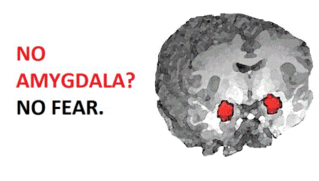
(…PTSD as a Limbic Disorder continued)

Slide 34
Additional Brain Involvement
Today we know more about additional brain involvement
Brain areas involved in the Stress Response include the:
Amygdala
Hippocampus
Prefrontal cortex
Thalamus
Hypothalamus
Locus coeruleus

Slide 35
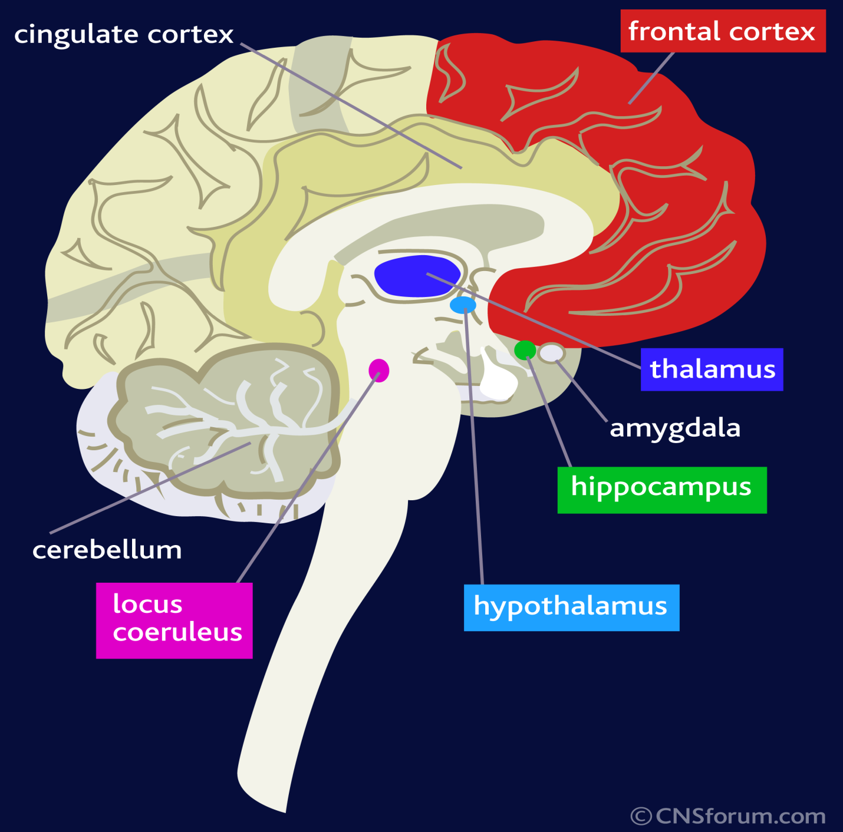

Slide 36
…Additional Brain Involvement continued
Traumatic stress is associated with lasting changes in the:
Amygdala – Conditioned fear
Hippocampus -Declarative memory
Medial Prefrontal Cortex- Extinction to fear through Amygdala inhibition

Slide 37
…Additional Brain Involvement continued
Traumatic stress is associated with:
Increased cortisol and norepinephrine responses to subsequent stressors
Long-term dysregulation of norepinephrine and cortisol systems:
GC, glucocorticoid
CRF, corticotropin-releasing factor;
ACTH, adrenocorticotropin hormone
NE, norepinephrine HR, heart rate
BP, blood pressure
DA, dopamine
BZ, benzodiazapine
GC, glucocorticoid

Slide 38
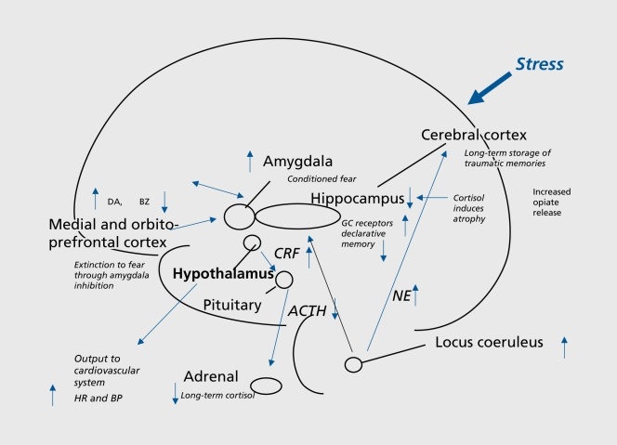
Lasting effects of trauma on the brain, showing long-term dysregulation of norepinephrine and cortisol systems, and vulnerable areas of hippocampus, amygdala, and medial prefrontal cortex that are affected by trauma. GC, glucocorticoid; CRF, corticotropin-releasing factor; ACTH, adrenocorticotropin hormone; NE, norepinephrine; HR, heart rate; BP, blood pressure; DA, dopamine; BZ, benzodiazapine; GC, glucocorticoid

Slide 39
…Additional Brain Involvement continued
Patients with PTSD show:
Smaller Hippocampal and Anterior Cingulate volumes
Increased Amygdala function( Hyperarousal)
Decreased Medial Prefrontal/Anterior Cingulate function
Increased cortisol and norepinephrine responses to stress

Slide 40
Malingering
Malingering definition per DSM-V:
“The essential feature of malingering is the
intentional production of false or grossly
exaggerated physical or psychological symptoms, motivated by external incentives such as avoiding military duty, obtaining financial compensation, evading criminal prosecution, or obtaining drugs.”

Slide 41
…Malingering continued
Partial malingering = exaggerating degree of impairment
Pure malingering= feigning condition

Slide 42
…Malingering continued
Malingering is not considered a mental disorder
It is categorized under “other conditions that may be a focus of clinical attention.”

Slide 43
…Malingering continued
Motivations for malingering
Financial
Veterans Disability
Social Security benefits
Civil litigation money
Worker’s Compensation

Slide 44
…Malingering continued
Forensic
Reduce or avoid criminal liability
NGI
Pretrial bargaining

Slide 45
…Malingering continued
Generally, if any combination exists, consider malingering if:
Person presents in a medico-legal context
Marked discrepancy present between person’s claimed stress or disability and objective findings and observations
Person demonstrated lack of cooperation during diagnostic evaluation and complying with a prescribed treatment plan
Person has an Antisocial Personality Disorder

Slide 46
…Malingering continued
Considerations for Malingering with PTSD
Malingerers are more often seen in outpatient settings
Malingerers are often uncooperative or unwilling with:
Exams
Clinical procedures or medication trials
Malingerers often have histories (APD) of:
Previous lawsuits
Run-ins with the law
Acting out behavior in school, workplace, military
Substance use
Turning down jobs that accommodate or accept “partial” disability
Few long-standing financial responsibilities

Slide 47
…Malingering continued
Malingerers have difficulty elaborating on their symptoms.
Malingerers have a decreased capacity to work but increased ability to enjoy recreational activities.
Malingerers have histories of a lack of improvement of their condition over time.
Malingerers lack objective (emphasis added) evidence of concentration deficits, hypervigilence, irritability and avoidance (especially avoidance of trauma-related topics during the interview).

Slide 48
…Malingering continued
What to do: Multimodal Approach to Identify PTSD Malingering
Specific interview techniques
Collection of collateral data
Psychological testing

Slide 49
…Malingering continued
Interview techniques:
Open-ended questions- not leading
Avoid interrupting
More talking , more likely to reveal contradictions
Use empathic style- highlights temptation to exaggerate symptoms
Obtain detailed history of symptoms

Slide 50
…Malingering continued
Elicit capacity for work vs. enjoying recreation activities
Elicit course of illness
Elicit premorbid (before TE) functioning
Conduct mental status exam- look for hypervigilence, concentration deficits, irritability and avoidance
Interview person separately from third parties

Slide 51
…Malingering continued
Psychological Testing
No gold standard method or single instrument to determine PTSD malingering
Those generally reliable for malingering:
Structured Interview for Reported Symptoms (SIRS)
Minnesota Multiphasic Personality Inventory (MMPI-2)
Miller Forensic Assessment of Symptoms Test (M-FAST)

Slide 52
Elicit capacity for work vs. enjoying recreation activities Elicit course …Malingering continued Elicit …
PTSD Assessment
Clinician Administered PTSD Scale for DSM-5 (CAPS)

Slide 53
…Malingering continued
Most efficient:
M-FAST
Full diagnostic clinical interview
Review collateral data- records, spouses
If insufficient, SIRS, MMPI-2 or both

Slide 54
Alternative Diagnoses
Alternative Diagnoses:
Acute Stress Disorder
TE must occur and symptoms be resolved within 4weeks of TE.
If symptoms last > 4 wks., and the symptom pattern fits that characteristic of PTSD, the diagnosis may be changed to PTSD.
Adjustment Disorder
an appropriate diagnosis for a stressor and a symptom pattern that does not meet the criteria for PTSD,
partner being fired, spouse leaving

Slide 55
…Alternative Diagnoses continued
Drug-Induced Psychotic Disorders
can be considered if substance abuse is involved
Major Depressive Disorder
Symptoms may precede TE
Do not usually include Criterion B and C symptoms
Personality Disorders
interpersonal difficulties prior to TE

Slide 56
…Alternative Diagnoses continued
Psychotic Disorders
Flashbacks need to be distinguished from illusions, hallucinations, i.e., Schizophrenia, Depressive and Bipolar Disorders, and Psychotic
Disorders due to a General Medical Condition.
Traumatic Brain Injury
Re-experiencing and avoidance are characteristic of PTSD
Persistent disorientation and confusion more specific to TBI

Slide 57
…Alternative Diagnoses continued
Obsessive Compulsive Disorder
Intrusive thoughts are recurring but not related to a specific TE.
Compulsions are usually present, but symptoms of Acute Stress Disorder and PTSD are typically absent
Arousal and dissociative symptoms of Panic Disorder typically absent
Avoidance, irritability and anxiety of Generalized Anxiety Disorder are not associated with a specific TE.

Slide 58
Recommendations
If opposing counsel raises PTSD as a diagnosis, get your own psychological expert.
Underlined words in this presentation are grounds for challenging the PTSD diagnosis.
Ask if the opposing expert utilized the assessment techniques outlined- if not , have him or her explain reasoning for not.

Slide 59
Contact Information
For questions or further information:
Lisa A. Jeko, Ph.D.
415-674-3884
drlisajeko@comcast.net

