Slide 1

PX 101:
Beyond The Holding Order

Slide 2
Presentation Overview:
PX Law & Common Issues
Tips For Success

Slide 3

Reality Check:

Slide 4
THE BASICS.

Slide 5
10 Day Right to a Speedy PX:
All defendants, regardless of custodial status, have a right to a preliminary examination within 10 court days from date of AN or Plea, whichever is later. (PC 859b)

Slide 6
10 Day Rule: A Two Way Street
PC 859b: Both the defendant and the people have the right to a PX at the earliest possible time … unless both waive that right or good cause for a continuance is found as provided for in Section 1050 …
Don’t Give In!

Slide 7

Continuance within 10 days, but no good cause?
People v. Smith (2016) 245 Cal.App.4th 869, 875.

Slide 8
10 Day Violation – Dismissal?!
It depends…

Slide 9
10 Day Violation – In Custody:
DISMISSAL unless the People establish good cause for the delay …
… but D will be entitled to release from custody (PC 859b, 1318)

Slide 10
10 Day Rule: Waiver
Personal Right – lawyer and/or court can’t do it (Ramos v. Superior Court (2007) 146 Cal.App.4th 719.)
One and Done – once waived, the 10-day rule may not be reasserted. (People v. Love (2005) 132 Cal.App.4th 276, 281-83.)

Slide 11
60 Day Rule:
“The magistrate shall dismiss the complaint if the preliminary examination is set or continued more than 60 days … unless the defendant personally waives his or her right (PC 859b, subd.(b).)
Check your dates!

Slide 12
Continuance within 60 days, but no good cause?
People v. Alvarez (1989) 208 Cal.App.3d 567, 575.

Slide 13
60 Day Rule: Be Careful
Applies regardless of whether D is in or out of custody. (People v. Standish (2006) 38 Cal.4th 858.)
Can apply even if there is good cause to continue the preliminary hearing beyond the 60th day. (Ramos v. Superior Court (2007) 146 Cal.App.4th 719.)

Slide 14
60 Day Rule: Waiver
Can a D who waives the 60th day ever reassert it?
Technically no but … People v. Love only addressed the 10-day waiver, not the 60. No case on point re: 60th day.
Get it done!

Slide 15
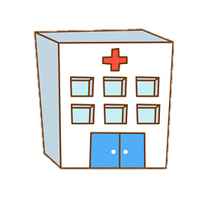
PC 1368 & PX Issues:

Slide 16
1368 PX Issues:
D can demand a probable cause hearing before proceedings are suspended. (PC 1368.1)
Hearing does not result in a holding order. If D is restored to competence, new PX hearing must be held. (People v. Duncan (2000) 78 Cal.App.4th 765, 768.)
Why???

Slide 17
1368 Issues: Back from Napa?
PX must be held within 10 days (!) EVEN if D waived the 10/60 day rule before criminal proceedings were suspended.
(Davis v. S. Court (2017) 18 Cal.App.5th 1061, 1067, review filed (Feb. 7, 2018).) ← Solano County
Um, Witnesses?

Slide 18
Waiving PX?
Where D waives PX, the DA may NOT amend the information to add new charges. (People v. Rogers (2016) 245 Cal.App.4th 1353, 1360.)
Undercharged Case?
Overcharged Case?
Correctly Charged?
Be Skeptical!

Slide 19
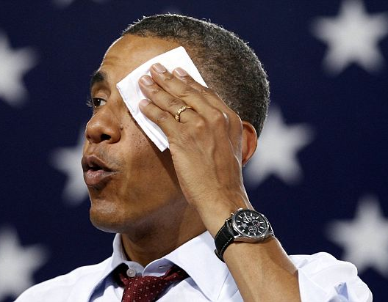
Proposition 115:
PC 872(b) creates limited exception to the rule against hearsay for use at PX:
Can’t use an officer as a ‘mere reader’
Can’t use this to overcome multiple hearsay layers

Slide 20
Proposition 115:
Officer used a translator?!
Correa v. S. Ct. (2002) 27 Cal.4th 444, 452-463

Slide 21
Proposition 115:
Co-def case: using D1’s statement against D2 at PX?
P v. Miranda (2000) 23 Cal.4th 340, 351

Slide 22
Proposition 115:
D trying to introduce his/her own statement?
Nienhouse v. S. Ct. (1996) 42 Cal.App.4th 83

Slide 23
Proposition 115:
Doesn't apply @ 1538.5 hearings!!!

Slide 24
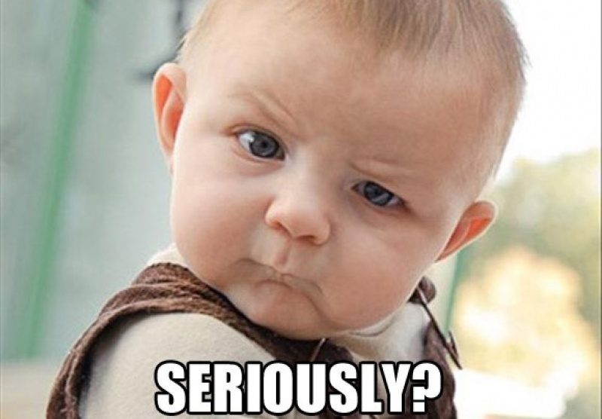
Defense Evidence @ PX:

Slide 25
Defense Evidence @ PX:
At the request of the DA, the magistrate “shall require” an offer of proof from D concerning the testimony of any witness D’ce plans to call @ PX. (PC 866(a), PC 866(b))
Be aggressive!

Slide 26
Defense Evidence @ PX:
Limited under PC 866(a):
Establish an affirmative d’ce?
Negate element(s) of crime?
Impeach testimony?

Slide 27
Defense Evidence @ PX:
An “optimistic expectation” is insufficient to satisfy the offer of proof requirement in section 866. (People v. Eid (1994) 31 Cal.App.4th 114, 126-128.)
352!

Slide 28
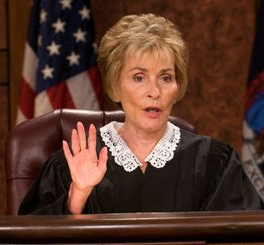
Defense Evidence @ PX:
PX is NOT to be used for discovery purposes
PC 866(b)

Slide 29
Proving Priors?
“If a prior conviction is an element of the charged offense, it must be proven at PX.”
Thompson v. S. Ct. (2001) 91 Cal.App.4th 144, 150-151

Slide 30
Proving Priors?
Prior convictions generally?
Ex-felon with a gun?
Bail/OR Release Enhancement?
Indecent Exposure Prior?

Slide 31
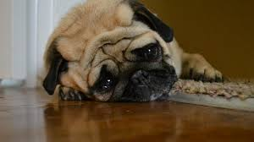
Case Dismissed:

Slide 32
Dismissal & Refiling:
PC 1387 authorizes refiling after 1st dismissal
Can be done immediately using the existing complaint. (People v. Standish (2006) 38 Cal.4th 858, 881-82)
Give it a try …

Slide 33


Slide 34
Expect the Judge NOT to Know the Law

Slide 35
Protect y(our) credibility.

Slide 36
Put On Difficult Witnesses
&
Anticipate Unavailability

Slide 37
Protect our record.

Slide 38
Do The Little Things

Slide 39
Police Witnesses

Slide 40
Civilian Witnesses

Slide 41
In Court Identifications:
“Do you think you would recognize the person if you saw them again?”

Slide 42
Review, Mark, Admit

Slide 43
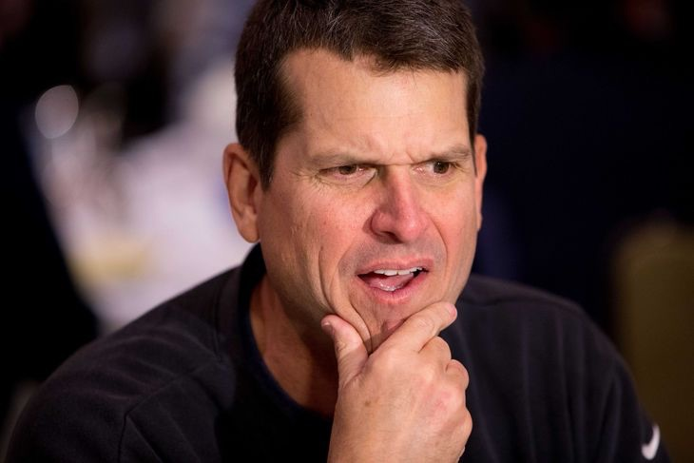
Impeach Your Own Witness!
EC 1237 → Evidence of a statement previously made by a witness is not made inadmissible by the hearsay rule if …
… the writing may be read into evidence (but not admitted, unless by adverse party)

Slide 44
Rule of Completeness:
EC 356 → Where part of a writing is given in evidence by one party, the whole on the same subject may be inquired into by an adverse party and … if necessary to make it understood [any portion of the writing or stmt] “may also be given into evidence.”

Slide 45
Firearm Nuances

Slide 46
“Do your best, forget the rest.”

Slide 47
