Slide 1
PERSUASIVE WRITING
An Overview

Slide 2
Persuasive writing
Goals
Present your point quickly and up front
Use every opportunity to convince your reader
Focus on simplicity and clarity
Notes:
Overall goal of persuasive writing is to grab your reader’s interest and convince them.
And do the work for your reader – Do not just recite the law and state that the court should do this.
Strive to achieve all three goals in all aspects of writing – not just in argument – you can also do this in your statement of facts
Overall, do not let your reader to fend for themselves. DO THE WORK FOR YOUR READER AND PRODUCE A SELF-CONTAINED DOCUMENT
But first – getting started. Is there actually a process that helps you achieve these goals and persuade your reader? Yes.

Slide 3
FRAMING YOUR THOUGHTS
Writing process &
The Flowers Paradigm:
“Madman” - comes up with the idea
“Architect” - arranges ideas
“Carpenter” - builds the draft
“Judge” - editor-in-chief
Notes:
Oftentimes, we are faced with writer’s block – where do we begin? And even if we begin, we have all these ideas and responses but no real structure.
Flowers Paradigm breaks down the writing process so that you can achieve the goals of persuasive writing: to interest and convince your reader
Betty Flowers, a former Professor at the University of Texas, Austin
Popularized by Bryan Garner – author of Legal Writing in Plain English; the Elements of Legal Style
Madman: creative spirit; brainstorming; jotting down ideas in any order/form. What are your first thoughts? (after reading motion and doing research)
Architect: Planner who ensures integrity of the structure; organizes ideas from brainstorming; core product: headings & outline
Carpenter: takes the headings & outline from the Architect and builds the draft; writes sentences and builds paragraphs;
Judge: Audits the Carpenter’s work and corrects spelling, typographical errors; removes unnecessary words; converts passive to active voice; simplifies, refines; may even paraphrase quotations into simple, clear language.

Slide 4
INTRODUCTION
Present your point briefly and up front
Contains conclusions with supporting reasons
Notes:
This is where you present your point quickly and up front with a concrete summary.
This may be the last thing you actually write, but it is the first thing the reader sees.
Brief and contains conclusions with supporting reasons
Often it is a compilation of your headings.
How important is the Introduction? Very.
Justice Humes: first thing the justice reviews is the Table of Contents – which is a collection of headings
Types of Introductions:
Executive Summary: Conclusions with supporting reasons – a summary of your argument (do not waste precious real estate by summarizing opponent’s argument)
Deep Issue Statement: Ultimately presented in the form of a question, but the question is phrased in a way that favors your position.
Example: The issue is: Absent consent or good cause, the court must dismiss a felony case if it is not tried within the statutory time limits. The separation of powers doctrine restricts the Governor’s emergency powers to the executive branch. Here, the Governor’s Executive Order and the Judicial Council’s order extended trial time limits without defendant’s consent or good cause. Are these orders invalid, violating separation of powers and requiring the court to dismiss under section 1382?

Slide 5
Introduction
Deep Issue
Ultimately presented in the form of a question
Question phrased in way that favors your position
Notes:
Ultimately presented in the form of a question, but phrased in a way that favors your position.

Slide 6
Introduction
Deep Issue
Absent consent or good cause, the court must dismiss a felony case if it is not tried within the statutory time limits. The separation of powers doctrine restricts the Governor’s emergency powers to the executive branch. Here, the Governor’s Executive Order and the Judicial Council’s order extended trial time limits without defendant’s consent or good cause. Are these orders invalid, violating separation of powers and requiring the court to dismiss under section 1382?
Notes:
Ultimately presented in the form of a question, but phrased in a way that favors your position.

Slide 7
Introduction
Executive Summary
Conclusions with supporting reasons
Brief – 1 paragraph at most
Do not waste precious real estate summarizing opponent’s argument
Notes:
Conclusions with supporting reasons
Brief, one paragraph at most
Does not waste precious real estate on opponent’s argument

Slide 8
Introduction
Executive Summary
Defendant argues that the Court should dismiss the case because the series of Executive and Emergency Orders issued as a result of the COVID-19 pandemic exceeded the authority granted to the Governor and the Chief Justice, acting as the Chairperson of the Judicial Council. Defendant’s claims lack merit. Under the broad authority bestowed to the Governor by the Legislature in the Emergency Services Act, the Governor lawfully issued Executive Order N-38-20, which does not violate the separation of powers. Furthermore, the Chief Justice’s Emergency Statewide Orders and the San Francisco Superior Court’s Implementation Orders lawfully establish the timetable for resetting cases in light of the COVID-19 pandemic. In addition, good cause supports a continuance based upon the unprecedented pandemic. Therefore, the Court should deny Defendant’s motion to dismiss.
Notes:
Conclusions with supporting reasons
Brief, one paragraph at most
Does not waste precious real estate on opponent’s argument

Slide 9
ORGANIZATION
Substantive Organization
Visual Organization
Notes:
ARCHITECT
Again – do not let your reader fend for themselves – do the work for them!

Slide 10
ORGANIZATION
Substantive
Law as Order:
Threshold questions
Elements
Chronological or logical order
Persuasiveness
Notes:
Threshold questions: Address those first; May include: timeliness; jurisdiction; standing (reasonable expectation of privacy); standard of review
Elements: But remember you do not need to address every single element, particularly if there is no dispute as to some; Emphasize most important first
Chronological/logical order: Broad applicable before narrowly applicable; rules before exceptions
Persuasiveness: present strongest argument first; save weaker arguments for last (including policy reasons) –
Also, you do not have to respond in the same order as presented in initial briefing.
Overall, do not let your reader to fend for themselves. DO THE WORK FOR YOUR READER AND PRODUCE A SELF-CONTAINED DOCUMENT

Slide 11
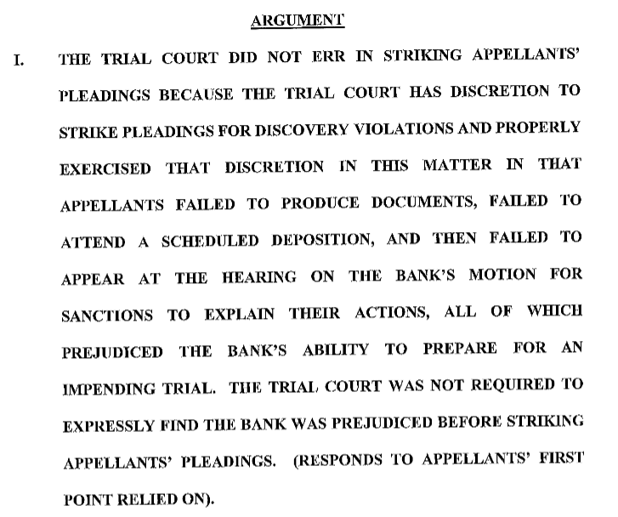
ORGANIZATION
Visual
Break up print and give reader “breathing” space
Notes:
Visual: including that blank space that gives your reader a break
Do not want to overwhelm reader – keep the reader interested
Page long paragraphs
Headings that exceed three lines
Headings: serve both substantive (outline) and visual (break up monotony) purpose;
Should include the conclusion and the reasons behind it.
Is this effective?

Slide 12
ADVOCATING WITH FACTS
Show, Don’t Tell
Emphasize best facts
Neutralize the bad facts
Use variations to avoid repetition
Notes:
Perspective of an advocate
EMPHASIZE ethics – do not by any means mislead the court.
OVERALL – remember duty of candor to the court
Cannot misrepresent the facts
These are techniques to present the facts, but in favor of your position
You need to lay the factual foundation for the legal argument that will follow. You need to explain all the facts that will be relevant to the court’s analysis of the legal issue, and you need to do so with scrupulous accuracy. You have to discuss all legally material facts, whether they hurt or help you.
Have the audience see the story from your perspective. You have to make a busy judge care about your side.
Because your story must be true, you can manipulate only the selection and arrangement of facts. Selection is simple. You will discuss the material facts -- those that benefit you, harm you, or set the context of the story. All other “facts” are irrelevant to your purpose, and you should omit them.

Slide 13
ADVOCATING WITH FACTS
Show, Don’t Tell
Do not tell your reader what to think
Show your reader what to think by using the facts
Notes:
Reading examples of writing is one of the best ways to improve your ability to write persuasively
Stewart, Pulizer-Prize winning author of Den of Thieves – insider trading involving Ivan Boesky

Slide 14
ADVOCATING WITH FACTS
Show, Don’t Tell
John Mulheren says that Boesky was always a conspicuous consumer. At his first meeting with Boesky, a dinner at an expensive restaurant in Manhattan, the waiter recited the day’s eight specials, and Boesky ordered them all. The waiter wheeled out a table with the dishes on them, Boesky examined each of them, then sent back all but one. Mulheren says he’s glad he did not have to pick up the bill.
(Stewart, Follow the Story: How to Write Successful Nonfiction)
Notes:
Reading examples of writing is one of the best ways to improve your ability to write persuasively
Stewart, Pulizer-Prize winning author of Den of Thieves – insider trading involving Ivan Boesky

Slide 15
ADVOCATING WITH FACTS
Show, Don’t Tell
John Mulheren says that Boesky was always a conspicuous consumer. At his first meeting with Boesky, a dinner at an expensive restaurant in Manhattan, the waiter recited the day’s eight specials, and Boesky ordered them all. The waiter wheeled out a table with the dishes on them, Boesky examined each of them, then sent back all but one. Mulheren says he’s glad he did not have to pick up the bill.
(Stewart, Follow the Story: How to Write Successful Nonfiction)
Notes:
Reading examples of writing is one of the best ways to improve your ability to write persuasively
Stewart, Pulizer-Prize winning author of Den of Thieves – insider trading involving Ivan Boesky

Slide 16
ADVOCATING WITH FACTS
Show, Don’t Tell
When the Café des Artistes waiter came to take their order, Boesky said he hadn’t decided and the others should make their selections. Then Boesky ordered: “I’ll have every entrée.” The waiter’s pen stopped midair. “Bring me each one of those entrees….” When the food arrived, the waiter wheeled a table next to them. On it were the eight featured dishes of the day. Boesky looked them over carefully, circled the table, took one bite of each. He selected one, and sent the rest back.

Slide 17
ADVOCATING WITH FACTS
Techniques
Fact positioning
Independent vs. dependent clauses
Juxtapose facts
Mechanics
Notes:
FACT POSITIONING – Emphasizing best facts and de-emphasizing bad facts; reader recalls best what they read first and last
INDEPENDENT CLAUSES – emphasize best facts by placing in independent clauses
JUXTAPOSITION – compare and contrast good with bad
MECHANICS: active voice; word choice – strong words; vivid descriptions
WIZARD BATTLE: Although Snape drew his wand first, he never fired at McGonagall. In fact, Snape deflected McGonagall’s shots towards the dark wizards standing behind him.

Slide 18
ADVOCATING WITH FACTS
Fact positioning, etc.
Lay factual foundation for legal argument
Explain all facts relevant to court’s analysis
Duty of candor: scrupulous accuracy
Discuss all legally material facts, whether they help or hurt you
Advocate so that audience see story from your perspective
Arrange facts in favorable and persuasive manner
Notes:
Perspective of an advocate
EMPHASIZE ethics – do not by any means mislead the court.
OVERALL – remember duty of candor to the court
Cannot misrepresent the facts
These are techniques to present the facts, but in favor of your position
You need to lay the factual foundation for the legal argument that will follow. You need to explain all the facts that will be relevant to the court’s analysis of the legal issue, and you need to do so with scrupulous accuracy. You have to discuss all legally material facts, whether they hurt or help you.
Have the audience see the story from your perspective. You have to make a busy judge care about your side.
Because your story must be true, you can manipulate only the selection and arrangement of facts. Selection is simple. You will discuss the material facts -- those that benefit you, harm you, or set the context of the story. All other “facts” are irrelevant to your purpose, and you should omit them.

Slide 19
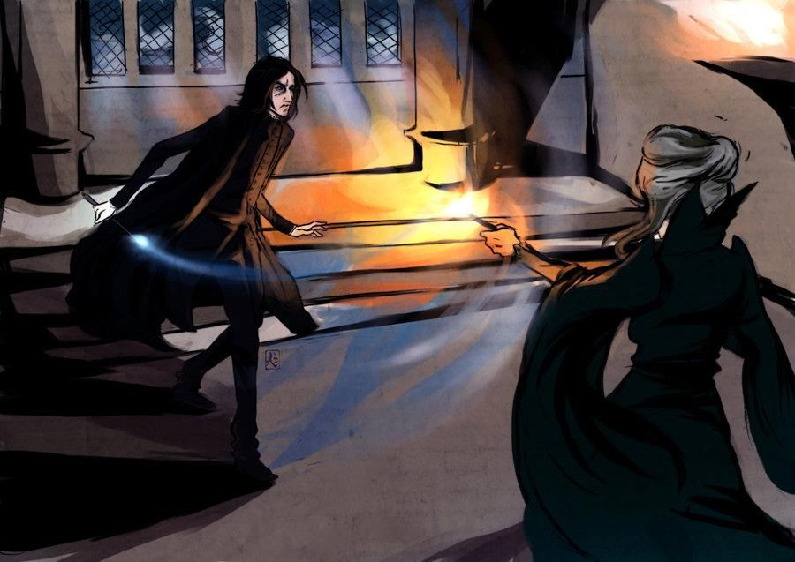
Wizard duel
Although Snape drew his wand first, he never fired at McGonagall. In fact, Snape deflected McGonagall’s shots towards the dark wizards standing behind him.
Notes:
As to the duel only, identify the good facts and bad facts for Snape.
How can you emphasize the good facts, while neutralizing the bad facts?
WIZARD BATTLE: Although Snape drew his wand first, he never fired at McGonagall. In fact, Snape deflected McGonagall’s shots towards the dark wizards standing behind him.

Slide 20
ADVOCATING WITH FACTS
Active voice
Persuasive paraphrasing

Slide 21
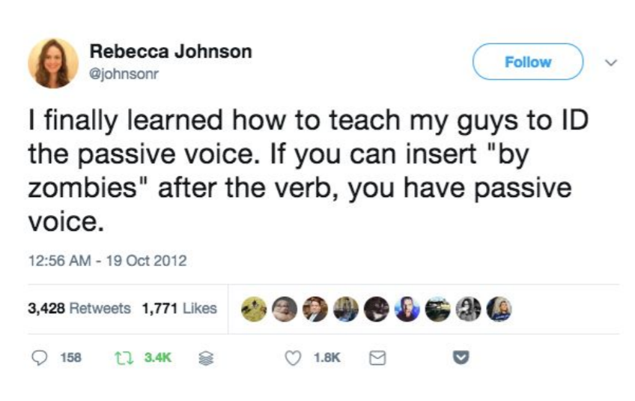
ADVOCATING WITH FACTS
Active Voice
Active Voice: Subject performs action in a sentence
Passive Voice: Subject receives the action
Notes:
USE ACTIVE VOICE
Why is active voice so important:
Sentences necessarily shorter
Easy to understand
Shorter sentences
Passive voice
Sentences become too wordy and complicated
Dilutes argument and persuasiveness
Is it ever okay to use PASSIVE VOICE?
SPARINGLY to NEUTRALIZE BAD FACTS
EXAMPLE
Defendant ran a red light and crashed into the victims
The victim was hit by a car and died shortly thereafter
TWITTER

Slide 22
ADVOCATING WITH FACTS
Active Voice
Why active voice is so important:
Sentences necessarily shorter
Easier to understand
More compelling and interesting for your reader
Notes:
USE ACTIVE VOICE
Why is active voice so important:
Sentences necessarily shorter
Easy to understand
Shorter sentences
Passive voice
Sentences become too wordy and complicated
Dilutes argument and persuasiveness
Is it ever okay to use PASSIVE VOICE?
SPARINGLY to NEUTRALIZE BAD FACTS
EXAMPLE
Defendant ran a red light and crashed into the victims
The victim was hit by a car and died shortly thereafter
TWITTER

Slide 23
ADVOCATING WITH FACTS
Persuasive Paraphrasing
Defendant returned the officer’s call
Defendant volunteered to go to the police station with the officers
Defendant agreed to speak with the officers
Notes:
Blending of legal concepts / words into your statement of facts
Miranda
Statement of a defendant
Question: did the person initiate contact with law enforcement

Slide 24
WORD CHOICE
Words are, in my not-so-humble opinion, our most inexhaustible source of magic. Capable of both inflicting injury and remedying it.
Albus Dumbledore

Slide 25
Simplify Word Choice
INSTEAD OF
USE
Commence
Implement
Request
Demonstrate
Observed
Start, begin
Carry out, set up
Ask
Show
Saw

Slide 26
Word choice
Avoid Jargon
JARGON
PLAIN ENGLISH
Engaged in a foot pursuit
Exited
Initiated a verbal exchange
Ran after
Left
Spoke

Slide 27
Word choice
Remove Wordy Phrases
INSTEAD OF
USE
At this juncture
Pursuant to
In the vicinity of
In regards to
On behalf of
Due to the fact that
Now
Under
Near
About
For
Because
Notes:
OTHER WORDS FOR BECAUSE

Slide 28
Word choice
Avoid Timid Phrases
It seems
It would appear that
It might be said that
It is respectfully suggested that
The fact that
Notes:
Lawyers are notorious for qualifying every statement
Timid phrases are those unnecessary conditional phrases included in legal writing
Conveys doubt

Slide 29
PARAGRAPH PLANNING
Begin paragraphs with topic sentences
Bridge between paragraphs
Vary paragraph length, but keep short
Signposts
(Garner, Legal Writing in Plain English (2d ed. 2013).)
Notes:
Introduce each paragraph with a topic sentence
One topic per paragraph & begin a paragraph with topic sentence
Create bridges between paragraphs – linking them together
Should be able to read the topic sentence from each paragraph and understand the argument
Transitions Link sentences and paragraphs
Transitions can be a single word or a phrase
Visual organization:
NO FULL PAGE PARAGRAPHS & no single sentence paragraphs

Slide 30
PARAGRAPH PLANNING
Topic Sentences
Begin paragraphs with a topic sentence
Reader should be able to read topic sentences and understand your argument
Notes:
Should be able to read the topic sentence from each paragraph and understand the argument

Slide 31
PARAGRAPH PLANNING
Topic Sentences
Do not begin topic sentence with a case citation
In Oregon v. Mathiason, the Supreme Court defined custodial interrogation “as questioning initiated by law enforcement officers after a person has been taken into custody…
A custodial interrogation occurs when law enforcement officers question a suspect after taking the suspect into custody…

Slide 32
PARAGRAPH PLANNING
Bridge Between Paragraphs
Topic sentences should also act as a bridge between paragraphs
Bridges:
Pointing words
Explicit connectives
Signposts
Echo link
Notes:
Every paragraph opener should contain transitional word or phrase that keeps the reader with you
“Pointing words” – words like this, that, these, those – refer directly to something already mentioned. If you refer to the Hall of Justice and then say “that building” the word “that” points to the preceding reference of HOJ, creating a connection between the two.
“Explicit connectives” – words whose chief purpose is to supply a transition – but, and, besides, even so, also, further, therefore, still, instead, yet.
CAN BEGIN sentence with And, But
“Signposts” – series of reasons: use of remote technology at a preliminary hearing satisfies the confrontation clause in two ways: First, the use of remote technology ensures the reliability of the testimony. Second, the use of remote technology is necessary to serve a compelling government interest.
“Echo links” – repeat of a word or phrase – not which creates a connection between paragraphs;

Slide 33
PARAGRAPH PLANNING
Pointing Words
Refer directly to something already mentioned
Examples: this, that, these, those
If you refer to the Hall of Justice and then write “that building” the word “that” points to the preceding reference of HOJ, creating a connection between the two
Notes:
Every paragraph opener should contain transitional word or phrase that keeps the reader with you
“Pointing words” – words like this, that, these, those – refer directly to something already mentioned. If you refer to the Hall of Justice and then say “that building” the word “that” points to the preceding reference of HOJ, creating a connection between the two.
“Explicit connectives” – words whose chief purpose is to supply a transition – but, and, besides, even so, also, further, therefore, still, instead, yet.
CAN BEGIN sentence with And, But
“Signposts” – series of reasons: use of remote technology at a preliminary hearing satisfies the confrontation clause in two ways: First, the use of remote technology ensures the reliability of the testimony. Second, the use of remote technology is necessary to serve a compelling government interest.
“Echo links” – repeat of a word or phrase – not which creates a connection between paragraphs;

Slide 34
PARAGRAPH PLANNING
Explicit Connectives
Words whose chief purpose is to supply a transition
Examples: But, and, besides, even so, also, further, therefore, still, instead, yet
Can you begin a sentence with “and” or “but”?
Notes:
Every paragraph opener should contain transitional word or phrase that keeps the reader with you
“Pointing words” – words like this, that, these, those – refer directly to something already mentioned. If you refer to the Hall of Justice and then say “that building” the word “that” points to the preceding reference of HOJ, creating a connection between the two.
“Explicit connectives” – words whose chief purpose is to supply a transition – but, and, besides, even so, also, further, therefore, still, instead, yet.
CAN BEGIN sentence with And, But
“Signposts” – series of reasons: use of remote technology at a preliminary hearing satisfies the confrontation clause in two ways: First, the use of remote technology ensures the reliability of the testimony. Second, the use of remote technology is necessary to serve a compelling government interest.
“Echo links” – repeat of a word or phrase – not which creates a connection between paragraphs;

Slide 35
PARAGRAPH PLANNING
Signposts
Series of reasons
Example: The use of two-way audiovisual technology at a preliminary hearing satisfies the confrontation clause in two ways. First, the use of remote technology ensures the reliability of testimony because the clerk places the witness under oath, and all parties can see and hear each other. Second, the use of remote technology is necessary to serve a compelling government intertest.
Notes:
Every paragraph opener should contain transitional word or phrase that keeps the reader with you
“Pointing words” – words like this, that, these, those – refer directly to something already mentioned. If you refer to the Hall of Justice and then say “that building” the word “that” points to the preceding reference of HOJ, creating a connection between the two.
“Explicit connectives” – words whose chief purpose is to supply a transition – but, and, besides, even so, also, further, therefore, still, instead, yet.
CAN BEGIN sentence with And, But
“Signposts” – series of reasons: use of remote technology at a preliminary hearing satisfies the confrontation clause in two ways: First, the use of remote technology ensures the reliability of the testimony. Second, the use of remote technology is necessary to serve a compelling government interest.
“Echo links” – repeat of a word or phrase – not which creates a connection between paragraphs;

Slide 36
PARAGRAPH PLANNING
Echo Link
Repeating a word or phrase which creates a link between paragraphs
¶ 1:
The Court rejected the suggestion that courts should conduct case-by-case balancing of interests each time a reporter is subpoenaed by a grand jury. Instead the Court struck a one-time balance: the state’s interest in “law enforcement and in ensuring effective grand juries” justifies the “burden on First Amendment rights” when “reporters [ . . . ]
¶ 2:
In striking this balance, the Court carefully analyzed the competing interests. [ . . . ]
Notes:
Every paragraph opener should contain transitional word or phrase that keeps the reader with you
“Pointing words” – words like this, that, these, those – refer directly to something already mentioned. If you refer to the Hall of Justice and then say “that building” the word “that” points to the preceding reference of HOJ, creating a connection between the two.
“Echo links” – repeat of a word or phrase – not which creates a connection between paragraphs;
“Explicit connectives” – words whose chief purpose is to supply a transition – but, and, besides, even so, also, further, therefore, still, instead, yet.

Slide 37
PARAGRAPH PLANNING
Addressing Counter-Arguments
Present your strongest arguments first
Then respond counter-arguments directly
Do not set out opponent’s arguments at great length
Notes:
Undercut opponent’s arguments swiftly

Slide 38
EDITING
Improving Readability
Shorten sentences by removing prepositional phrases
Grammar and punctuation
Notes:
JUDGE
Take the time to proofread before filing
Better yet, have someone else read (often times we have read the document many-times over and naturally our eye will miss any mistakes)
Do not rely upon spell check alone.
NOTE: Word does have additional features – checking for passive voice; complicated words;

Slide 39
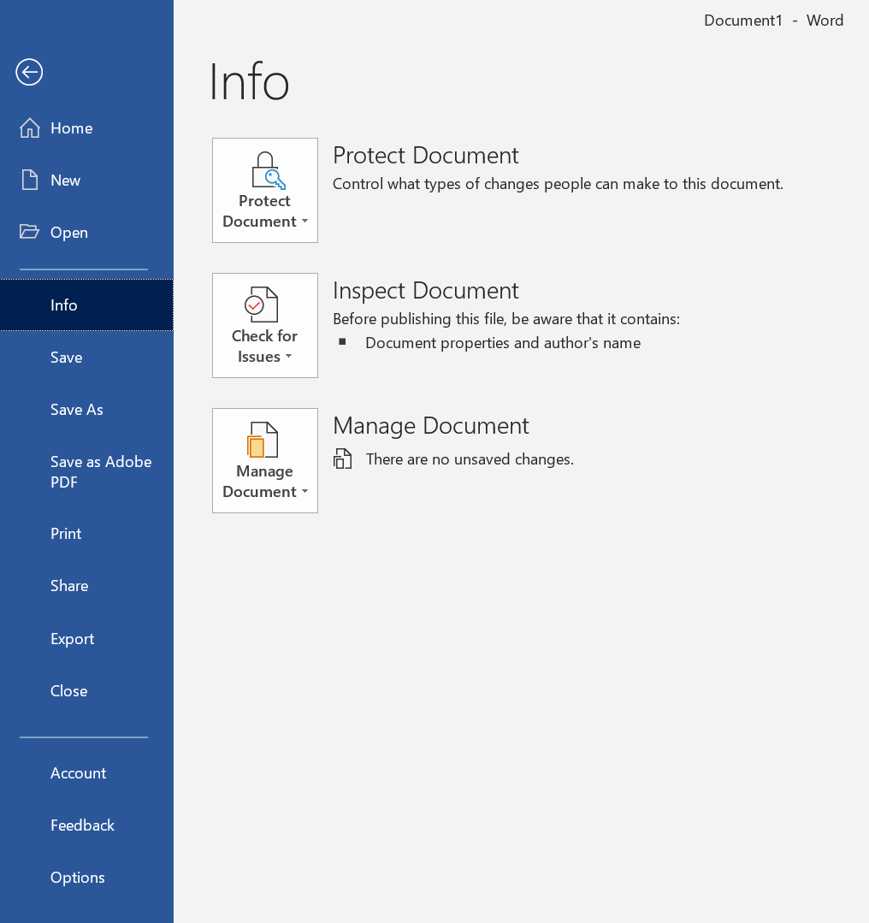
Editing
Word Settings

Slide 40
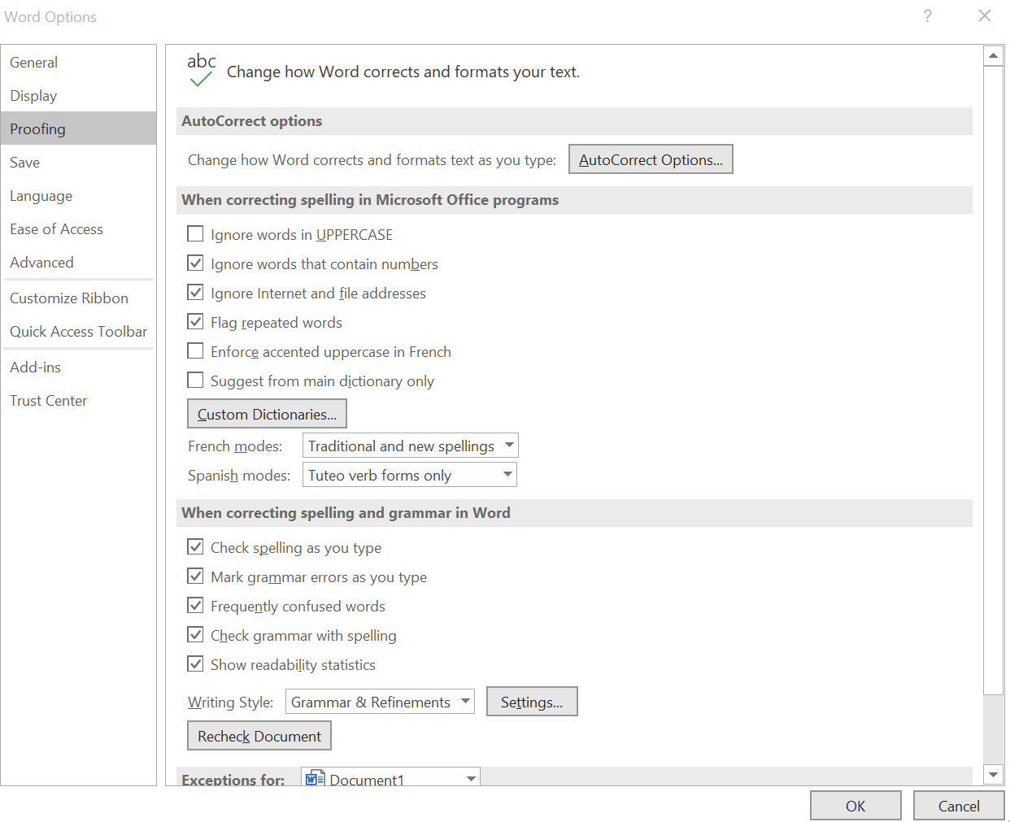
Editing
Word Settings

Slide 41
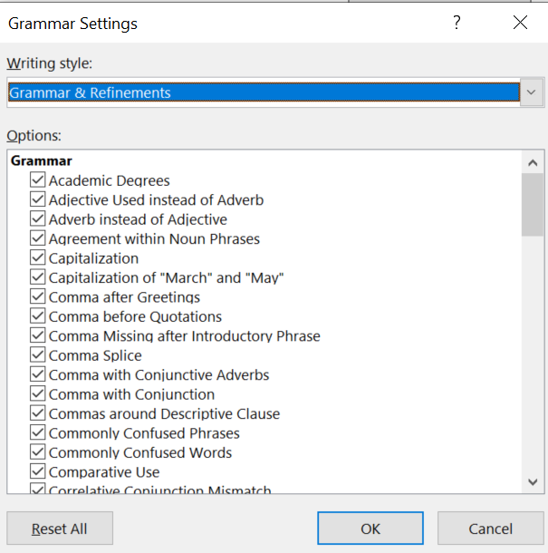
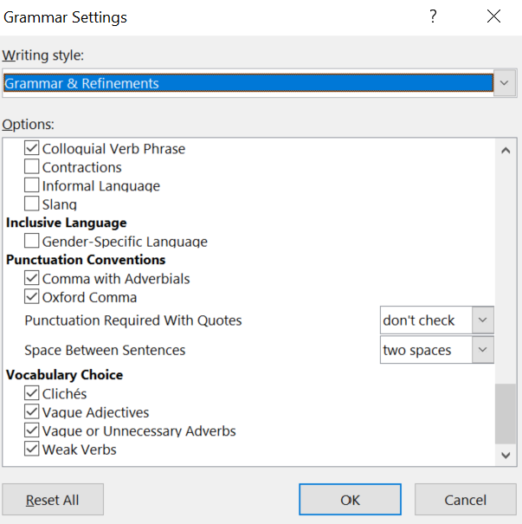
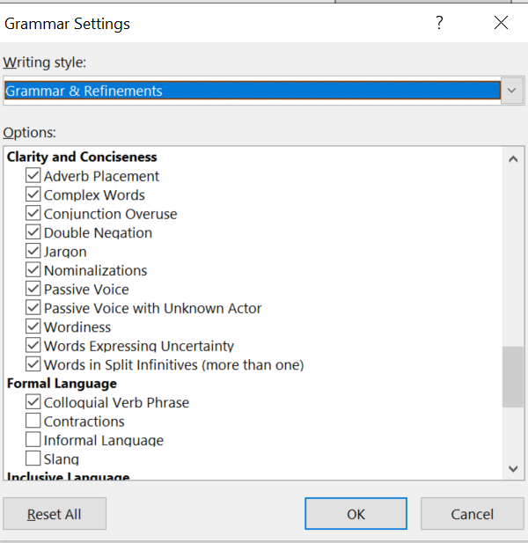
Editing
Word Settings

Slide 42
