Slide 1
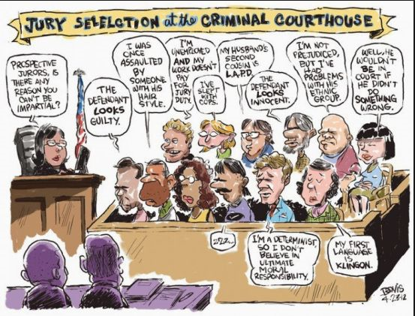

Slide 2
§ 223. Voir Dire In Criminal Jury Trial
(d) “. . . Examination of prospective jurors shall be conducted only in aid of the exercise of challenges for cause.”

Slide 3
§ 225. Challenges For Cause
(1) A challenge for cause, for one of the following reasons:
(A) General disqualification—that the juror is disqualified from serving in the action on trial.
(B) Implied bias—as, when the existence of the facts as ascertained, in judgment of law disqualifies the juror.
(C) Actual bias—the existence of a state of mind on the part of the juror in reference to the case, or to any of the parties, which will prevent the juror from acting with entire impartiality, and without prejudice to the substantial rights of any party.

Slide 4
§ 203. Persons Not Qualified To Be Jurors
(a) All persons are eligible and qualified to be prospective trial jurors, except the following:
  Minors / Felons / Out of County Residents / Conserved individuals
  “Persons who are not possessed of sufficient knowledge of the English language . . .”

Slide 5
NON-ENGLISH SPEAKERS
IF A JUROR DOES NOT POSSESS SUFFICIENT FLUENCY IN ENGLISH TO UNDERSTAND THE EVIDENCE AND ENGAGE IN DELIBERATIONS (BOTH HEARING OTHERS OPINIONS AND EXPRESSING THEIR OWN) . . . THEY SHOULD NOT BE ON THE JURY AND YOU SHOULD NOT HAVE TO BURN A PEREMPTORY.

Slide 6
§ 223. Voir Dire In Criminal Jury Trial cont.
(b)(1) “. . . the trial judge shall permit liberal and probing examination calculated to discover bias or prejudice with regard to the circumstances of the particular case or the parties before the court.”

Slide 7
§ 223. Voir Dire In Criminal Jury Trial cont.
(b)(2) The trial judge shall not impose specific unreasonable or arbitrary time limits or establish an inflexible time limit policy for voir dire. As voir dire proceeds, the trial judge shall permit supplemental time for questioning based on individual responses or conduct of jurors that may evince attitudes inconsistent with suitability to serve as a fair and impartial juror in the particular case.

Slide 8
§ 223. Voir Dire In Criminal Jury Trial Cont.
(b)(3) “. . . an ‘improper question’ is any question that, as its dominant purpose, attempts to precondition the prospective jurors to a particular result or indoctrinate the jury.”

Slide 9
What Are You Trying to Accomplish???
Familiarizing yourself with Juror beliefs relevant to issues present in your case
Pushing a favorable juror away from a defense challenge for cause.
Pushing an unfavorable juror towards a prosecution challenge for cause.
Prepare jurors for the weaknesses in your case.
Introducing yourself to the Jury (what perception of you do want to leave them with).

Slide 10
Familiarizing Yourself With Juror Beliefs Relevant To Issues Present In Your Case
Issues Present in Most Cases
Beyond a Reasonable Doubt
Ability to Prove Mental States Beyond a Reasonable Doubt
Direct vs. Circumstantial Evidence
Police Officer Witnesses
Commitment to Vote Guilty if Burden of Proof is Satisfied
Ability to Follow the Law
  Juror’s Oath

Slide 11
JUROR’S OATH
Do you and each of you understand and agree that you will well and truly try the cause now pending before this Court, and a true verdict render according only to the evidence presented to you and to the instructions of the Court. If you agree, please answer "I do."

