Slide 1
The Law of Arson in California

Slide 2
PC 451. Arson of structure, forest land or property or causing great bodily injury
A person is guilty of arson when he or she willfully and maliciously sets fire to or burns or causes to be burned or who aids, counsels, or procures the burning of, any structure, forest land, or property.
(a) Arson that causes great bodily injury is a felony punishable by imprisonment in the state prison for five, seven, or nine years.
(b) Arson that causes an inhabited structure or inhabited property to burn is a felony punishable by imprisonment in the state prison for three, five, or eight years.
(c) Arson of a structure or forest land is a felony punishable by imprisonment in the state prison for two, four, or six years.
(d) Arson of property is a felony punishable by imprisonment in the state prison for 16 months, two, or three years. For purposes of this paragraph, arson of property does not include one burning or causing to be burned his or her own personal property unless there is an intent to defraud or there is injury to another person or another person's structure, forest land, or property.

Slide 3
§ 452. Unlawfully causing a fire of any structure, forest land or property or causing great bodily injury
A person is guilty of unlawfully causing a fire when he recklessly sets fire to or burns or causes to be burned, any structure, forest land or property.
(a) Unlawfully causing a fire that causes great bodily injury is a felony punishable by imprisonment in the state prison for two, four or six years, or by imprisonment in the county jail for not more than one year, or by a fine, or by both such imprisonment and fine.
(b) Unlawfully causing a fire that causes an inhabited structure or inhabited property to burn is a felony punishable by imprisonment in the state prison for two, three or four years, or by imprisonment in the county jail for not more than one year, or by a fine, or by both such imprisonment and fine.
(c) Unlawfully causing a fire of a structure or forest land is a felony punishable by imprisonment in the state prison for 16 months, two or three years, or by imprisonment in the county jail for not more than six months, or by a fine, or by both such imprisonment and fine.
(d) Unlawfully causing a fire of property is a misdemeanor. For purposes of this paragraph, unlawfully causing a fire of property does not include one burning or causing to be burned his own personal property unless there is injury to another person or to another person's structure, forest land or property.

Slide 4
PC § 450. Definitions
“Structure” means any building, or commercial or public tent, bridge, tunnel, or powerplant.
(b) “Forest land” means any brush covered land, cut-over land, forest, grasslands, or woods.
(c) “Property” means real property or personal property, other than a structure or forest land.
(d) “Inhabited” means currently being used for dwelling purposes whether occupied or not. “Inhabited structure” and “inhabited property” do not include the real property on which an inhabited structure or an inhabited property is located.
(e) “Maliciously” imports a wish to vex, defraud, annoy, or injure another person, or an intent to do a wrongful act, established either by proof or presumption of law.
(f) “Recklessly” means a person is aware of and consciously disregards a substantial and unjustifiable risk that his or her act will set fire to, burn, or cause to burn a structure, forest land, or property. The risk shall be of such nature and degree that disregard thereof constitutes a gross deviation from the standard of conduct that a reasonable person would observe in the situation. A person who creates such a risk but is unaware thereof solely by reason of voluntary intoxication also acts recklessly with respect thereto.

Slide 5
ARSON
UNLAWFULLY CAUSING A FIRE
Straight Felony (§451(a)-(d)) serious felony strike
(a) 5/7/9
(b) Inhabited structure 3/5/8
(c) Structure/forest land 2/4/6
(d) Property 16/2/3
451(a), (b) = violent felony strike
Requires registration (§457.1)
Mental state: willfully and maliciously
Felony wobbler (§452(a)-(c)) (a) GBI 2/4/6
(b) Inhabited structure 2/3/4
(c) Structure / forest land 16/2/3
(d) Property = Misdemeanor
Non-strike
Does not require registration
Mental state: recklessly

Slide 6
Enhancements to PC § 451 and § 452
Arson sentence enhancements PC § 451.1 (3/4/5)
Previous conviction 451/452 felony
Firefighter, peace officer, emergency personnel suffer GBI
Proximately caused GBI to more than one victim
Proximately caused multiple structures to burn
Use of device designed to accelerate fire or delay ignition
Aggravated arson PC § 451.5 (10-life)
Willfull, deliberate, premediated , with intent to cause injury to 1 or more person, or damage 1 or more inhabited dwellings (10-life) if prior arson conviction within 10 years, or property damage / loss exceeds $8.3 million, or damaged 5 or more inhabited structures.
Aggravating factors PC § 452.1 (1/2/3)
Violation of Arson Statutes during Insurrection or Emergency PC § 454
§ 451(a), (b) or (c) (5/7/9)
§ 451(d) or § 452 (3/5/7)

Slide 7
Other Related Crimes
Possession of Flammable / Explosive / Combustible Material with intent to set fire/burn § 453
Attempt to set fire/burn structure, forestland/property § 455 (16/2/3)
Order for Psych Examination upon Conviction § 457
Registration § 457.1
Defrauding or Prejudicing Insurer § 548
Destructive Devices and Explosives § 18710 et seq.

Slide 8
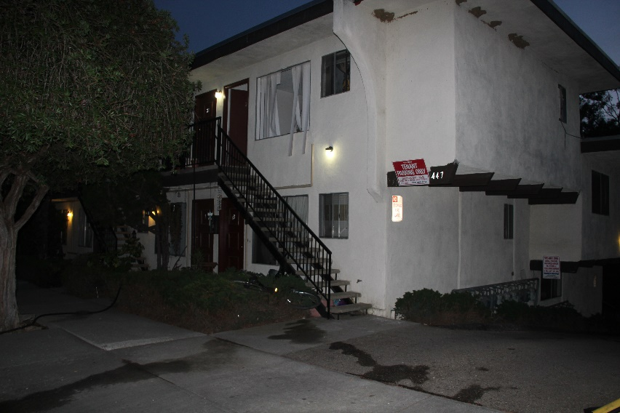
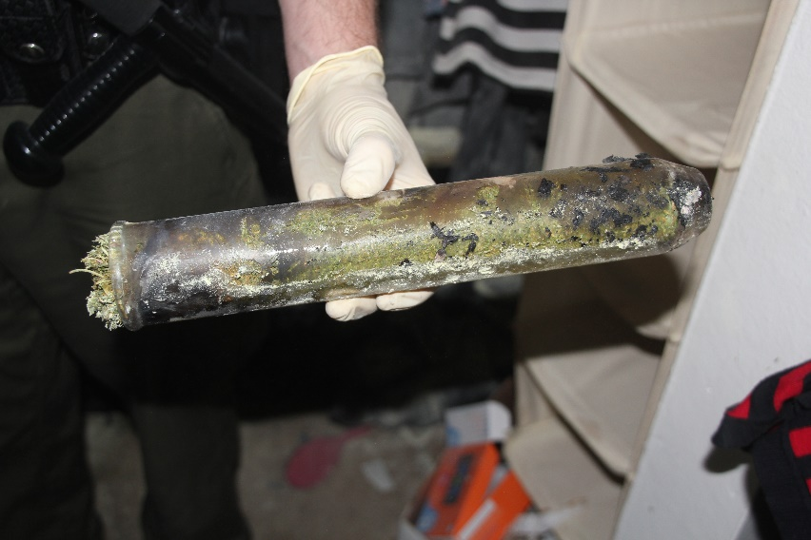
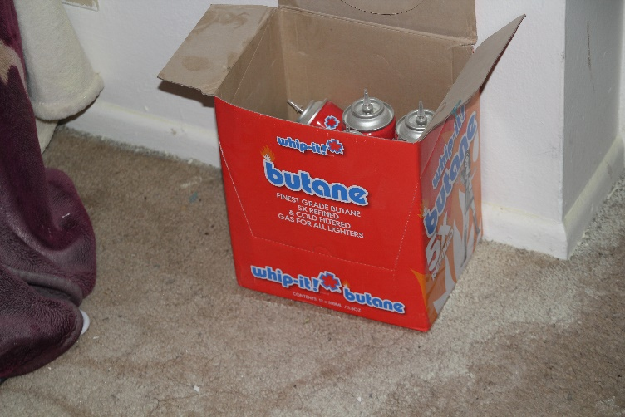
Other Related Crimes
HS § 11379.6
Manufacturing controlled substance by chemical extraction or chemical synthesis
BHO Lab Explosion
Consider § 451, § 273a

Slide 9
Other Related Crimes
Except as otherwise provided in this chapter, no person shall use open outdoor fires for the purpose of disposal or burning of petroleum wastes, demolition debris, tires, tar, trees, wood waste, or other combustible or flammable solid or liquid waste; or for metal salvage or burning of motor vehicle bodies.
Typically charged for Isla Vista couch fires
Does not require malice or recklessness
Punishment: misdemeanor, up to 6 months jail, up to $15,000 fine (HSC §42400)
Unlawful Outdoor Fires HS § 41800

Slide 10
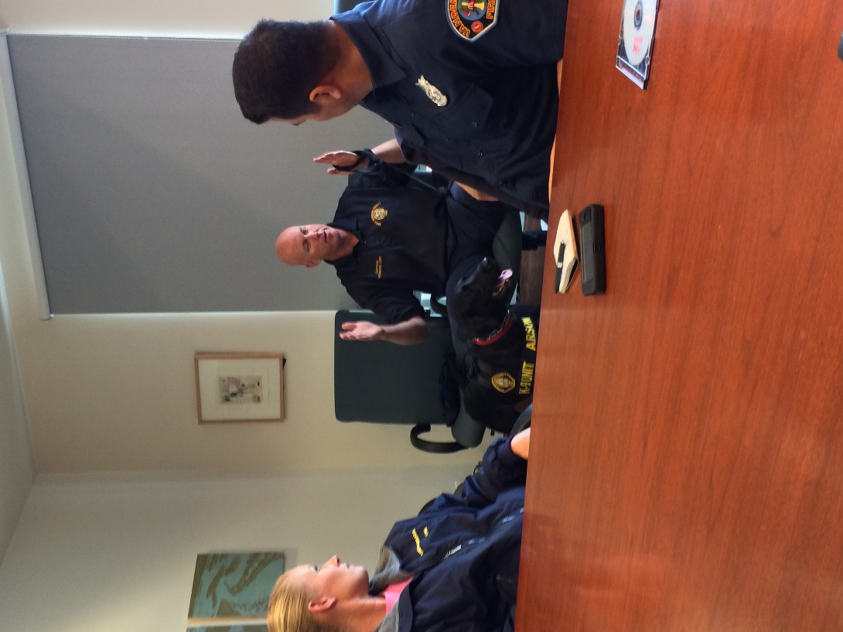
Arson Investigations
Go to the scene
Have fire investigator (your expert) walk you through it and explain his / her conclusions
Know local arson investigators
Law enforcement, fire departments, crime lab, pathologist, DA Investigators
Get training in fire investigations through CDAA, Fire Agencies, DOJ, Go to fires
Arson Task Force

Slide 11
Special Evidentiary Problems
Criminal origin of burning – proof that fire was could not be spontaneous or accidental
Charring = completed arson; blackening or sooting = attempt
People. v. Haggerty (1873) 46 Cal. 354, 355: “…the burning of any part, however small, completes the offense, the same as of the whole. Thus, if the floor of the house is charred in a single place, so as to destroy any of the fibers of the wood, this is a sufficient burning in a case of arson.”
Anticipate 1368 proceedings

Slide 12
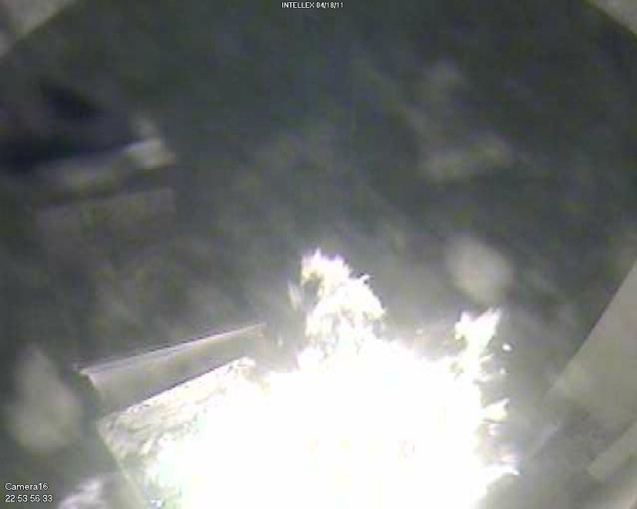
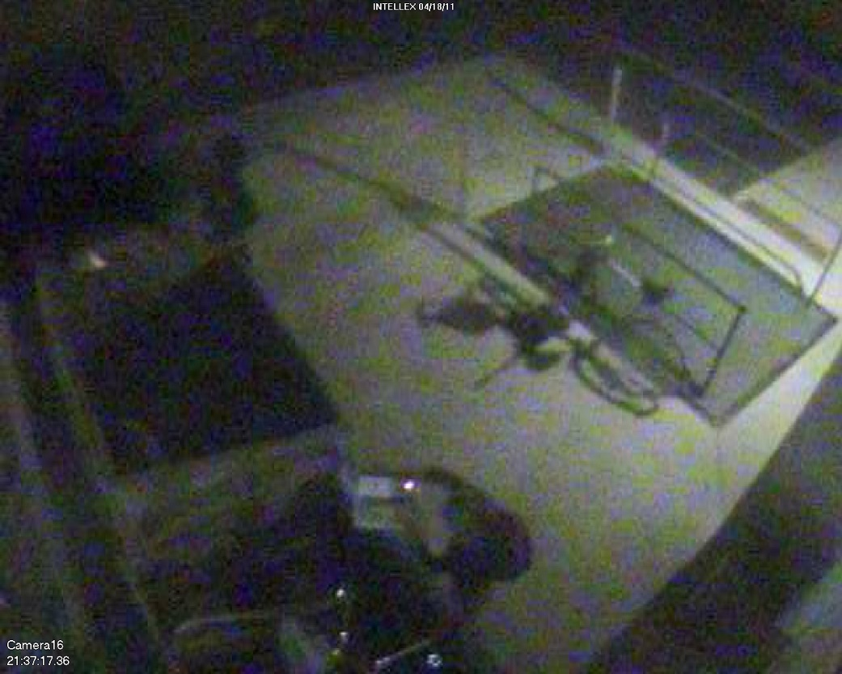
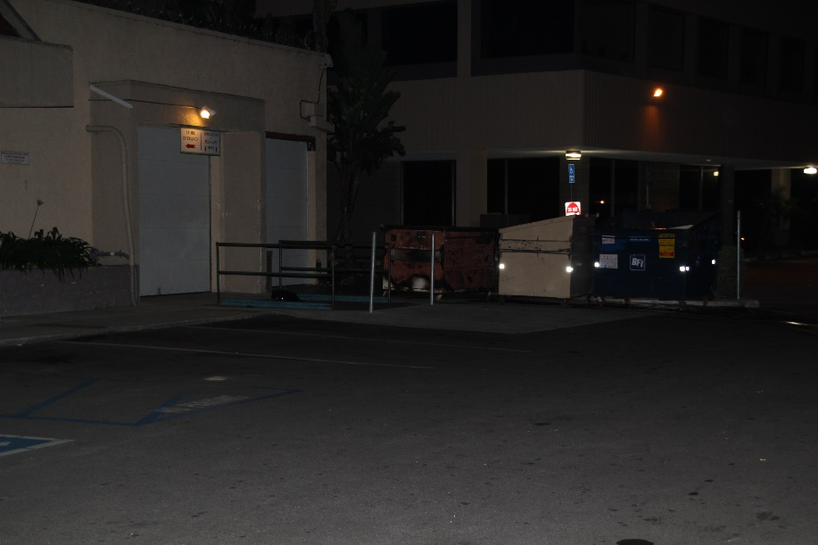
People v. Roger Powell PC 451(d)

Slide 13
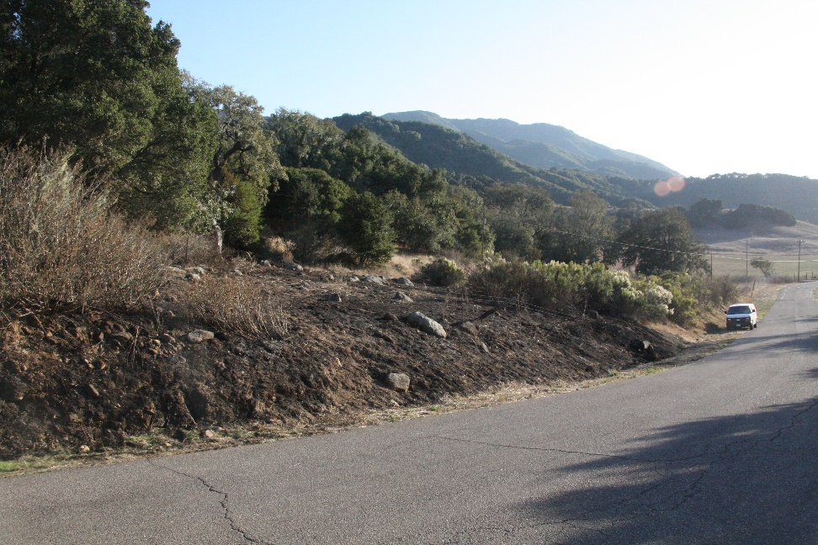
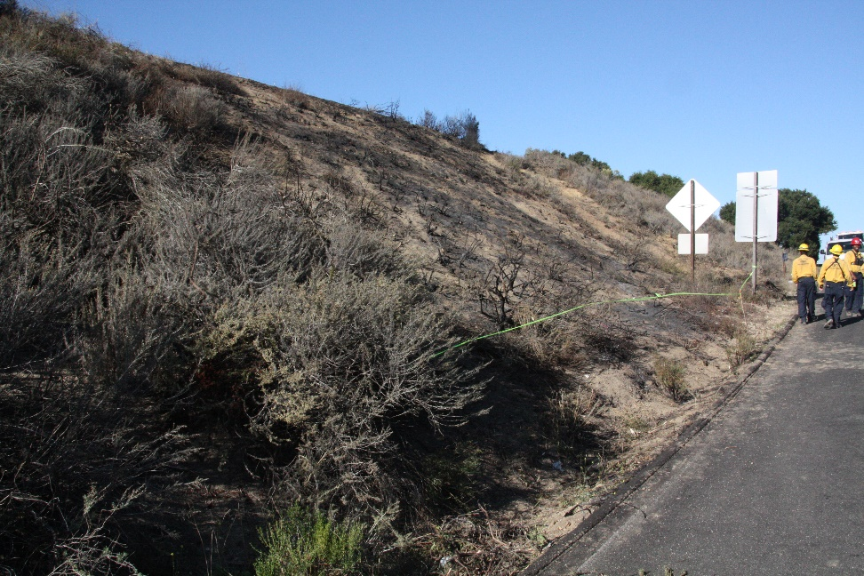
People v. Warren Berry Count 1 PC 451(c) Alisal Rd Count 2 PC 451(c) Nojoqui Summit

Slide 14
Applicable Case Law Arson = General Intent Crime
People v. Atkins (2001) 25 Cal.4th 76, 86
D told others he hated V and was going to burn down V’s house
D claimed he lit weeds on fire near V’s residence (since the area was in poor condition) using gasoline but did not intend the ensuing brush fire which burned for 3 days. The fire came within feet of V’s house.
Fire marshal testified the fire had not been started in a cleared area and no evidence that is was accident during debris burn.
D convicted of PC 451(c)
The statute does not require an additional specific intent to burn a “structure, forest land, or property,” but rather requires only an intent to do the act that causes the harm.
D’s claimed voluntary intoxication was not a defense to arson

Slide 15
Applicable Case Law Defining Malice
In re V.V. (2011) 51 Cal.4th 1020
Minors set off firecrackers on brush covered hillside in Pasadena adjacent to a housing development
DA alleged both 451(c) and 452(c)
Juvenile court found 451(c) true. Appellate courts split.
Evidence sufficient to establish mental state of malice because V.V. intentionally and deliberately set off a firecracker on a brush covered hill
The second type of Malice (intent to do a wrongful act) may be presumed or implied from the deliberate and intentional ignition or act of setting a fire without legal justification, excuse or claim of right
Minor may be guilty of arson if he acts with awareness of facts which would lead a reasonable person to realize that the direct, natural and highly probably consequences of igniting and throwing a firecracker into dry brush would be burning the hillside

Slide 16
Search and Seizure
Exigent circumstances
…exigent circumstances means an emergency situation requiring swift action to prevent imminent danger to life or serious damage to property, or to forestall the imminent escape of a suspect or destruction of evidence. (People v. Ramey (1976) 16 Cal.3d 263,276.)
A burning building creates exigency to justify a warrantless entry by fire officials to fight the blaze. (Michigan v. Clifford (1984) 464 US 287, 293)
Once in a building for this purpose, firefighters may seize evidence of arson that is in plain view (Michigan v. Tyler (1978) 436 U.S. 499, 509.)
Once in the building, officials need no warrant to remain for a “reasonable time to investigate the cause of the blaze after it has extinguished” (Michigan v. Tyler (1978) 436 US 499, 510.)
Therefore, an immediate investigation into the cause and origin of a fire is proper for a reasonable time after the fire is extinguished. Prompt determination of the fire’s origin may be necessary to prevent reoccurrence or preserve evidence.

Slide 17
Search and Seizure
Subsequent entries after fire
Absent consent or exigent circumstances, a warrant is required to re-enter and investigate cause of fire unless there is no reasonable expectation of privacy
An entry to fight a fire requires no warrant, …once in the building, officials may remain there for a reasonable time to investigate the cause of the blaze. Thereafter, additional entries to investigate the cause of the fire must be made pursuant to the warrant procedures governing administrative searches.” (Michigan v. Tyler (1978) 436 U.S. 499, 511. )

Slide 18
Search and Seizure
Warrants
Administrative warrant – required to determine cause and origin of fire
primary object is to determine the cause and origin of a recent fire
fire officials need show only that a fire of undetermined origin has occurred on the premises, that the scope of the proposed search is reasonable and will not intrude unnecessarily on the fire victim's privacy, and that the search will be executed at a reasonable and convenient time. (Michigan v. Clifford, 464 U.S. 287, 294.)
Administrative warrant search may not be expanded if evidence of arson found
Criminal warrant – (upon showing of probable cause) required for collection of criminal activity
Greater showing than fact that fire is of undermined origin
Given totality of circumstances …that there is a fair probability that contraband or evidence of a crime will be found in a particular place. (Illinois v. Gates (1983) 462 US 213, 238-239.)

