Slide 1

Presenting Forensic Evidence
Edward A. Andrews
Deputy District Attorney

Slide 2
FORENSIC EVIDENCE IN A DUI CASE:
Evidence from Percipient Witnesses
Expert Testimony
Arguing Forensic Evidence

Slide 3
FORENSIC EVIDENCE IN A DUI CASE:
Evidence from Percipient Witnesses
Expert Testimony
Arguing Forensic Evidence

Slide 4

THE EXPERT
Why have an expert?
What can an expert do?
How can I use an expert in my trial?

Slide 5
THE EXPERT
Qualifying Expert to Testify (EC§ 720.)
Basis for the Opinion
Eliciting the Opinion
Explaining the Opinion (If Needed)

Slide 6
THE EXPERT
Qualifying Expert to Testify (EC§ 720.)
Basis for the Opinion
Eliciting the Opinion
Explaining the Opinion

Slide 7
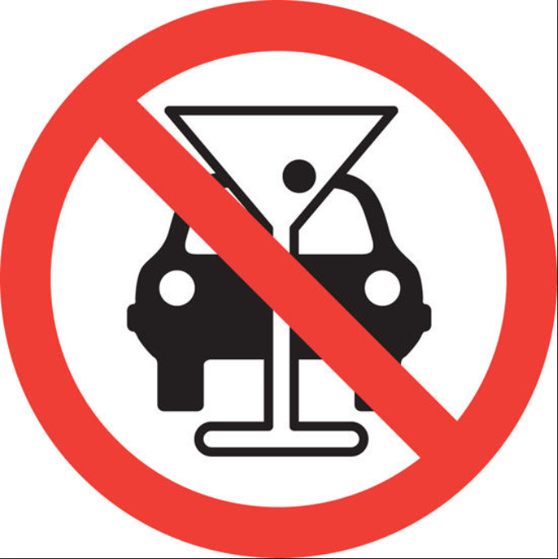
A UNIVERSE OF EXPERTS

Slide 8
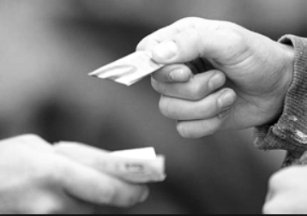


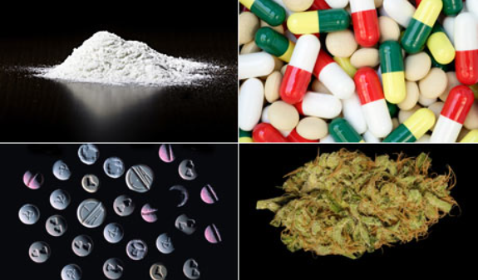
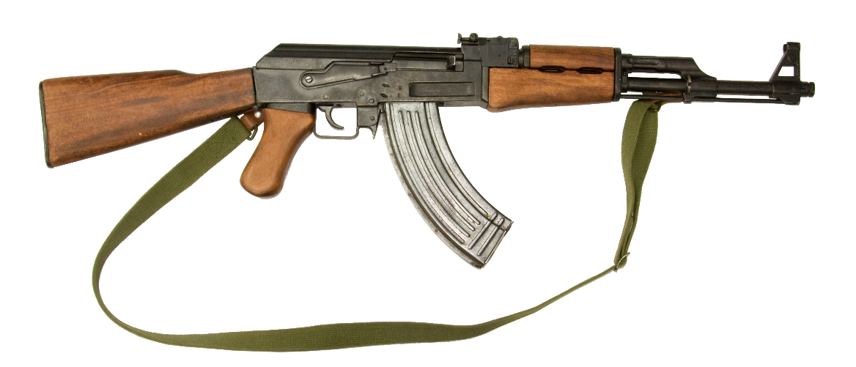

A UNIVERSE OF EXPERTS

Slide 9
The Expert Witness
Establishing Expertise: Scientific Background
Current occupation & employer?
Qualifications: Education; Certifications; Associations; Papers; Research; Awards;
What do you do;
How long have you done that;
Prior testimony;
Testimony for defense (no bias);
Additional compensation? (No bias)

Slide 10
THE EXPERT
Qualifying Expert to Testify (EC§ 720.)
Basis for the Opinion
Eliciting the Opinion
Explaining the Opinion

Slide 11
Resources
CDAA DUI Prosecution Manual;
  Chapter XIII: Examination of the Blood-Alcohol Expert;
SFST/ARIDE Training;
Fellow prosecutors.

Slide 12
Percipient Witnesses
Observations of Defendant
Any witness’ observations (EC § 702, 800):
  Civilians;
  Victims;
  Officers;
  Medical personnel & EMTs
Prepare for speculation objections
  (But see, e.g., People v. Ruiz (1968) 265 Cal.App.2d 766, 773 [“a non-expert witness may give his opinion as to the intoxication or sobriety of a defendant.”].)

Slide 13
Percipient Witnesses
Tests of Defendant
Officer or medical personnel
  Blood Tests
  Breath Tests
  DIR
Remember to prepare examination of percipient witnesses to include all facts for expert’s opinion(s)

Slide 14
THE EXPERT
Qualifying Expert to Testify (EC§ 720.)
Basis for the Opinion
Eliciting the Opinion
Explaining the Opinion

Slide 15
THE EXPERT
Qualifying Expert to Testify (EC§ 720.)
Basis for the Opinions
Eliciting the Opinion
Explaining the Opinion

Slide 16
OPINION
Percipient witnesses’ testimony
Basis for the Opinion
Hypothetical
Elicit the Opinion
Justifications and critical facts
Explanation of the Opinion
Move towards next opinion

Slide 17
COMMON OUTLINE FOR DUI EXPERT
TOPIC | QUAL/QUANT? | Δ/GEN’L
I. Effects of Alcohol | Qualitative | General
II. FSTs | Both | Defendant
III. Science of Alcohol | Quantitative | General
IV. BAC Sample | Quantitative | Defendant
V. Retrograde Extrapolation | Quantitative | Defendant
VI. Ultimate DUI Opinion | Both | Defendant
Use the order that matters in your case;
Opinions every step of the way . . .

Slide 18
The Expert Witness
Effects of Alcohol: Mental v. Physical Impairment
Effects of alcohol, mental and physical;
Establish mental impairment occurs before physical impairment;
First opinions;
Not “drunk” before impaired;

Slide 19
The Expert Witness
FSTs
Unbiased scientist explaining legitimacy of FSTs to jury;
  Standardized and validated;
  NHTSA;
  Cues/clues;
Initial opinions on cues;
Always emphasize totality of circumstances.

Slide 20
The Expert Witness
FSTs
Walk & Turn and One Leg Stand
  Cues/clues;
  Demonstration – typically bad idea
Anticipate cross:
  Expert has never tested defendant;
  Expert was not there;
  Expert cannot opine based only on this test that defendant was DUI

Slide 21
The Expert Witness
FSTs
HGN
  Cues/clues;
Anticipate cross:
  Expert has never tested defendant;
    Rare reasons someone would have HGN without being UI-Alcohol
HGN can be very effective evidence;
  Explain lack of control over HGN

Slide 22
The Expert Witness
FSTs
Romberg and Finger-to-Nose
  Standardized but not validated FSTs:
Questions:
  How helpful;
  How used in DUI investigation;
Anticipate cross and argument:
  Do not include in ultimate hypothetical;
  Argue to jury Def. UI-Alcohol even discounting these tests.

Slide 23
The Expert Witness
Science of Alcohol: Elimination Rate
How the body absorbs alcohol;
Typical length of absorptive phase;
Elimination conceptually;
Elimination rate
  E.g., 0.018% avg.; Conservatively, 0.015%
  Explanation of conservative rate;
Widmark curve

Slide 24
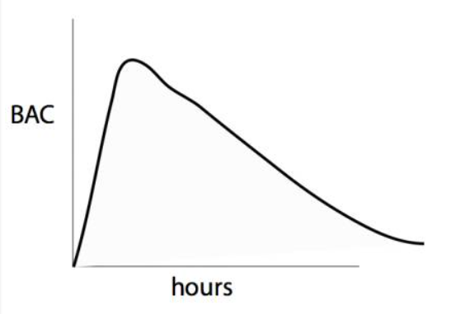
The Expert Witness
Science of Alcohol: Widmark Curve
Conceptual likely better, as defendant/circumstances differ

Slide 25
The Expert Witness
0.08 percent = Impairment
Opinion as to whether correlation between amount of alcohol in person’s system and degree of impairment for purposes of driving?
Everyone is impaired at 0.08 BAC or higher.
  Most drivers impaired between 0.05 and 0.08 percent.

Slide 26
The Expert Witness
Testing: Reliability of Sample
Breath
  Crime lab often maintains PAS and EPAS, usually same device. If CHP or old, another agency may maintain PAS and/or EPAS;
  Approved device;
  Instrument maintained, checked for accuracy, calibrated if needed;
  Instrument safeguards;
  Instrument properly functioning;
  Expect breath tests to be valid and accurate.

Slide 27
The Expert Witness
Testing: Reliability of Sample
Blood
  Rely on percipient witnesses.
  Blood draw reliability (People v. Cuevas (2013) 218 Cal.App.4th 1278, 1285-1286)

Slide 28
The Expert Witness
Testing: Reliability of Sample
Defenses
  Chain of custody important but quick;
  Consider thoughtfully which defenses to anticipate (e.g., do I need to spend the jurors’ time on mouth alcohol?);
  Jurors already working to follow reliability safeguards outside everyday experience;
  Often more effective to establish safeguards and address specific challenges to reliability in redirect.

Slide 29
The Expert Witness
Testing: Forensic Alcohol Analysis
If breath, basically occurs at the scene;
If blood, explain method of analysis and safeguards

Slide 30
The Expert Witness
The Idea of a Standard Drink
What a standard drink is;
  Jurors often think a “drink” is more than a standard drink;
Number of standard drinks acting on system at given BAC;
If factor in burn-off, standard drinks would be higher.

Slide 31
The Expert Witness
Retrograde Extrapolation – Applying Science the Jury Has Learned
Explain Retrograde Extrapolation;
  If anticipating forward-grade extrapolation based defense, perhaps include, or provide in rebuttal;
Hypothetical;
BAC at drive time.

Slide 32
THE EXPERT
Qualifying Expert to Testify (EC§ 720.)
Basis for the Opinion
Eliciting the Opinion
Explaining the Opinion

Slide 33
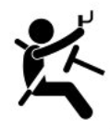
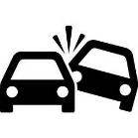
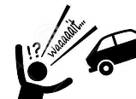

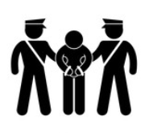
The Way It Happened
In a linear order. E.g., driving pattern, 911 call, lay witness observations, contact, observations, DUI evaluation, symptomology, FSTs, chemical test.

Slide 34
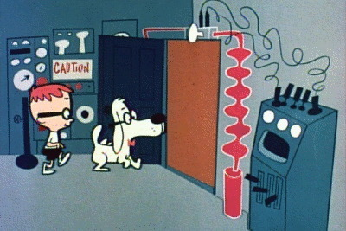

WABAC Machine?
No. Worth emphasizing in voir dire. How will facts be shown?

Slide 35


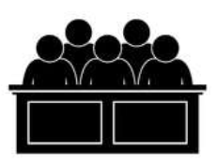

PERCIPIENT WITNESSES &
CUSTODIANS OF RECS.
Coming in based on witness availability.
Will provide foundation for exhibits that will be used for multiple reasons, some of which will seem out-of-order or irrelevant.
Some statements may be coming in through other witnesses via hearsay.

Slide 36
PERCIPIENT WITNESSES
This is one reason a clean, easy-to-follow closing argument is critical.
It is also an opportunity to give a logical presentation of critical facts in a linear order through a witness who is usually required, but also useful . . .

Slide 37
THE EXPERT

Slide 38
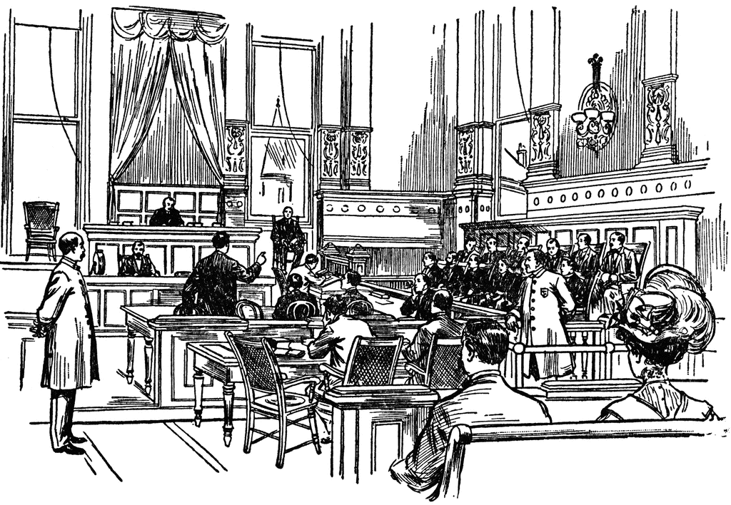
THE EXPERT
Opportunity:
A Focused Retelling of Percipient Witnesses’ Testimony,
with a Conclusion

Slide 39
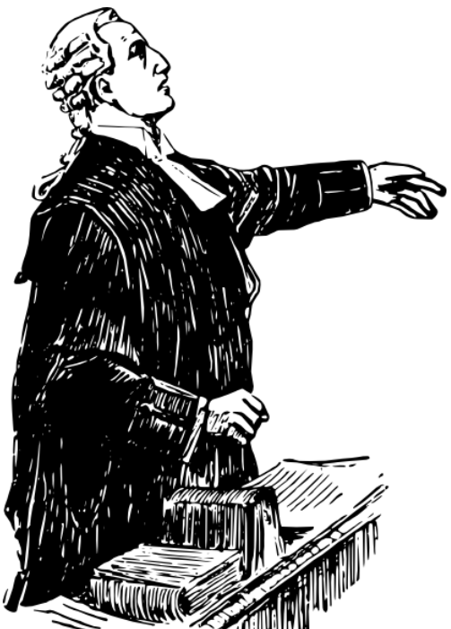
CLOSING ARGUMENT

Slide 40

THE EXPERT

Slide 41
Objective Signs of Impairment
ULTIMATE DUI OPINION
Admissions
FSTs
Testing Results
Retrograde Extrapolation

Slide 42
The Expert Witness
Ultimate DUI Opinion
Provide all information in hypothetical;
  Opportunity to list all evidence that supports ultimate conclusion;
  Even information on which expert may not rely, emphasizing expert opinion is conservative and correct;
Opinion for each count – (a) and (b);
  Expert opinion can go to “ultimate issue” for trier of fact (EC § 805).

Slide 43
THE EXPERT
Qualifying Expert to Testify (EC§ 720.)
Basis for the Opinion
Eliciting the Opinion
Explaining the Opinion
. . . If needed. Often better to frontload explanations, so that ultimate opinion is last set of questions.

Slide 44
A UNIVERSE OF EXPERTS

Slide 45
THE H&S 11550 (UI) EXPERTS
DRE:
More field tests and field information go into opinion;
Supports that Def. UI of something;
Supports that Def. UI of substance within specific category (e.g., CNS Stimulant, not Cannabis)

Slide 46
THE H&S 11550 (UI) EXPERTS
Crime Lab Analyst:
Toxicology;
Chain of custody;
Recent use, depending on substance, depending on case.

Slide 47
THE H&S 11350, 11377 (POSS.) EXPERT
Crime Lab Analyst:
Analysis of drugs;
  typically “dry drugs”;
Chain of custody.

Slide 48
THE H&S 11350, 11377 (POSS.) EXPERT(S)
DRE:
Perhaps, for usable amount;
On usable amount: People v. Rubacalba (1993) 6 Cal.4th 62
(Id. at p. 66 [“usable-quantity rule prohibits conviction only when the substance possessed simply cannot be used, such as when it is a blackened residue or a useless trace. It does not extend to a substance containing contraband, even if not pure, if the substance is in a form and quantity that can be used. No particular purity or narcotic effect need be proven.”].)

Slide 49
The Expert Witness
Example Common Legal Issues
Always be prepared with business records exception & public records exception (EC § 1271, 1280);
Anticipate Confrontation Clause issues;
Prepare for issues under People v. Lopez (2012) 55 Cal.4th 569.

Slide 50
CROSSING THE EXPERT
Preparing for cross-examination of People’s expert;
Cross-examination of defense expert.

Slide 51
Expert Cross-Examination:
Protecting Your Expert
Anticipate typical areas of cross and prepare:
Expert has no knowledge of defendant/item;
Adding or subtracting facts to test out defenses;
Claiming bias;
Demeaning credentials or training;
Eliciting improper opinions;
Example: partition ratio in breath cases.

Slide 52

Expert Cross-Examination:
Legally Improper Opinions
Reliability of breath testing machines generally;
  People v. Vangelder (2013) 58 Cal.4th 1, 34;
Misusing Title 17 requirements.
  E.g., Title 17 requirement that third sample be taken if evidentiary breath samples are not within 0.02% BAC of each other, to argue unreliable within 0.02% BAC;
Claiming Title 17 controls admissibility (weight v. admis.)

Slide 53
Expert Cross-Examination:
Opinions Not Scientifically Accepted
Forward-grade extrapolation
  As opposed to retrograde extrapolation.
  Retrograde extrapolation relies on standard average elimination rate;
  Forward-grade extrapolation relies on absorption rate;
  Absorption rate varies dramatically by individual and circumstances.

Slide 54
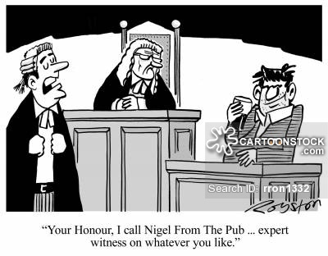
Expert Cross-Examination:
Crossing the Defense Expert

Slide 55
Defense Expert Cross-Examination:
Preparation
Is defense calling an expert?
Get opinion;
Get CV;
Share with your expert, obtain their view;
Review prior transcripts;
Reach out to others in Office;
Reach out to others outside of Office – CDAA chatboards about experts, e.g., other resources.

Slide 56
Defense Expert Cross-Examination:
Common Background Issues
Bias
  Unlike forensic analysts, who are compensated irrespective of testimony or result, D expert is paid fee;
Lack of experience
  Expert often has background – even high-level background – in forensic science, but outdated
    No longer testing samples, e.g.
    CV very helpful for this area.
Lack of knowledge of subject
  Expert typically never meets defendant;
  Phone consultation or merely examination of reports and discovery

Slide 57
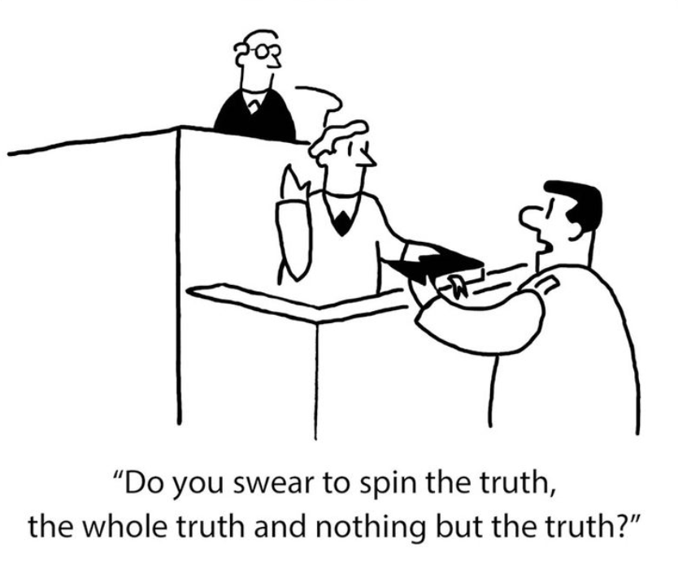
Expert Cross-Examination:
The Opinion

Slide 58
Expert Cross-Examination:
The Opinion
The defense opinion usually relies on unsupported scientific theory or an alternative version of the facts to put D below a 0.08% BAC or invalidate the chemical test
Examples:
  Rising defense
  Mouth alcohol
  Testing device
  Lab results
  BAC too high

Slide 59
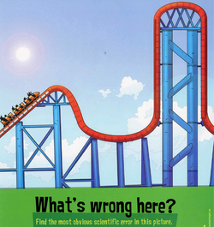
Expert Cross-Examination:
Challenging the Opinion
Different Strategies:
  Get-in & get-out?
  or
  Challenge on science?

Slide 60
Expert Cross-Examination:
Challenging the Opinion
An example approach:
Establish bias;
  Fee;
  Marketing;
Establish lack of current experience;
  No longer tests samples, maintains devices, etc.;
Establish lack of contact with defendant;
Find areas of agreement;
  Possible signs of impairment;
  Things established by prior employment;
  Everything possible;
Pin-down opinion – especially unreliable aspects – for rebuttal from your expert.
Start strong, end strong. (As with all cross.)

Slide 61
QUESTIONS?

